Slide 1

Chapter 14
Generics
Slides prepared by Rose Williams, Binghamton University
Kenrick Mock, University of Alaska Anchorage
Copyright © 2016 Pearson Inc. All rights reserved.

Slide 2
Introduction to Generics
Beginning with version 5.0, Java allows class and method definitions that include parameters for types
Such definitions are called generics
  Generic programming with a type parameter enables code to be written that applies to any class

Slide 3
Introduction to Generics
Code that uses generics has many benefits over non-generic code:
Stronger type checks at compile time.
A Java compiler applies strong type checking to generic code and issues errors if the code violates type safety. Fixing compile-time errors is easier than fixing runtime errors, which can be difficult to find.

Slide 4
Introduction to Generics
Elimination of casts
The following code snippet without generics requires casting:
List list = new ArrayList();
list.add("hello");
String s = (String) list.get(0);
When re-written to use generics,
the code does not require casting:
List<String> list = new ArrayList<String>();
list.add("hello");
String s = list.get(0); // no cast

Slide 5
Introduction to Generics
Enabling programmers to implement generic algorithms.
By using generics, programmers
can implement generic algorithms that work on collections of different types,
can be customized,
and are type safe and
easier to read.

Slide 6
Generics
Classes and methods can have a type parameter
  A type parameter can have any reference type (i.e., any class type) plugged in for the type parameter
  When a specific type is plugged in, this produces a specific class type or method
  Traditionally, a single uppercase letter is used for a type parameter, but any non-keyword identifier may be used
  public class Sample<T>

Slide 7
Generics
A class definition with a type parameter is stored in a file and compiled just like any other class
Once a parameterized class is compiled, it can be used like any other class
  However, the class type plugged in for the type parameter must be specified before it can be used in a program
  Doing this is said to instantiate the generic class
    Sample<String> object =
    new Sample<String>();

Slide 8
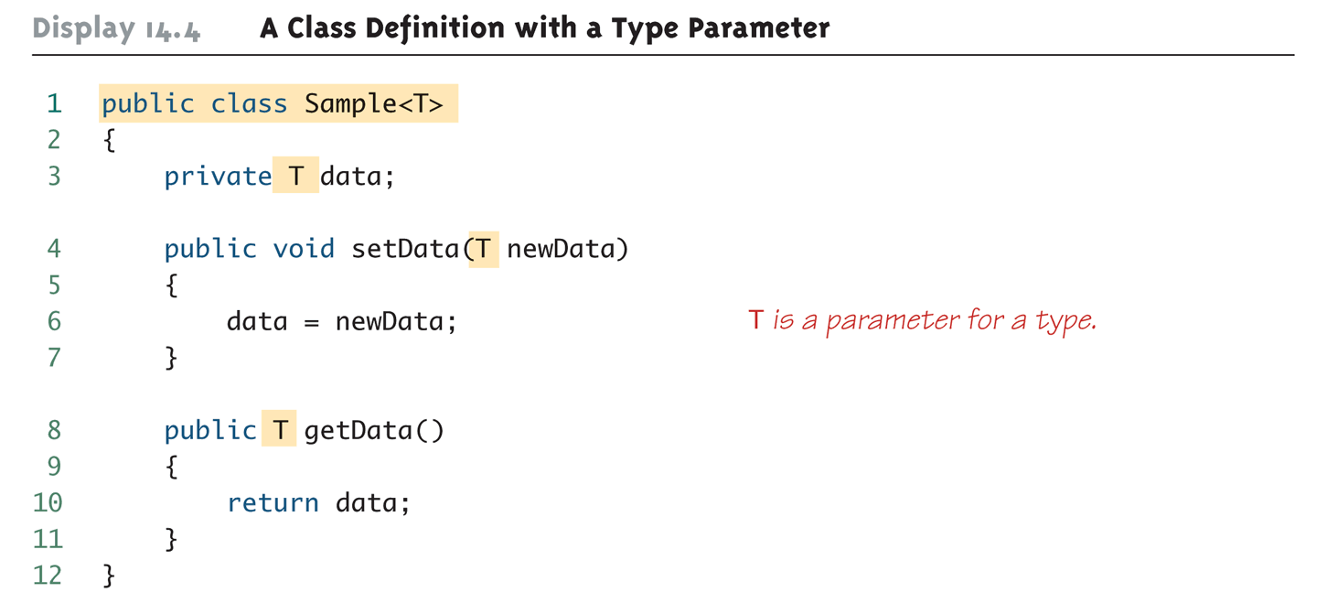
A Class Definition with a Type Parameter

Slide 9
Class Definition with a Type Parameter
A class that is defined with a parameter for a type is called a generic class or a parameterized class
  The type parameter is included in angular brackets after the class name in the class definition heading
  Any non-keyword identifier can be used for the type parameter, but by convention, the parameter starts with an uppercase letter
  The type parameter can be used like other types used in the definition of a class

Slide 10
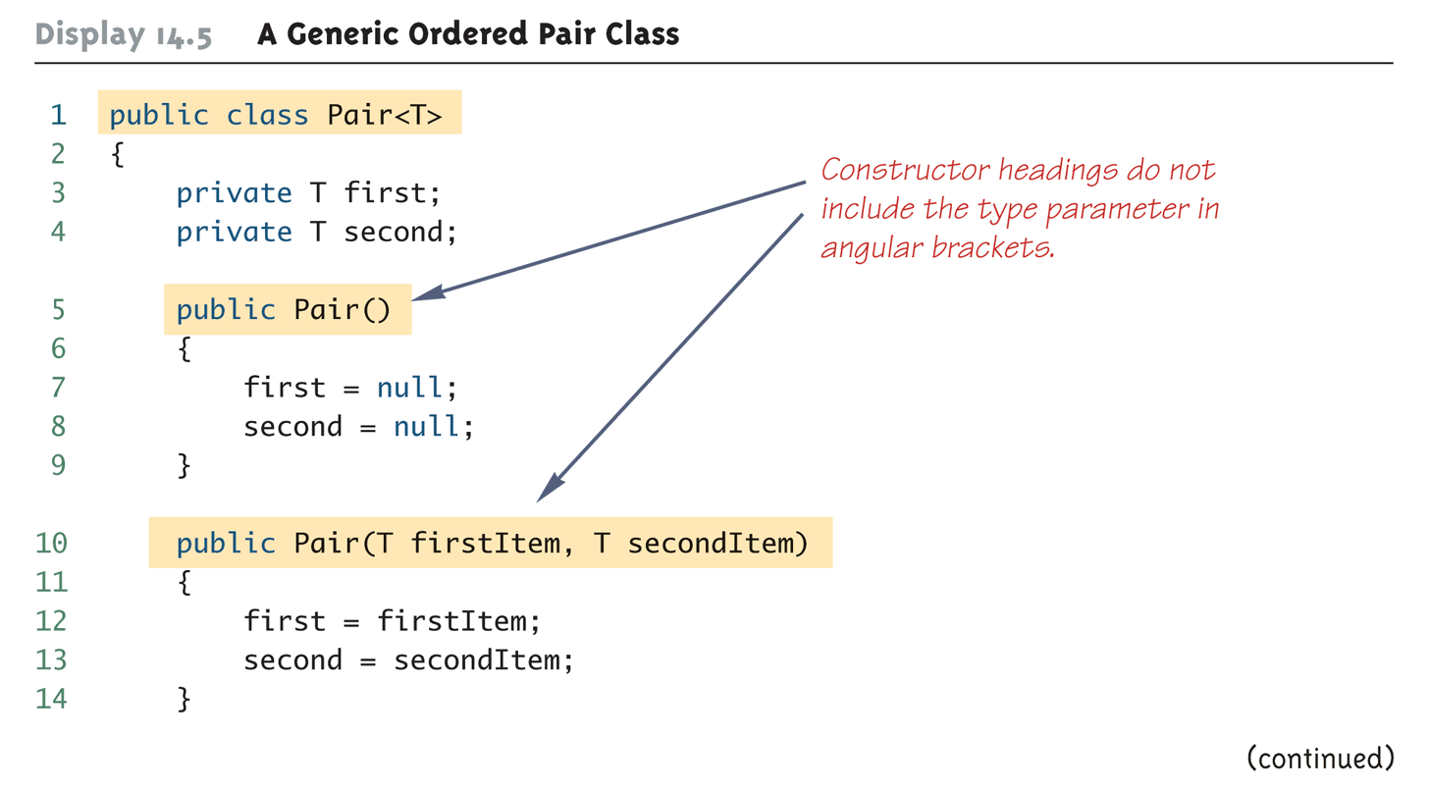
A Generic Ordered Pair Class (Part 1 of 4)

Slide 11
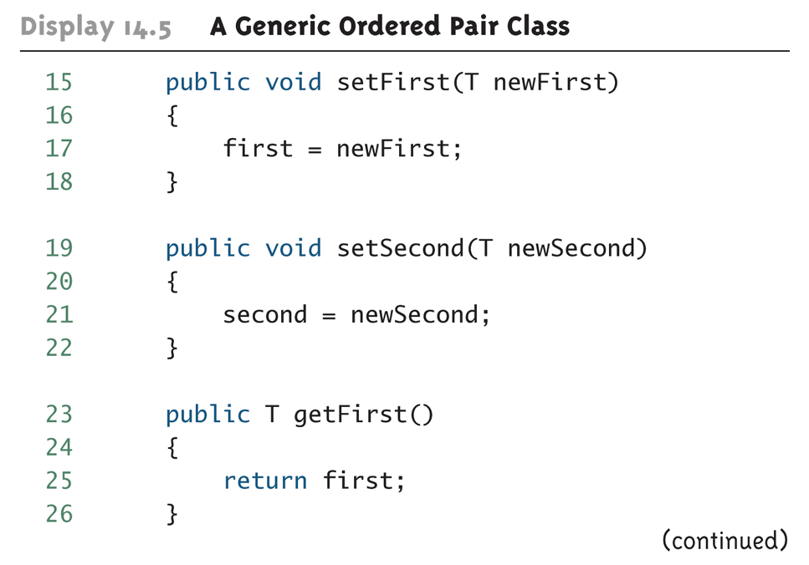
A Generic Ordered Pair Class (Part 2 of 4)

Slide 12
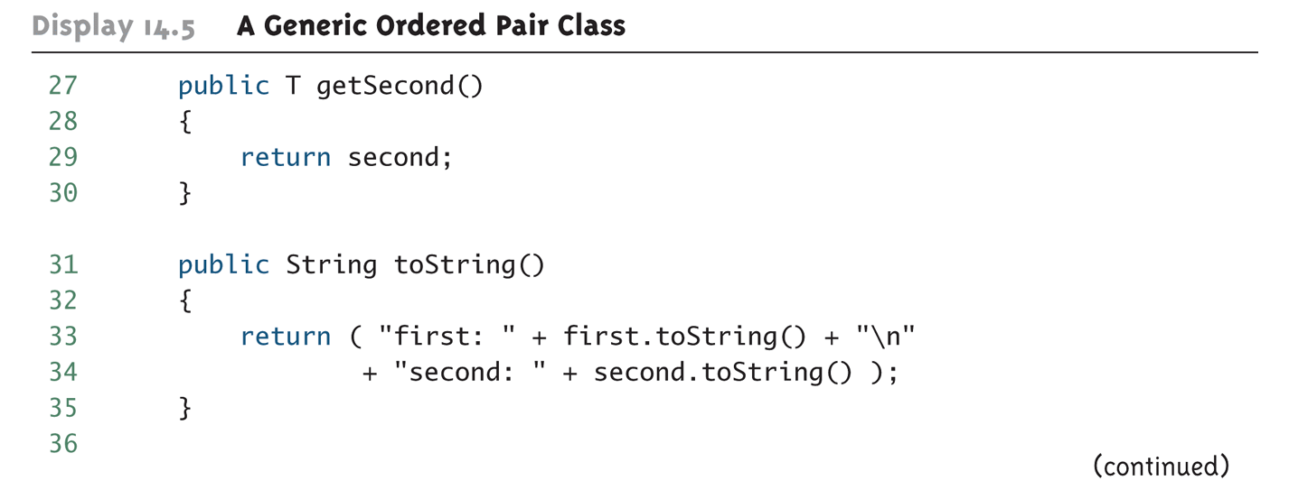
A Generic Ordered Pair Class (Part 3 of 4)

Slide 13
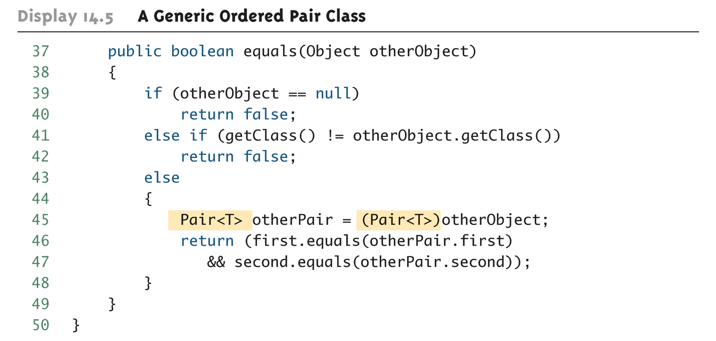
A Generic Ordered Pair Class (Part 4 of 4)

Slide 14
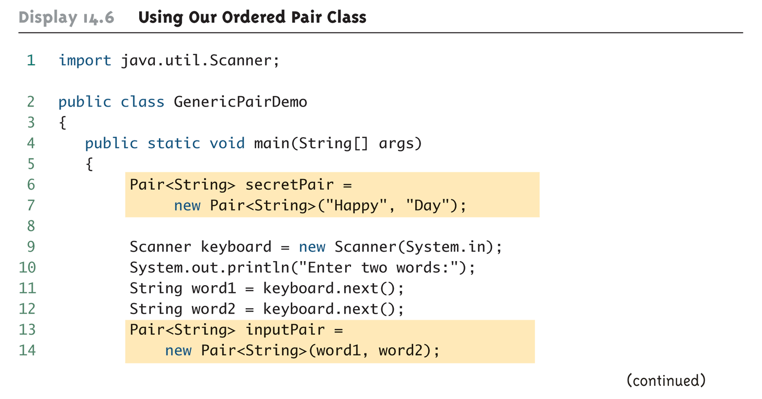
Using Our Ordered Pair Class (Part 1 of 3)

Slide 15
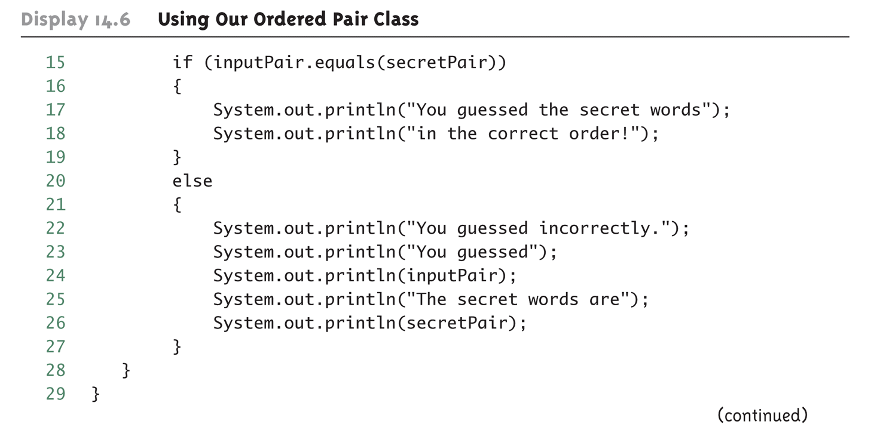
Using Our Ordered Pair Class (Part 2 of 3)

Slide 16
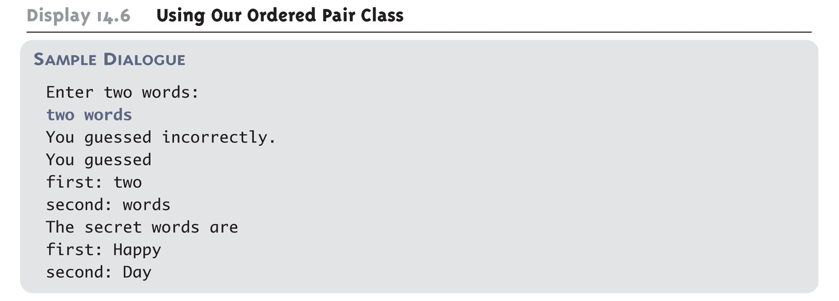
Using Our Ordered Pair Class (Part 3 of 3)

Slide 17
Pitfall: A Generic Constructor Name Has No Type Parameter
Although the class name in a parameterized class definition has a type parameter attached, the type parameter is not used in the heading of the constructor definition
    public Pair<T>() // not allowed
A constructor can use the type parameter as the type for a parameter of the constructor, but in this case, the angular brackets are not used
    public Pair(T first, T second)
However, when a generic class is instantiated, the angular brackets are used
    Pair<String> pair =
    new Pair<STring>("Happy", "Day");

Slide 18
Pitfall: A Primitive Type Cannot be Plugged in for a Type Parameter
The type plugged in for a type parameter must always be a reference type
  It cannot be a primitive type such as int, double, or char
  However, now that Java has automatic boxing, this is not a big restriction
  Note: reference types can include arrays

Slide 19
Pitfall: A Type Parameter Cannot Be Used Everywhere a Type Name Can Be Used
Within the definition of a parameterized class definition, there are places where an ordinary class name would be allowed, but a type parameter is not allowed
In particular, the type parameter cannot be used in simple expressions using new to create a new object
  For instance, the type parameter cannot be used as a constructor name or like a constructor:
    T object = new T(); // not allowed
    T[] a = new T[10]; // not allowed

Slide 20
Pitfall: An Instantiation of a Generic Class Cannot be an Array Base Type
Arrays such as the following are illegal:
  Pair<String>[] a =
  new Pair<String>[10];
  Although this is a reasonable thing to want to do, it is not allowed given the way that Java implements generic classes

Slide 21
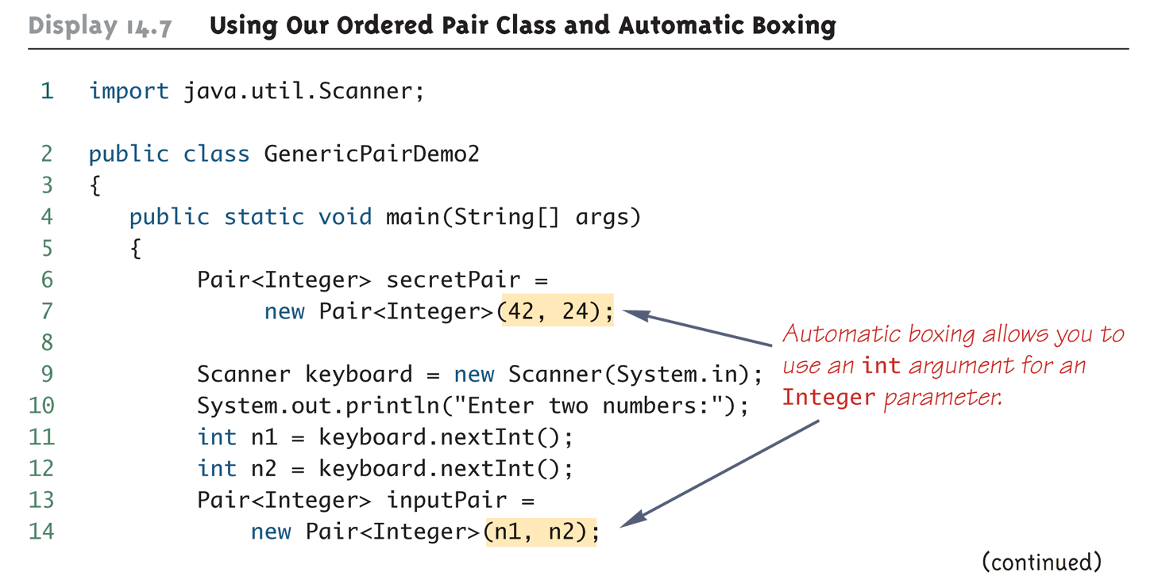
Using Our Ordered Pair Class and Automatic Boxing (Part 1 of 3)

Slide 22
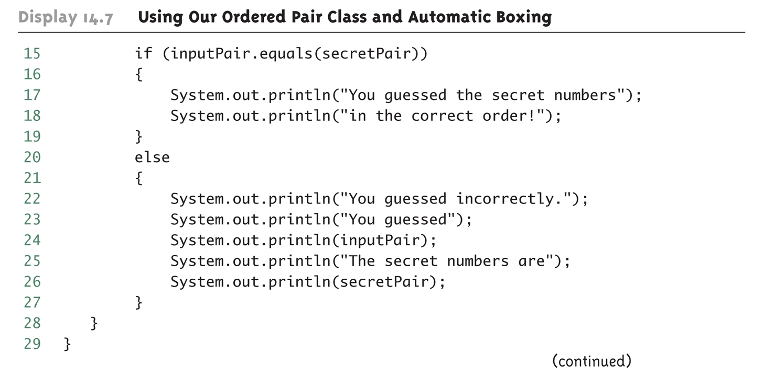
Using Our Ordered Pair Class and Automatic Boxing (Part 2 of 3)

Slide 23
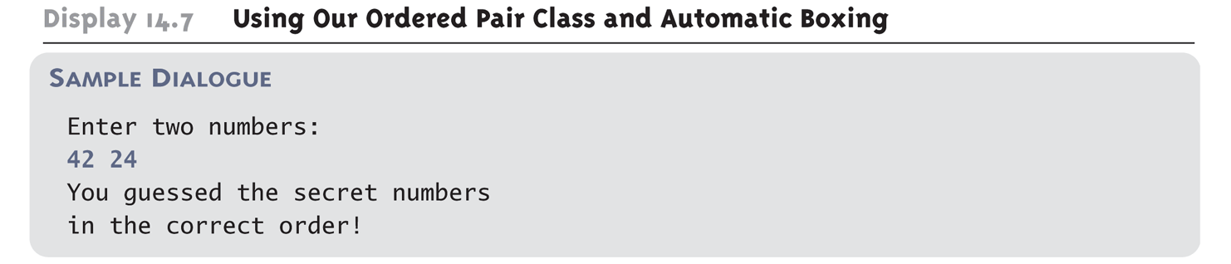
Using Our Ordered Pair Class and Automatic Boxing (Part 3 of 3)

Slide 24
Pitfall: A Class Definition Can Have More Than One Type Parameter
A generic class definition can have any number of type parameters
  Multiple type parameters are listed in angular brackets just as in the single type parameter case, but are separated by commas

Slide 25
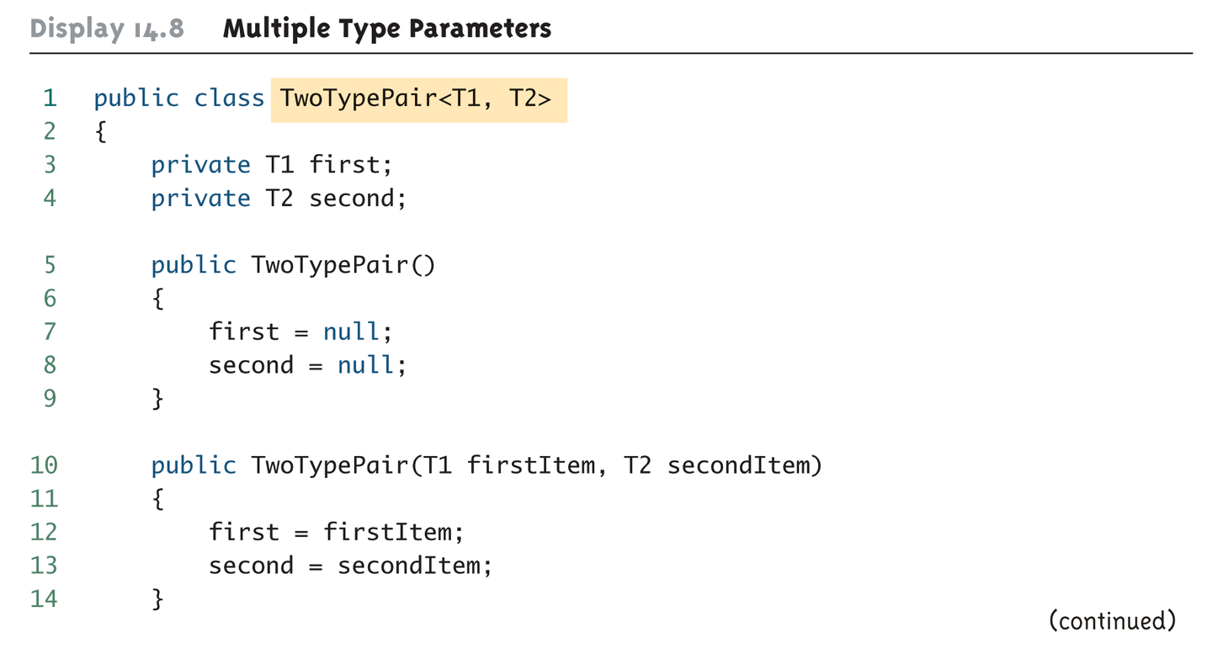
Multiple Type Parameters (Part 1 of 4)

Slide 26
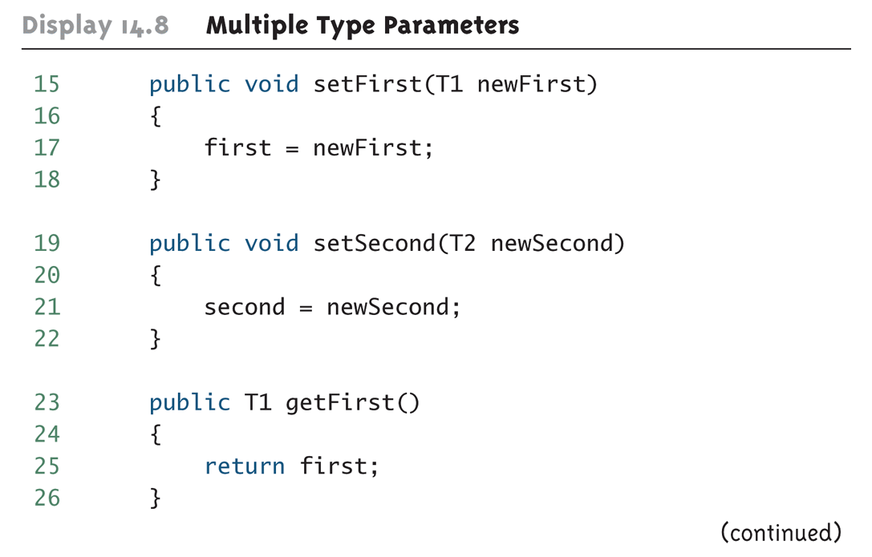
Multiple Type Parameters (Part 2 of 4)

Slide 27
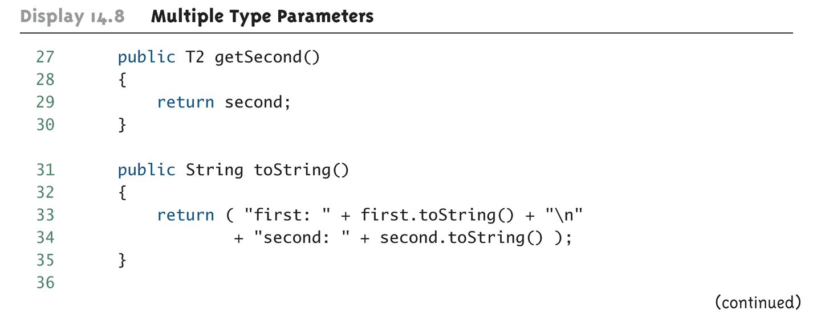
Multiple Type Parameters (Part 3 of 4)

Slide 28
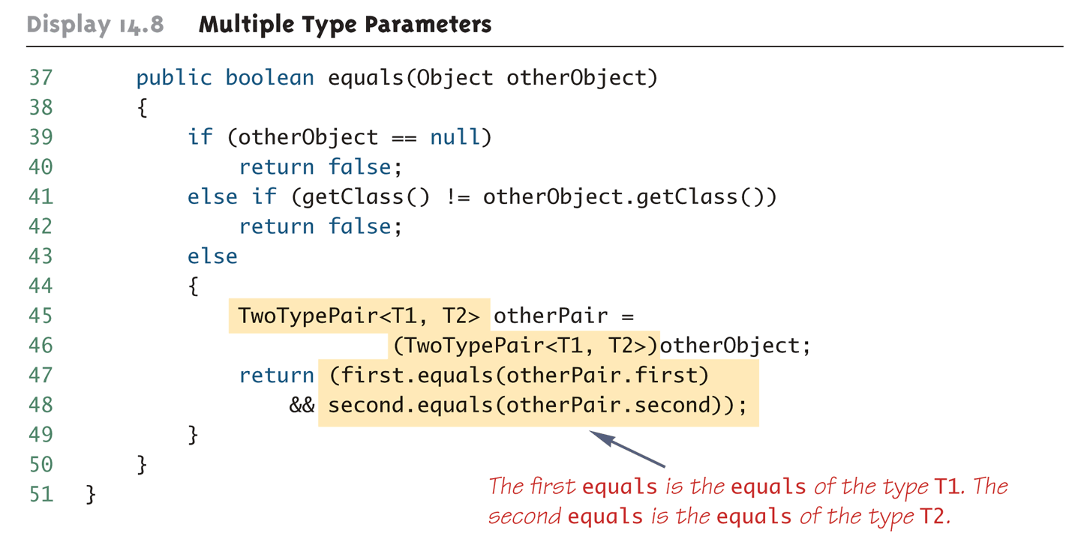
Multiple Type Parameters (Part 4 of 4)

Slide 29
Pitfall: A Generic Class Cannot Be an Exception Class
It is not permitted to create a generic class with Exception, Error, Throwable, or any descendent class of Throwable
  A generic class cannot be created whose objects are throwable
    public class Gex<T> extends Exception
  The above example will generate a compiler error message

Slide 30
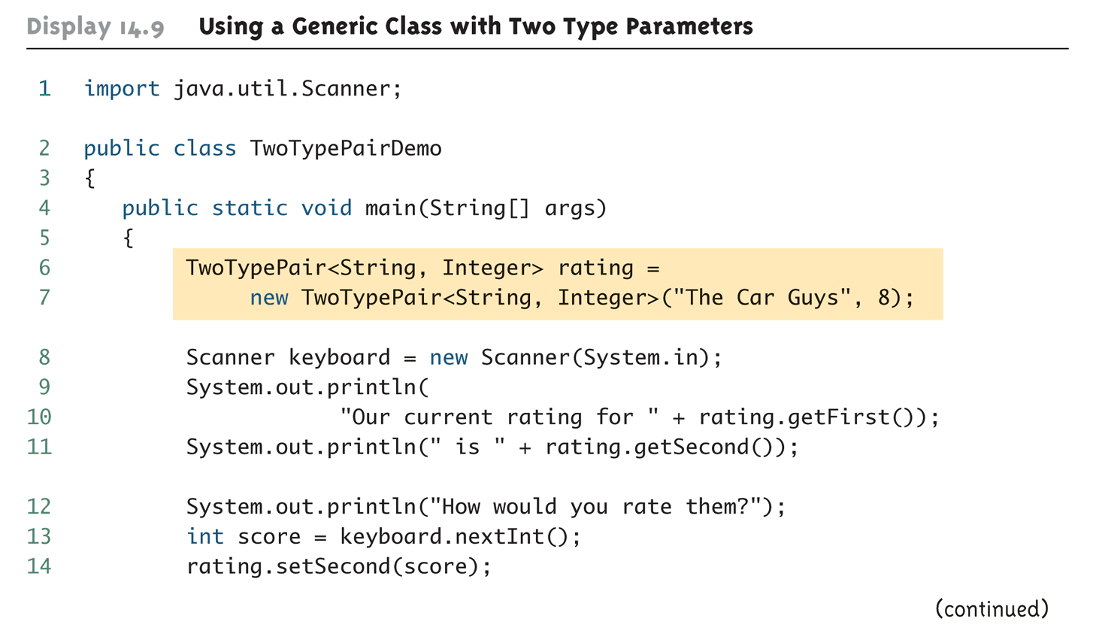
Using a Generic Class with Two Type Parameters (Part 1 of 2)

Slide 31
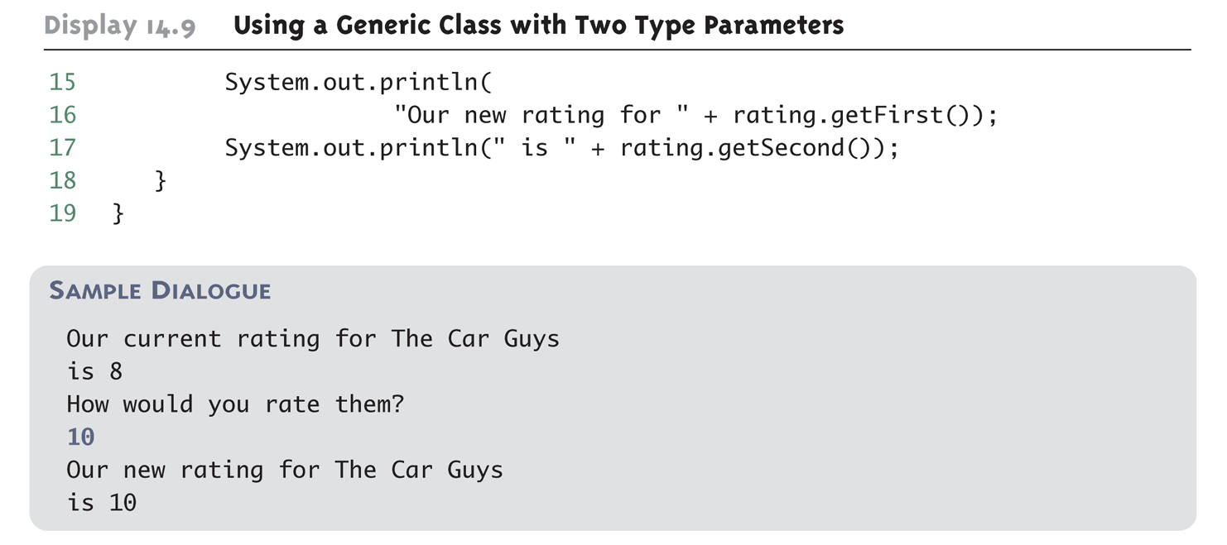
Using a Generic Class with Two Type Parameters (Part 2 of 2)

Slide 32
Bounds for Type Parameters
Sometimes it makes sense to restrict the possible types that can be plugged in for a type parameter T
  For instance, to ensure that only classes that implement the Comparable interface are plugged in for T, define a class as follows:
    public class RClass<T extends Comparable>
  "extends Comparable" serves as a bound on the type parameter T
  Any attempt to plug in a type for T which does not implement the Comparable interface will result in a compiler error message

Slide 33
Bounds for Type Parameters
A bound on a type may be a class name (rather than an interface name)
  Then only descendent classes of the bounding class may be plugged in for the type parameters
  public class ExClass<T extends Class1>
A bounds expression may contain multiple interfaces and up to one class
If there is more than one type parameter, the syntax is as follows:
  public class Two<T1 extends Class1, T2 extends Class2 & Comparable>

Slide 34
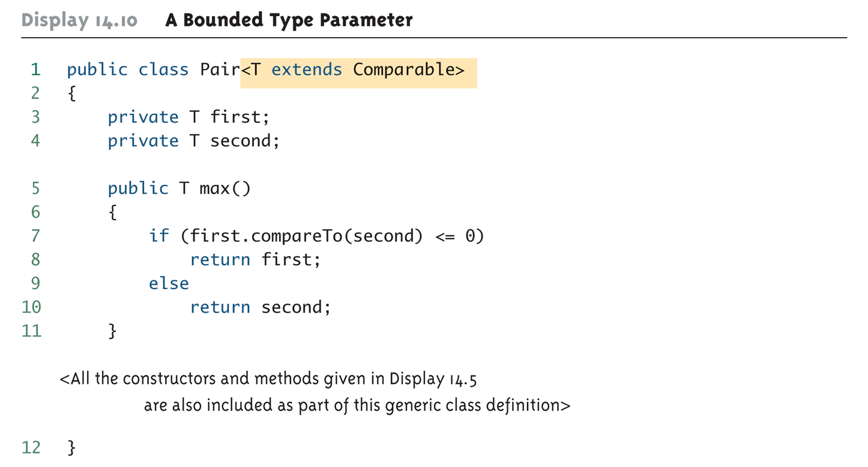
A Bounded Type Parameter

Slide 35
Tip: Generic Interfaces
An interface can have one or more type parameters
The details and notation are the same as they are for classes with type parameters

Slide 36
Generic Methods
When a generic class is defined, the type parameter can be used in the definitions of the methods for that generic class
In addition, a generic method can be defined that has its own type parameter that is not the type parameter of any class
  A generic method can be a member of an ordinary class or a member of a generic class that has some other type parameter
  The type parameter of a generic method is local to that method, not to the class

Slide 37
Generic Methods
The type parameter must be placed (in angular brackets) after all the modifiers, and before the returned type
  public static <T> T genMethod(T[] a)
When one of these generic methods is invoked, the method name is prefaced with the type to be plugged in, enclosed in angular brackets
  String s = NonG.<String>genMethod(c);

Slide 38
Inheritance with Generic Classes
A generic class can be defined as a derived class of an ordinary class or of another generic class
  As in ordinary classes, an object of the subclass type would also be of the superclass type
Given two classes: A and B, and given G: a generic class, there is no relationship between G<A> and G<B>
  This is true regardless of the relationship between class A and B, e.g., if class B is a subclass of class A

Slide 39
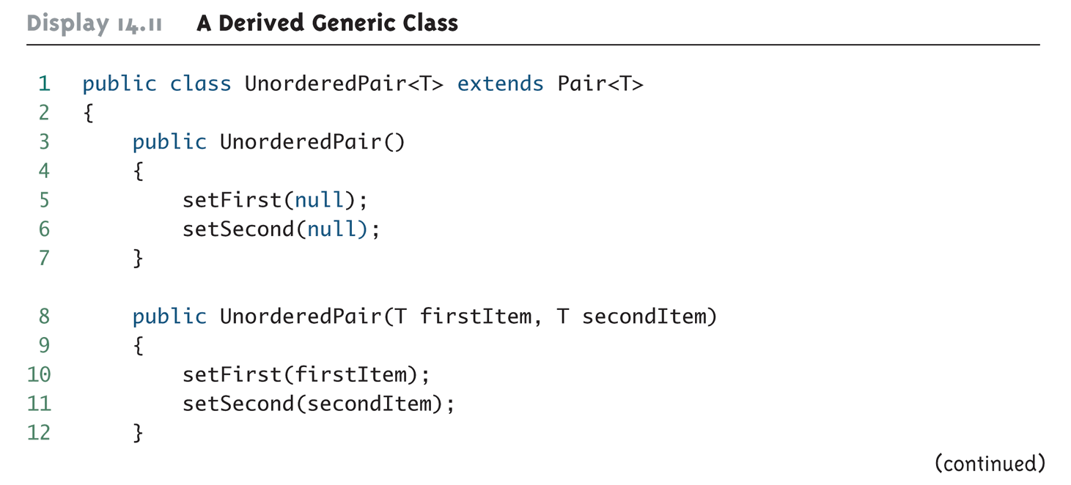
A Derived Generic Class (Part 1 of 2)

Slide 40
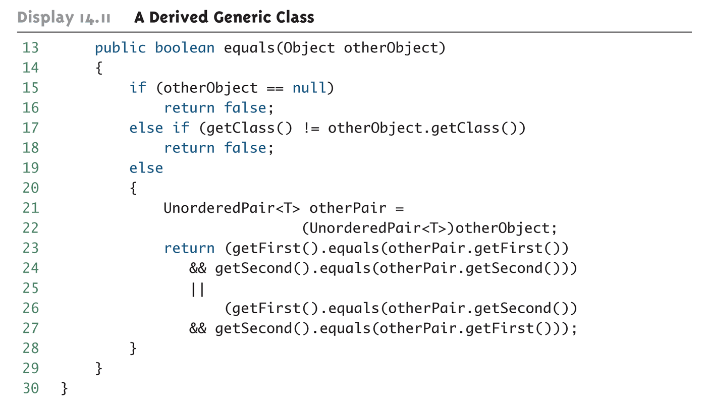
A Derived Generic Class (Part 2 of 2)

Slide 41
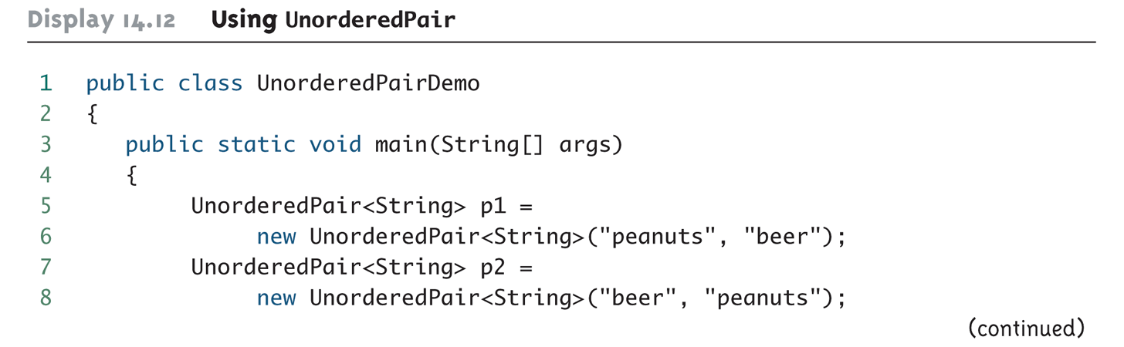
Using UnorderedPair (Part 1 of 2)

Slide 42
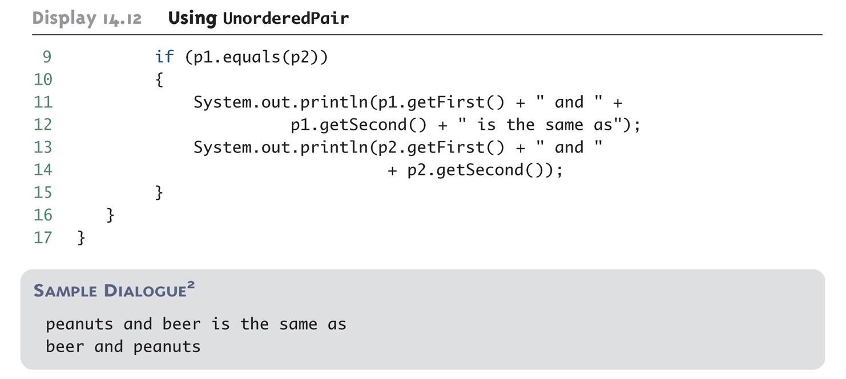
Using UnorderedPair (Part 2 of 2)

