Slide 1

Chapter 17
Swing I
Slides prepared by Rose Williams, Binghamton University
Kenrick Mock, University of Alaska Anchorage
Copyright © 2016 Pearson Inc. All rights reserved.

Slide 2
Introduction to Swing
A GUI (graphical user interface) is a windowing system that interacts with the user
The Java AWT (Abstract Window Toolkit) package is the original Java package for creating GUIs
The Swing package is an improved version of the AWT
  However, it does not completely replace the AWT
  Some AWT classes are replaced by Swing classes, but other AWT classes are needed when using Swing
Swing GUIs are designed using a form of object-oriented programming known as event-driven programming

Slide 3
Events
Event-driven programming is a programming style that uses a signal-and-response approach to programming
An event is an object that acts as a signal to another object know as a listener
The sending of an event is called firing the event
  The object that fires the event is often a GUI component, such as a button that has been clicked

Slide 4
Listeners
A listener object performs some action in response to the event
  A given component may have any number of listeners
  Each listener may respond to a different kind of event, or multiple listeners might may respond to the same events

Slide 5
Exception Objects
An exception object is an event
  The throwing of an exception is an example of firing an event
The listener for an exception object is the catch block that catches the event

Slide 6
Event Handlers
A listener object has methods that specify what will happen when events of various kinds are received by it
  These methods are called event handlers
The programmer using the listener object will define or redefine these event-handler methods

Slide 7
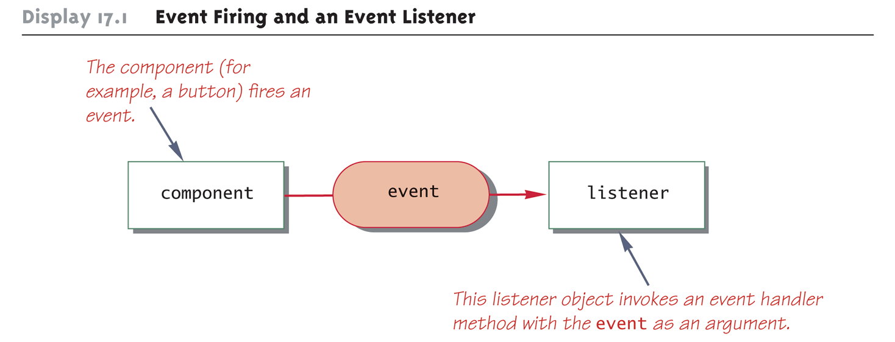
Event Firing and an Event Listener

Slide 8
Event-Driven Programming
Event-driven programming is very different from most programming seen up until now
  So far, programs have consisted of a list of statements executed in order
  When that order changed, whether or not to perform certain actions (such as repeat statements in a loop, branch to another statement, or invoke a method) was controlled by the logic of the program

Slide 9
Event-Driven Programming
In event-driven programming, objects are created that can fire events, and listener objects are created that can react to the events
The program itself no longer determines the order in which things can happen
  Instead, the events determine the order

Slide 10
Event-Driven Programming
In an event-driven program, the next thing that happens depends on the event that occurs
In particular, methods are defined that will never be explicitly invoked in any program
  Instead, methods are invoked automatically when an event signals that the method needs to be called

Slide 11
A Simple Window
A simple window can consist of an object of the JFrame class
  A JFrame object includes a border and the usual three buttons for minimizing, changing the size of, and closing the window
  The JFrame class is found in the javax.swing package
    JFrame firstWindow = new JFrame();
A JFrame can have components added to it, such as buttons, menus, and text labels
  These components can be programmed for action
    firstWindow.add(endButton);
  It can be made visible using the setVisible method
    firstWindow.setVisible(true);

Slide 12
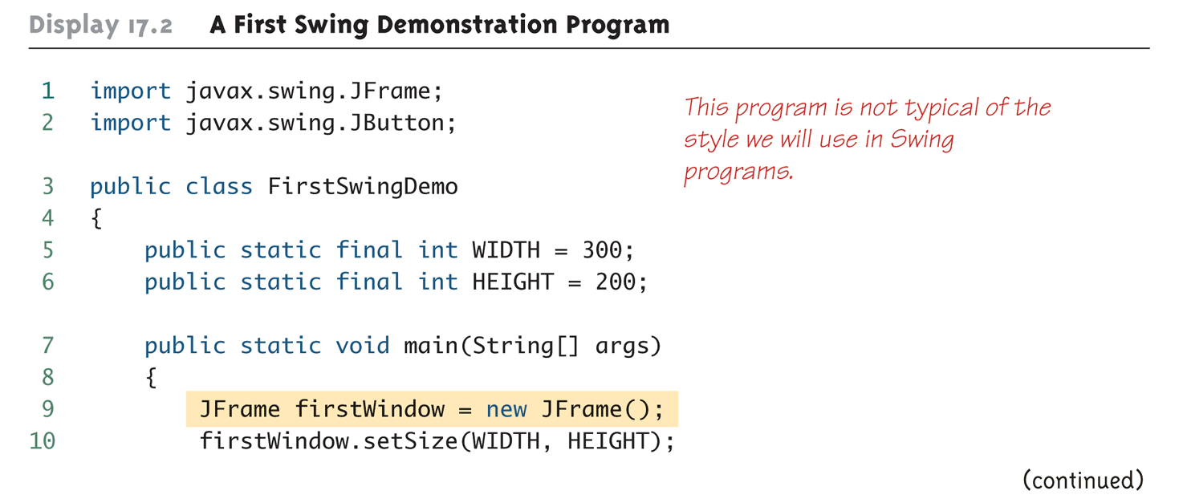
A First Swing Demonstration (Part 1 of 4)

Slide 13
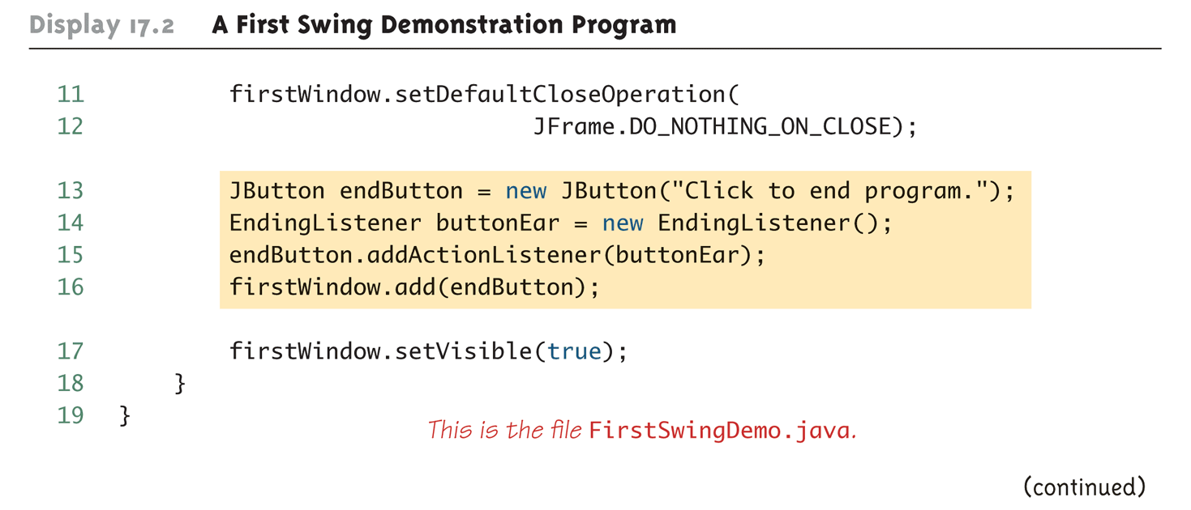
A First Swing Demonstration (Part 2 of 4)

Slide 14
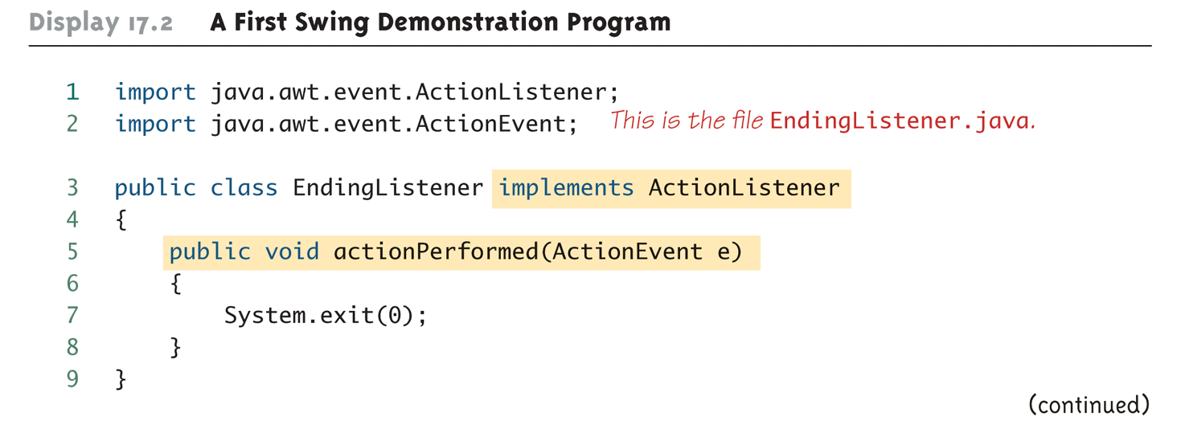
A First Swing Demonstration (Part 3 of 4)

Slide 15
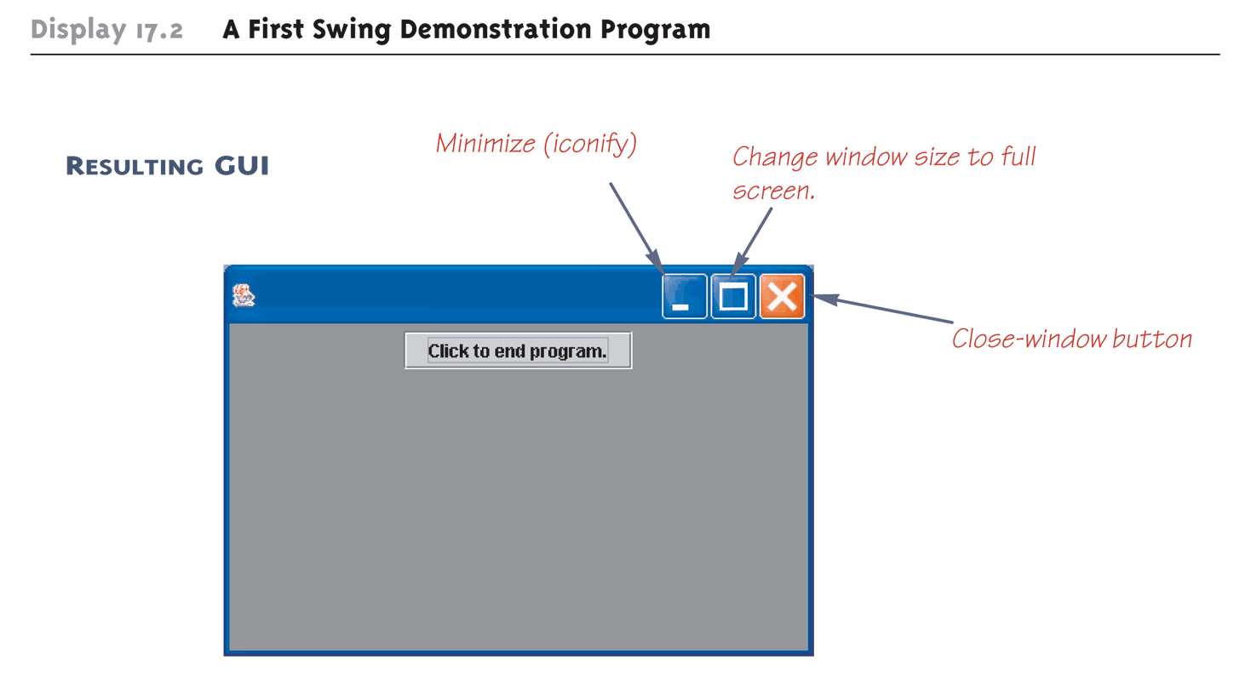
A First Swing Demonstration (Part 4 of 4)

Slide 16
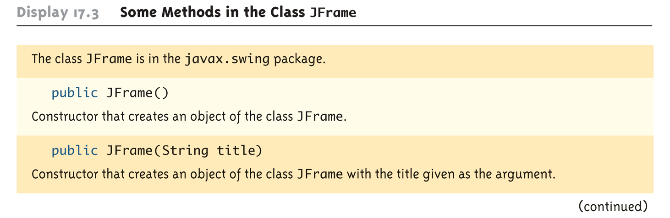
Some Methods in the Class JFrame (Part 1 of 3)

Slide 17
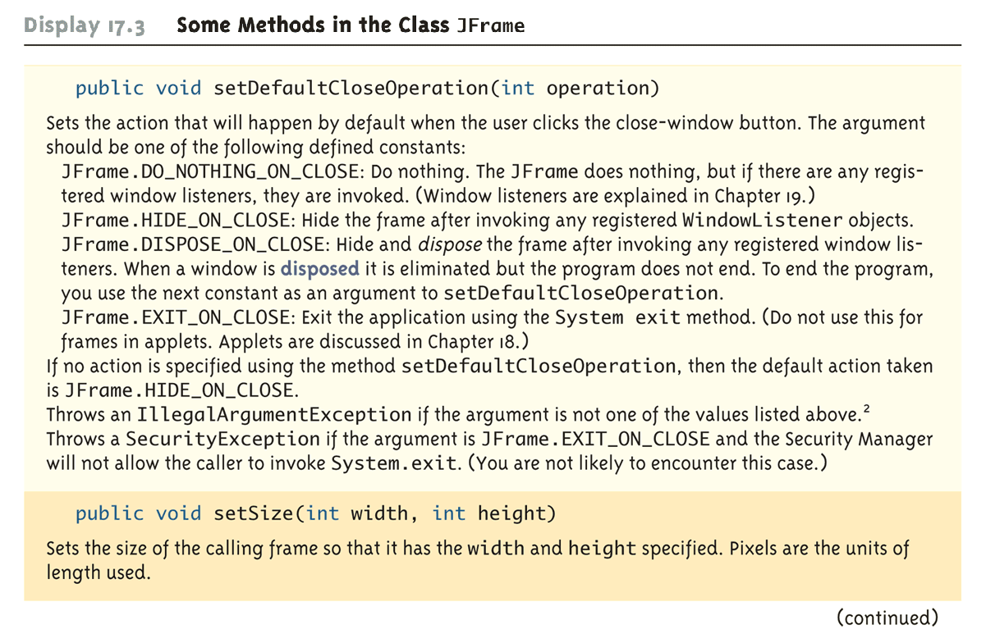
Some Methods in the Class JFrame (Part 2 of 3)

Slide 18
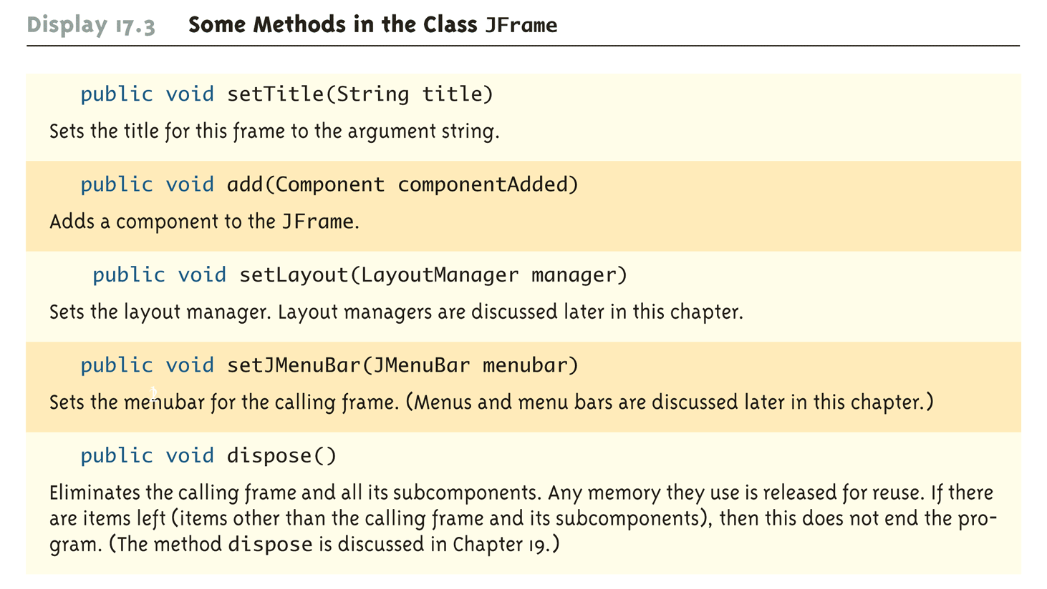
Some Methods in the Class JFrame (Part 3 of 3)

Slide 19
Pitfall: Forgetting to Program the
Close-Window Button
The following lines from the FirstSwingDemo program ensure that when the user clicks the close-window button, nothing happens
  firstWindow.setDefaultCloseOperation(
  JFrame.DO_NOTHING_ON_CLOSE);
If this were not set, the default action would be JFrame.HIDE_ON_CLOSE
  This would make the window invisible and inaccessible, but would not end the program
  Therefore, given this scenario, there would be no way to click the "Click to end program" button
Note that the close-window and other two accompanying buttons are part of the JFrame object, and not separate buttons

Slide 20
Buttons
A button object is created from the class JButton and can be added to a JFrame
  The argument to the JButton constructor is the string that appears on the button when it is displayed
  JButton endButton = new
  JButton("Click to end program.");
  firstWindow.add(endButton);

Slide 21
Action Listeners and Action Events
Clicking a button fires an event
The event object is "sent" to another object called a listener
  This means that a method in the listener object is invoked automatically
  Furthermore, it is invoked with the event object as its argument
In order to set up this relationship, a GUI program must do two things
  It must specify, for each button, what objects are its listeners, i.e., it must register the listeners
  It must define the methods that will be invoked automatically when the event is sent to the listener

Slide 22
Action Listeners and Action Events
EndingListener buttonEar = new
EndingListener());
endButton.addActionListener(buttonEar);
Above, a listener object named buttonEar is created and registered as a listener for the button named endButton
  Note that a button fires events known as action events, which are handled by listeners known as action listeners

Slide 23
Action Listeners and Action Events
Different kinds of components require different kinds of listener classes to handle the events they fire
An action listener is an object whose class implements the ActionListener interface
  The ActionListener interface has one method heading that must be implemented
  public void actionPerformed(ActionEvent e)

Slide 24
Action Listeners and Action Events
  public void actionPerformed(ActionEvent e)
  {
  System.exit(0);
  }
The EndingListener class defines its actionPerformed method as above
  When the user clicks the endButton, an action event is sent to the action listener for that button
  The EndingListener object buttonEar is the action listener for endButton
  The action listener buttonEar receives the action event as the parameter e to its actionPerformed method, which is automatically invoked
  Note that e must be received, even if it is not used

Slide 25
Pitfall: Changing the Heading for actionPerformed
When the actionPerformed method is implemented in an action listener, its header must be the one specified in the ActionListener interface
  It is already determined, and may not be changed
  Not even a throws clause may be added
  public void actionPerformed(ActionEvent e)
The only thing that can be changed is the name of the parameter, since it is just a placeholder
  Whether it is called e or something else does not matter, as long as it is used consistently within the body of the method

Slide 26
Tip: Ending a Swing Program
GUI programs are often based on a kind of infinite loop
  The windowing system normally stays on the screen until the user indicates that it should go away
If the user never asks the windowing system to go away, it will never go away
In order to end a GUI program, System.exit must be used when the user asks to end the program
  It must be explicitly invoked, or included in some library code that is executed
  Otherwise, a Swing program will not end after it has executed all the code in the program

Slide 27
A Better Version of Our First Swing GUI
A better version of FirstWindow makes it a derived class of the class JFrame
  This is the normal way to define a windowing interface
The constructor in the new FirstWindow class starts by calling the constructor for the parent class using super();
  This ensures that any initialization that is normally done for all objects of type JFrame will be done
Almost all initialization for the window FirstWindow is placed in the constructor for the class
Note that this time, an anonymous object is used as the action listener for the endButton

Slide 28
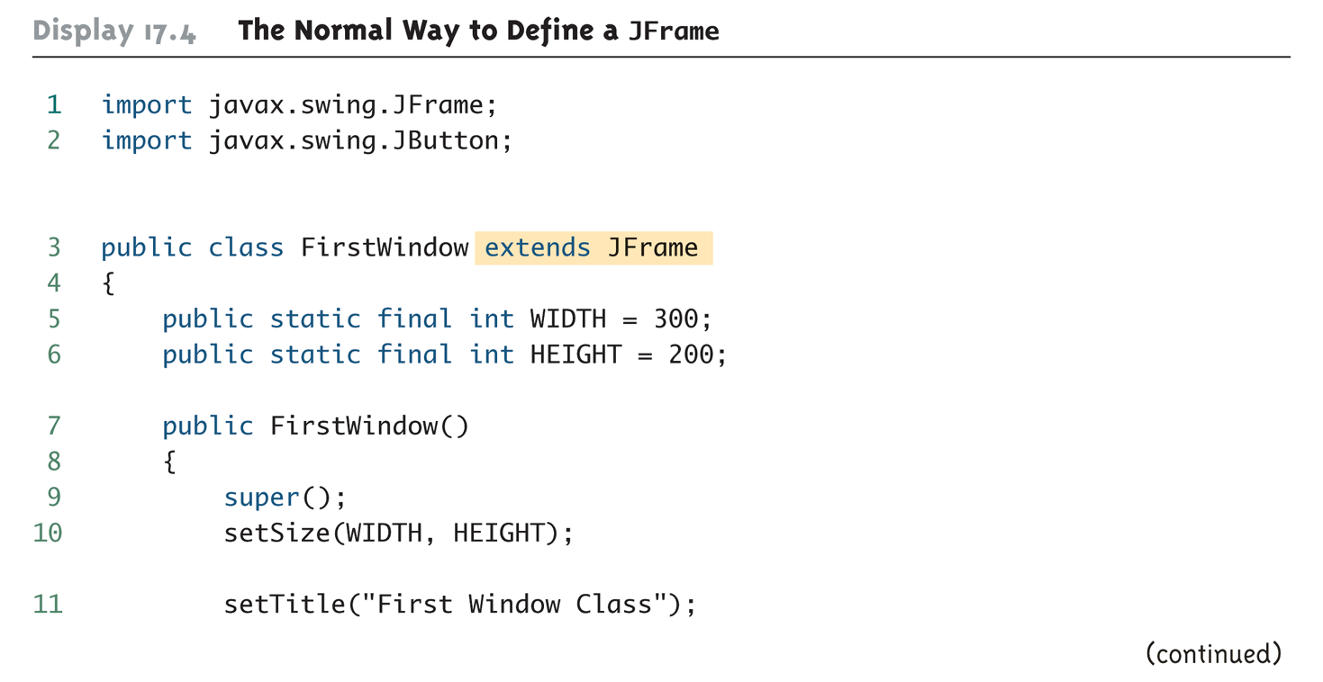
The Normal Way to Define a JFrame (Part 1 of 4)

Slide 29
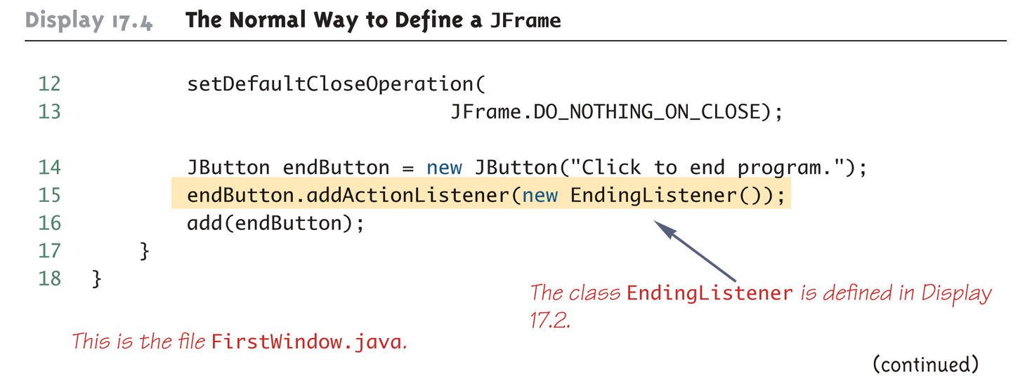
The Normal Way to Define a JFrame (Part 2 of 4)

Slide 30
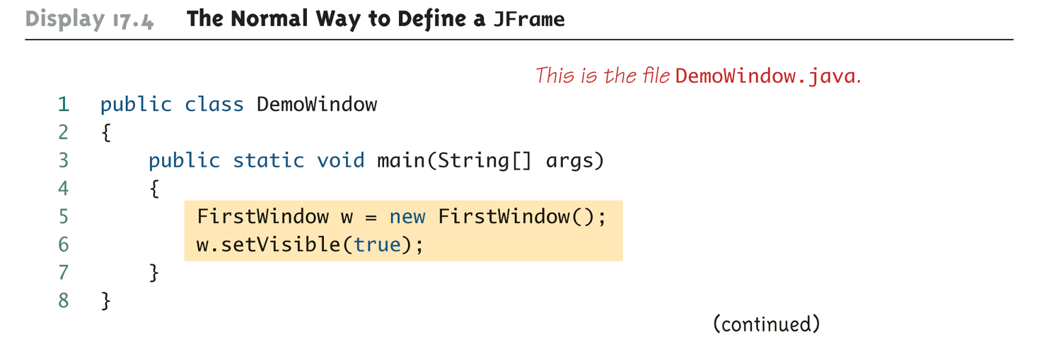
The Normal Way to Define a JFrame (Part 3 of 4)

Slide 31
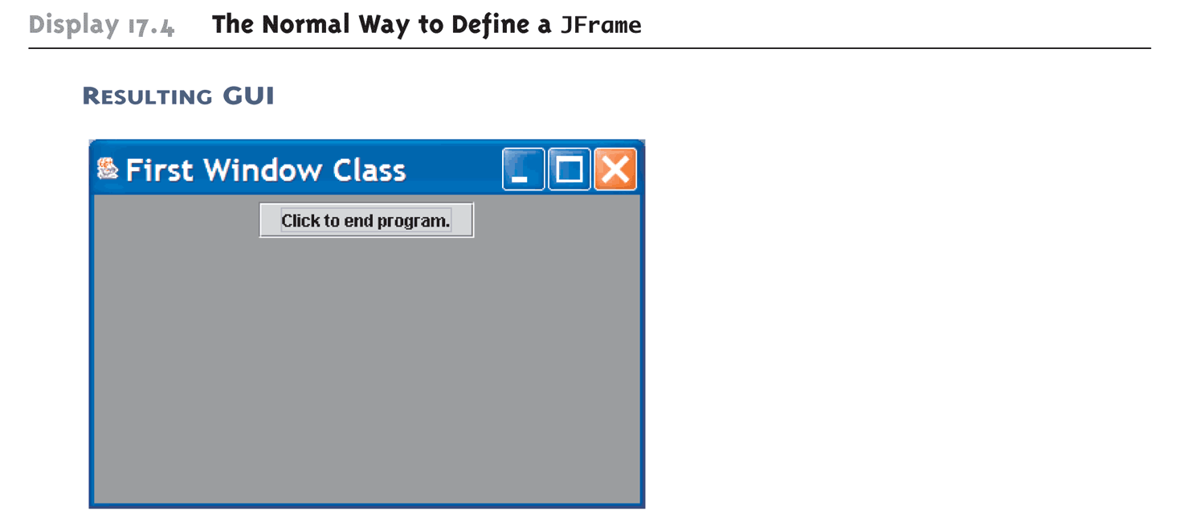
The Normal Way to Define a JFrame (Part 4 of 4)

Slide 32
Labels
A label is an object of the class JLabel
  Text can be added to a JFrame using a label
  The text for the label is given as an argument when the JLabel is created
  The label can then be added to a JFrame
    JLabel greeting = new JLabel("Hello");
    add(greeting);

Slide 33
Color
In Java, a color is an object of the class Color
  The class Color is found in the java.awt package
  There are constants in the Color class that represent a number of basic colors
A JFrame can not be colored directly
  Instead, a program must color something called the content pane of the JFrame
  Since the content pane is the "inside" of a JFrame, coloring the content pane has the effect of coloring the inside of the JFrame
  Therefore, the background color of a JFrame can be set using the following code:
    getContentPane().setBackground(Color);

Slide 34
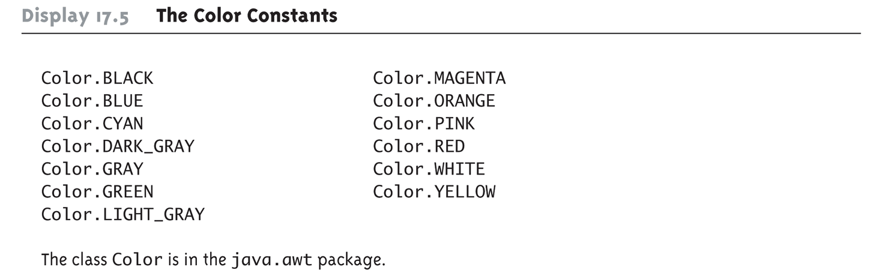
The Color Constants

Slide 35
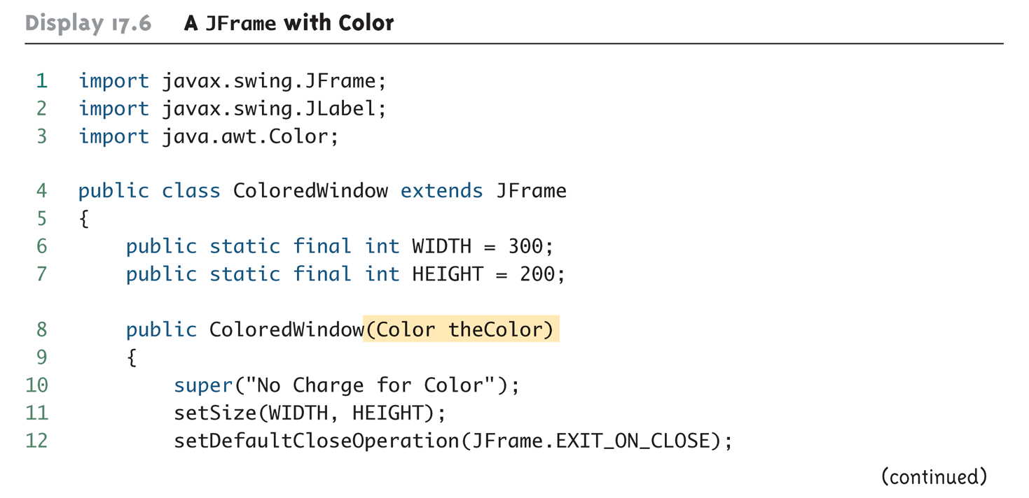
A JFrame with Color (Part 1 of 4)

Slide 36
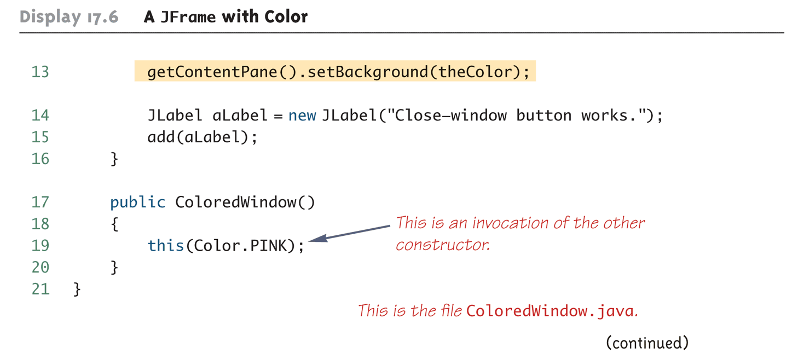
A JFrame with Color (Part 2 of 4)

Slide 37
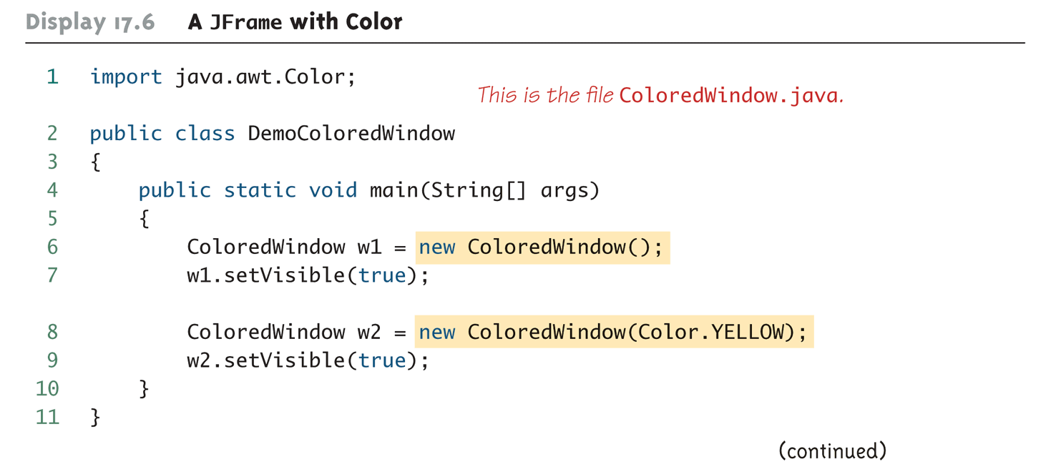
A JFrame with Color (Part 3 of 4)

Slide 38
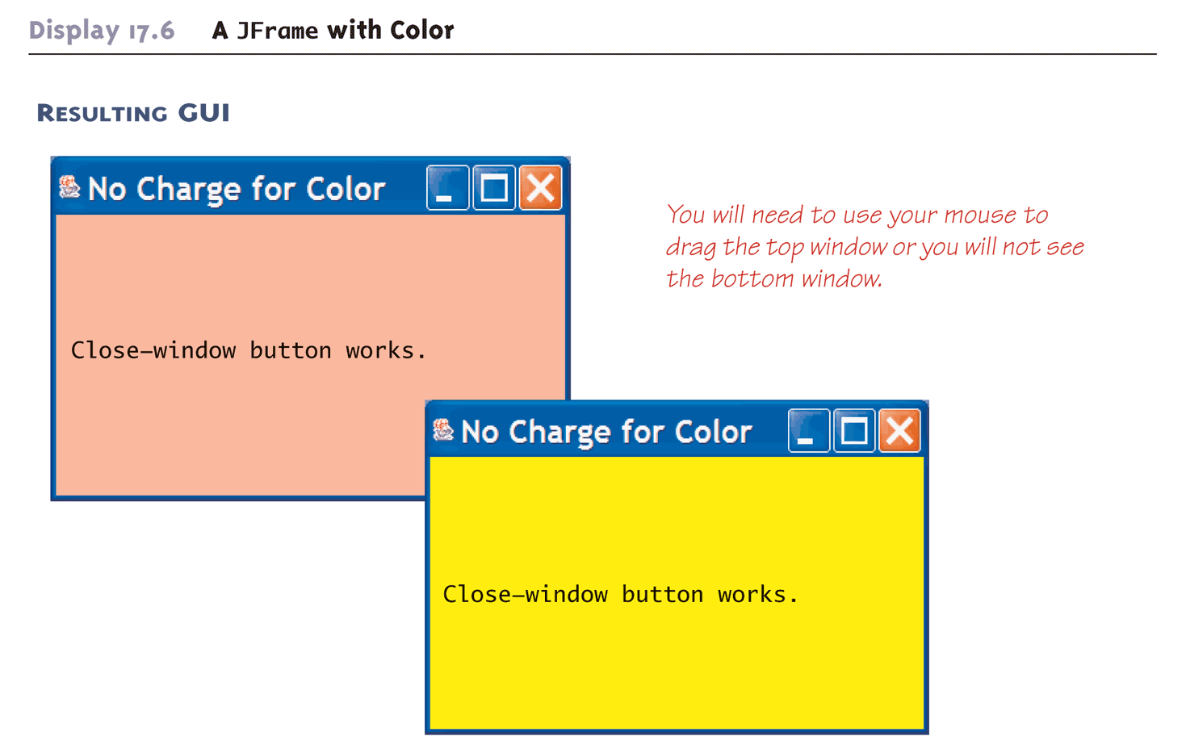
A JFrame with Color (Part 4 of 4)

Slide 39
Containers and Layout Managers
Multiple components can be added to the content pane of a JFrame using the add method
  However, the add method does not specify how these components are to be arranged
To describe how multiple components are to be arranged, a layout manager is used
  There are a number of layout manager classes such as BorderLayout, FlowLayout, and GridLayout
  If a layout manager is not specified, a default layout manager is used which is FlowLayout

Slide 40
Border Layout Managers
A BorderLayout manager places the components that are added to a JFrame object into five regions
  These regions are: BorderLayout.NORTH, BorderLayout.SOUTH, BorderLayout.EAST, BorderLayout.WEST, and BorderLayout.Center
A BorderLayout manager is added to a JFrame using the setLayout method
  For example:
    setLayout(new BorderLayout());

Slide 41
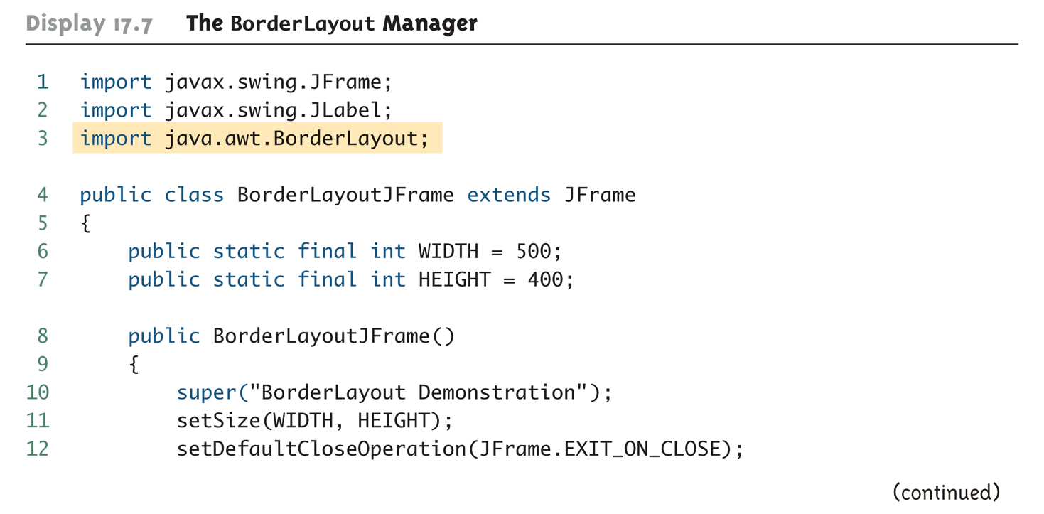
The BorderLayout Manager (Part 1 of 4)

Slide 42
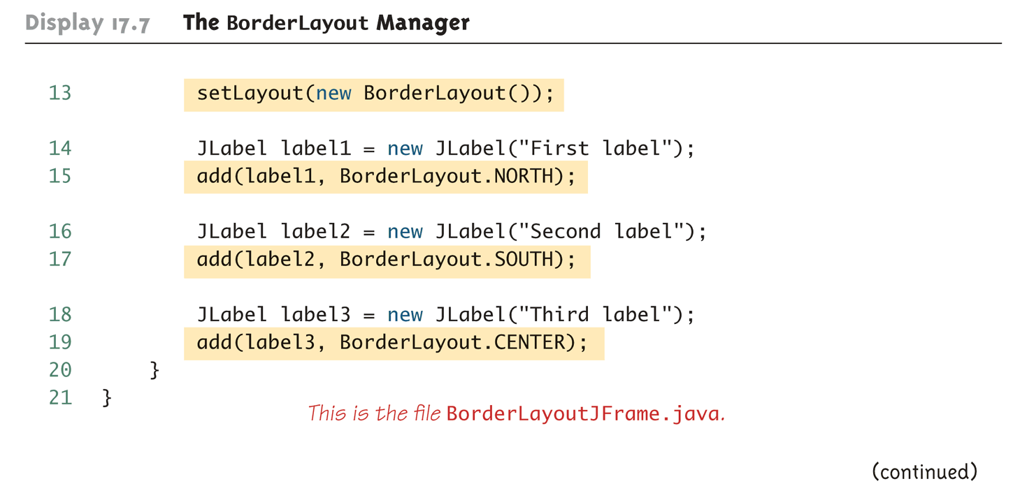
The BorderLayout Manager (Part 2 of 4)

Slide 43
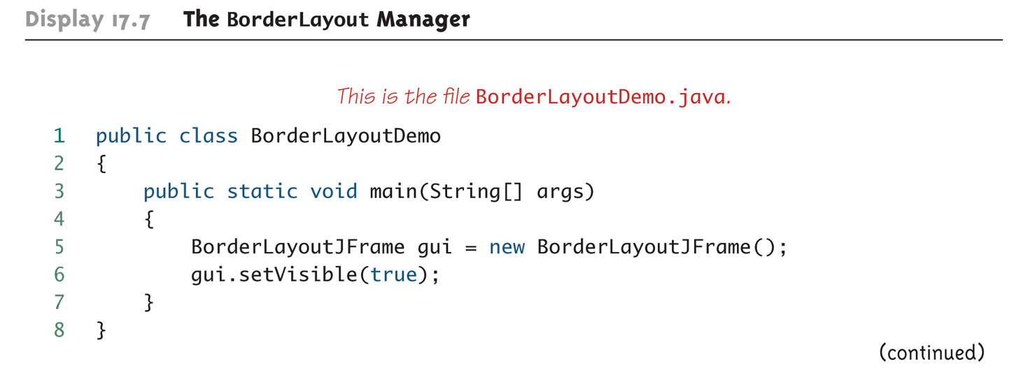
The BorderLayout Manager (Part 3 of 4)

Slide 44
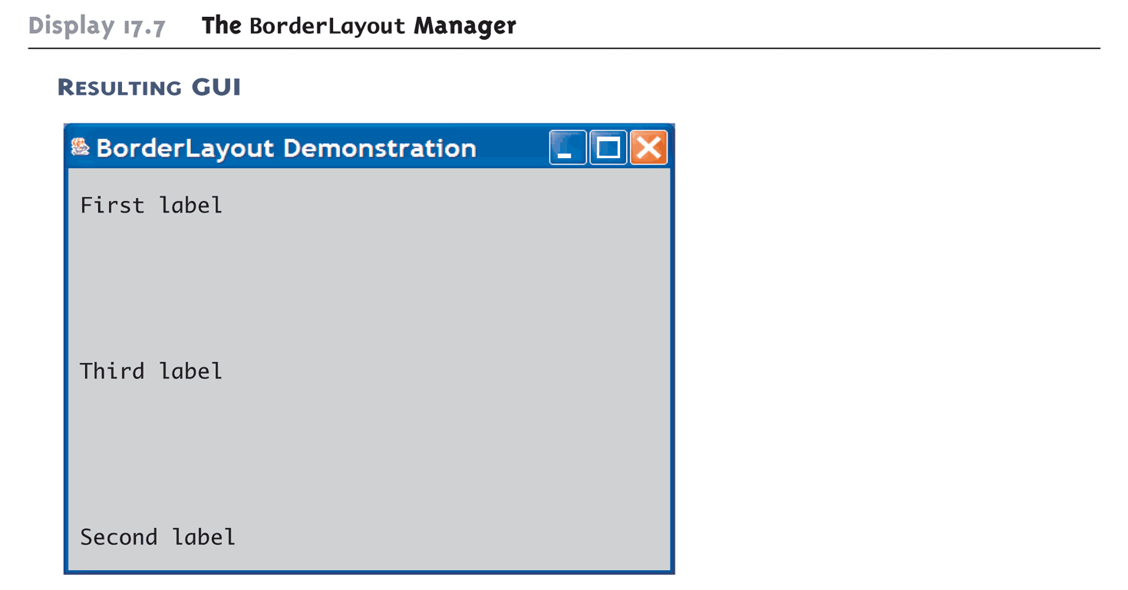
The BorderLayout Manager (Part 4 of 4)

Slide 45
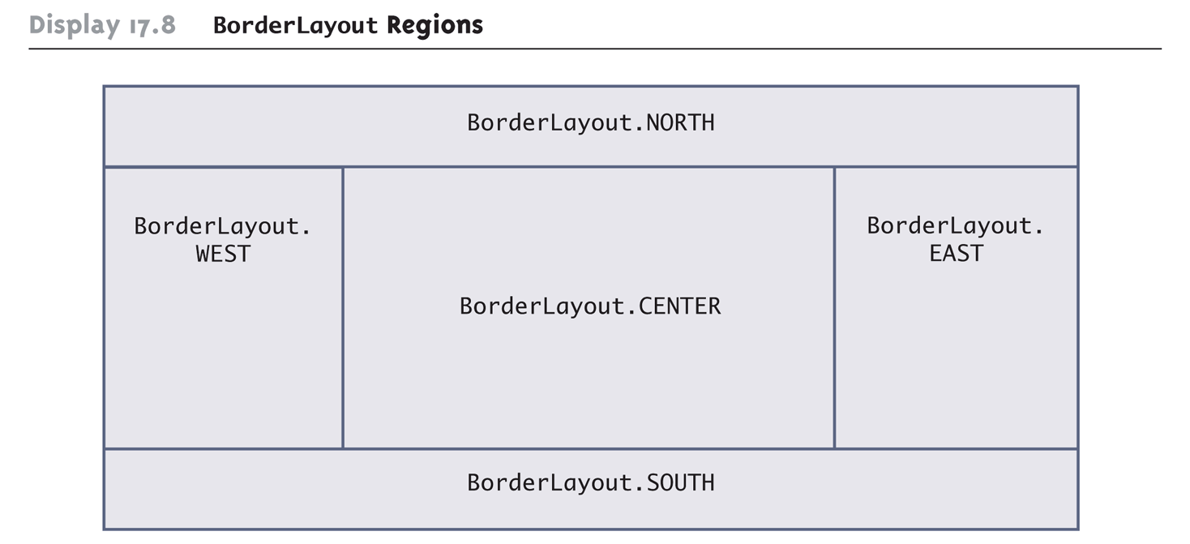
BorderLayout Regions

Slide 46
Border Layout Managers
The previous diagram shows the arrangement of the five border layout regions
  Note: None of the lines in the diagram are normally visible
When using a BorderLayout manager, the location of the component being added is given as a second argument to the add method
  add(label1, BorderLayout.NORTH);
  Components can be added in any order since their location is specified

Slide 47
Flow Layout Managers
The FlowLayout manager is the simplest layout manager and it is a default layout manager.
  setLayout(new FlowLayout());
  It arranges components one after the other, going from left to right
  Components are arranged in the order in which they are added
Since a location is not specified, the add method has only one argument when using the FlowLayoutManager
add(label1);

Slide 48
Grid Layout Managers
A GridLayout manager arranges components in a two-dimensional grid with some number of rows and columns
  setLayout(new GridLayout(rows, columns));
  Each entry is the same size
  The two numbers given as arguments specify the number of rows and columns
  Each component is stretched so that it completely fills its grid position
  Note: None of the lines in the diagram are normally visible

Slide 49
Grid Layout Managers
When using the GridLayout class, the method add has only one argument
  add(label1);
  Items are placed in the grid from left to right
  The top row is filled first, then the second, and so forth
  Grid positions may not be skipped
Note the use of a main method in the GUI class itself in the following example
  This is often a convenient way of demonstrating a class

Slide 50
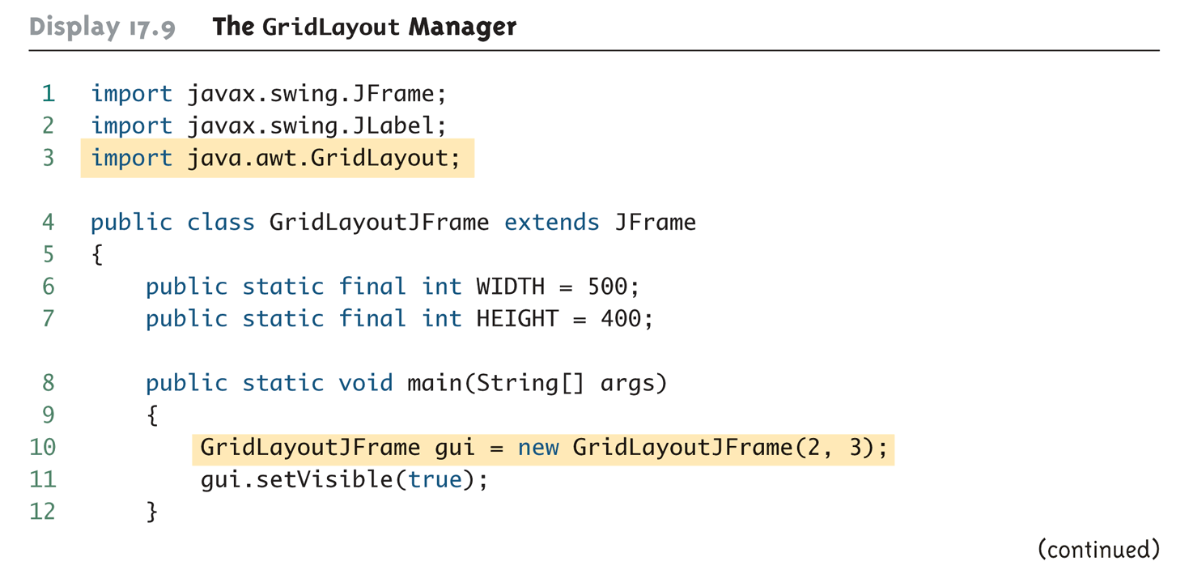
The GridLayout Manager (Part 1 of 4)

Slide 51
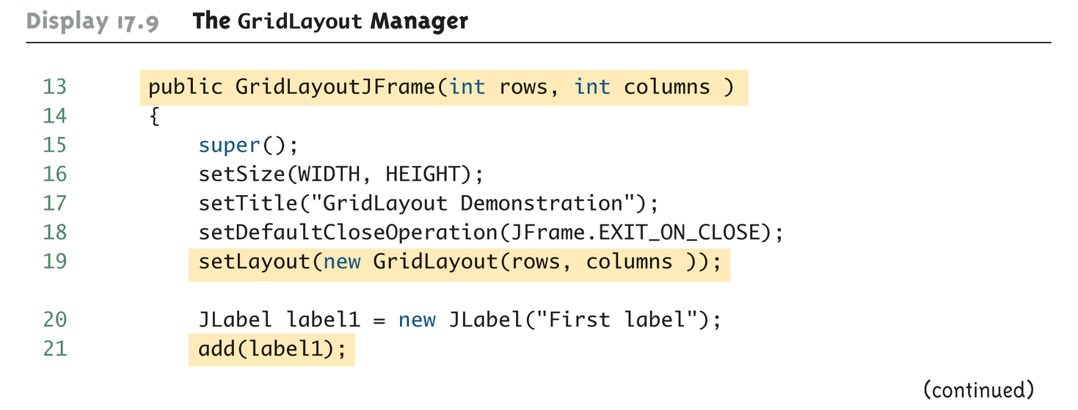
The GridLayout Manager (Part 2 of 4)

Slide 52
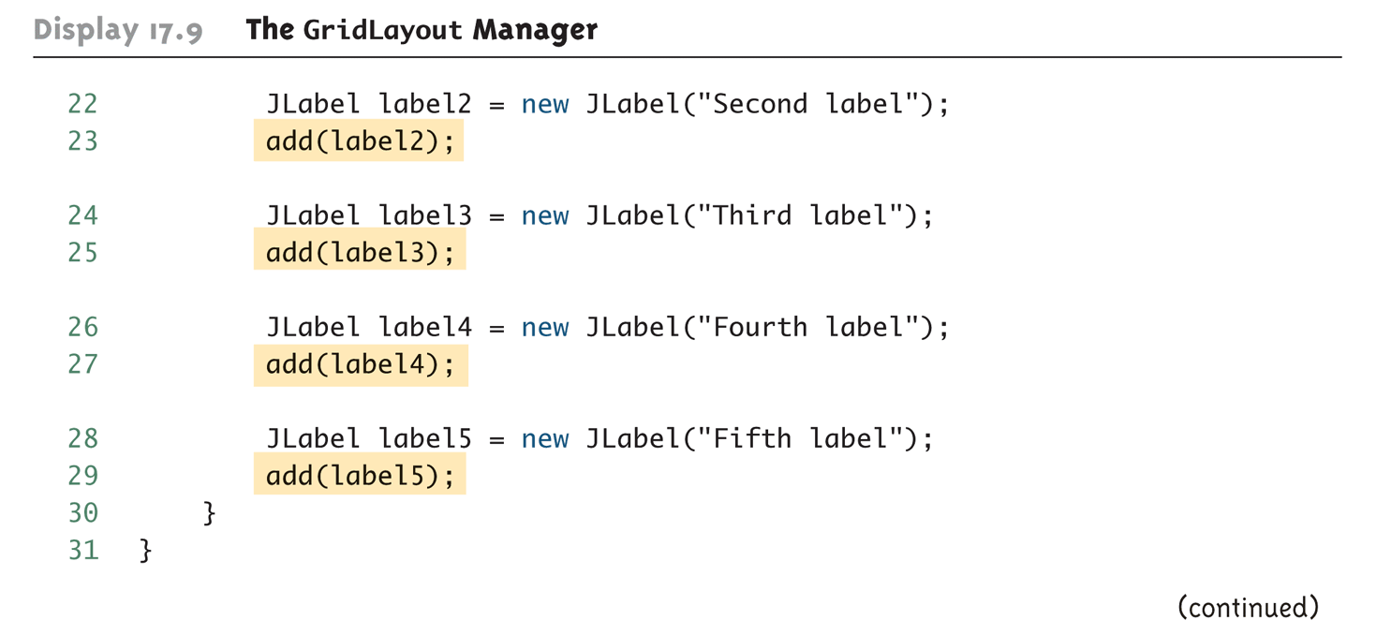
The GridLayout Manager (Part 3 of 4)

Slide 53
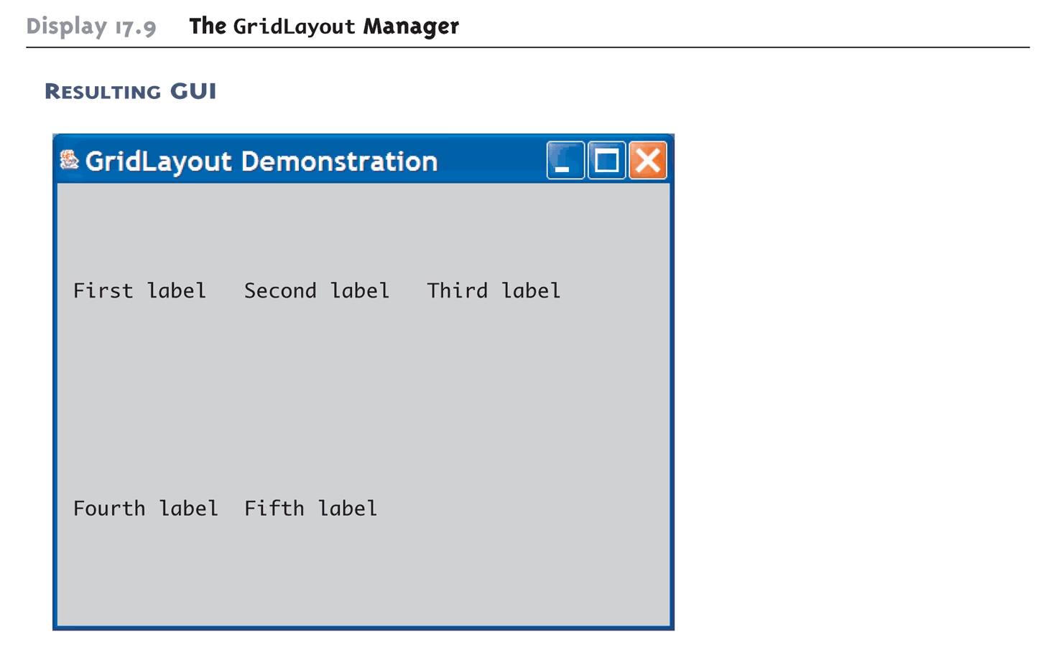
The GridLayout Manager (Part 4 of 4)

Slide 54
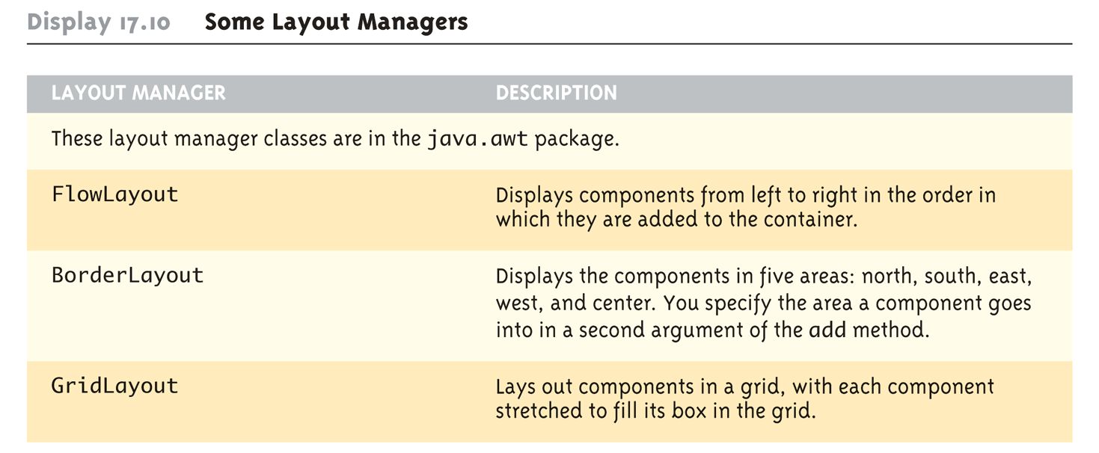
Some Layout Managers

Slide 55
Panels
A GUI is often organized in a hierarchical fashion, with containers called panels inside other containers
A panel is an object of the JPanel class that serves as a simple container
  It is used to group smaller objects into a larger component (the panel)
  One of the main functions of a JPanel object is to subdivide a JFrame or other container

Slide 56
Panels
Both a JFrame and each panel in a JFrame can use different layout managers
  Additional panels can be added to each panel, and each panel can have its own layout manager
  This enables almost any kind of overall layout to be used in a GUI
    setLayout(new BorderLayout());
    JPanel somePanel = new JPanel();
    somePanel.setLayout(new FlowLayout());
Note in the following example that panel and button objects are given color using the setBackground method without invoking getContentPane
  The getContentPane method is only used when adding color to a JFrame

Slide 57
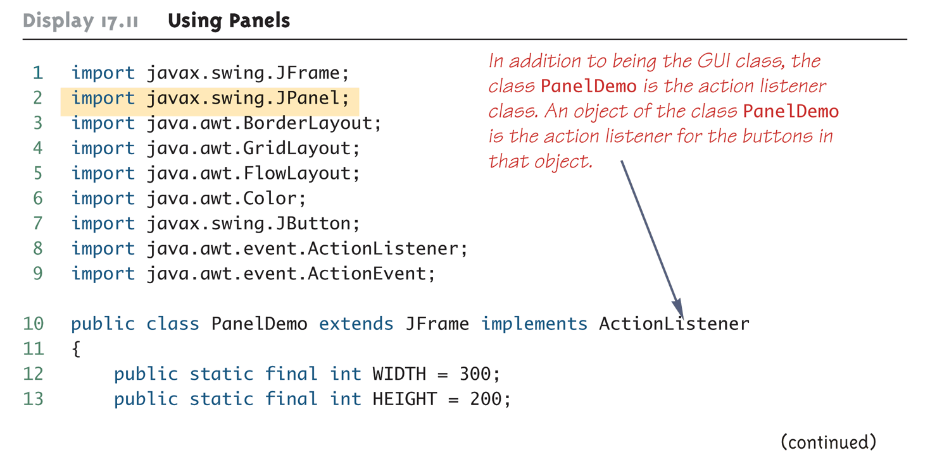
Using Panels (Part 1 of 8)

Slide 58
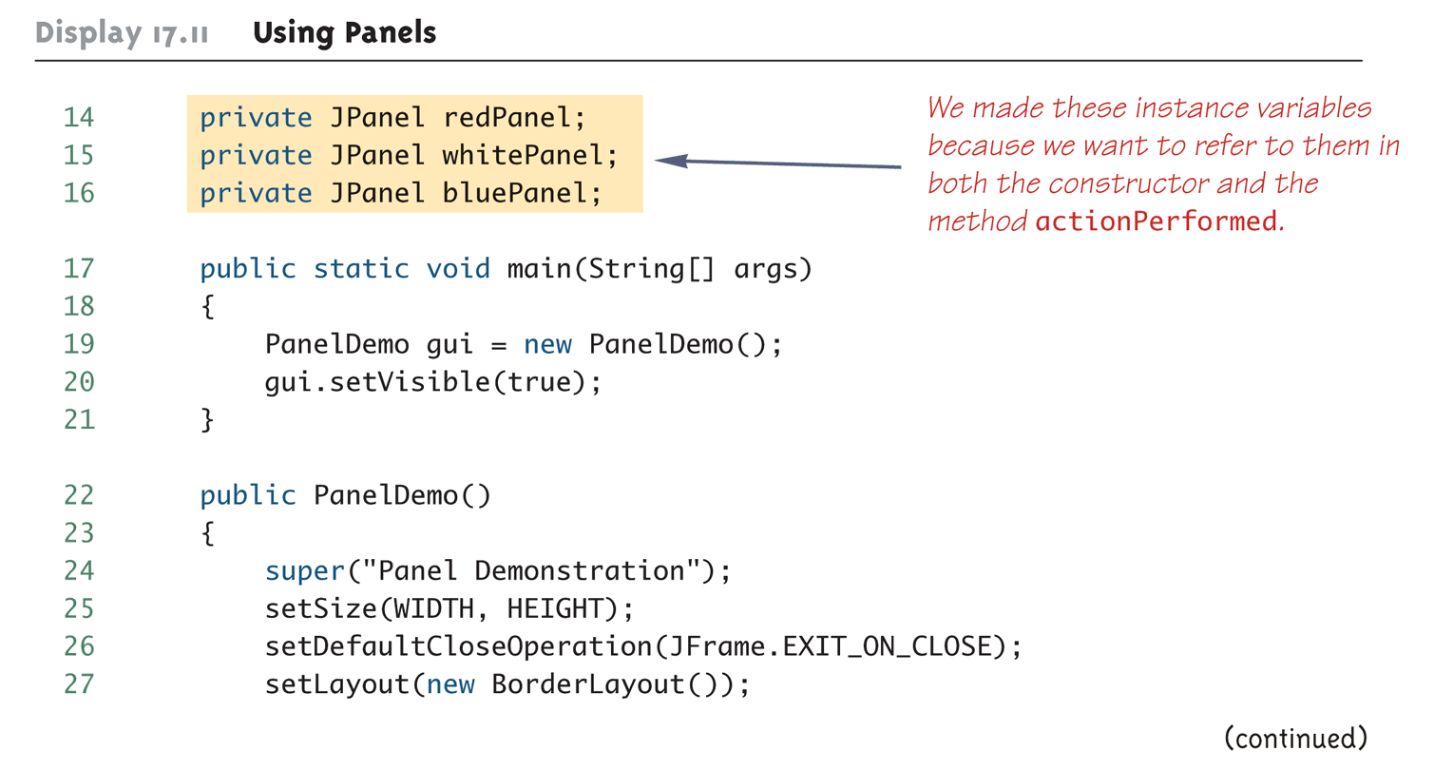
Using Panels (Part 2 of 8)

Slide 59
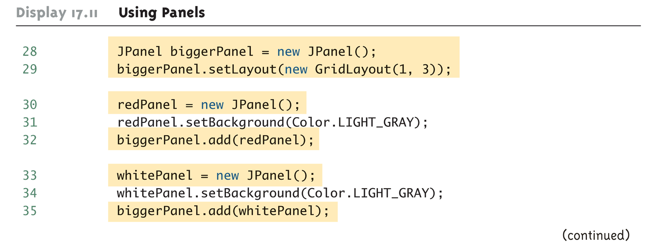
Using Panels (Part 3 of 8)

Slide 60
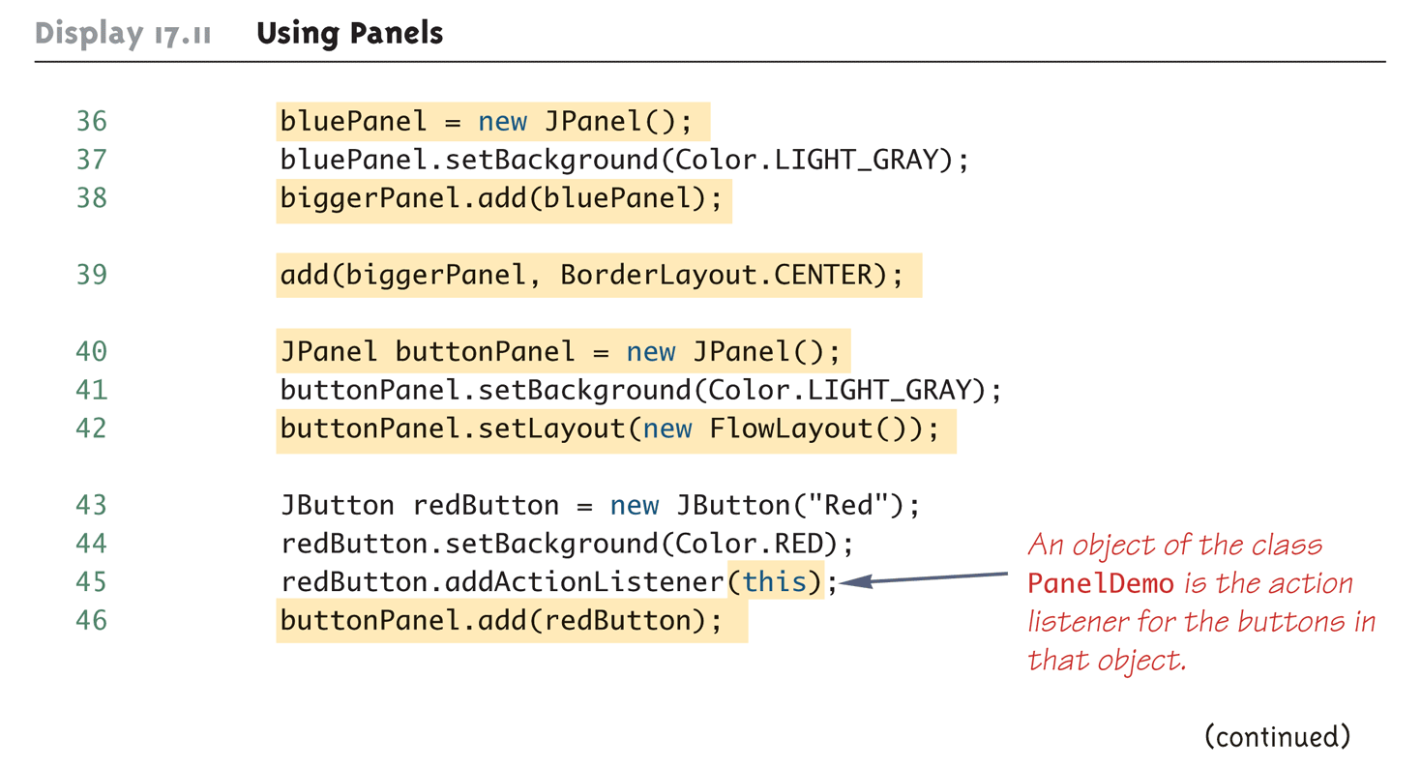
Using Panels (Part 4 of 8)

Slide 61
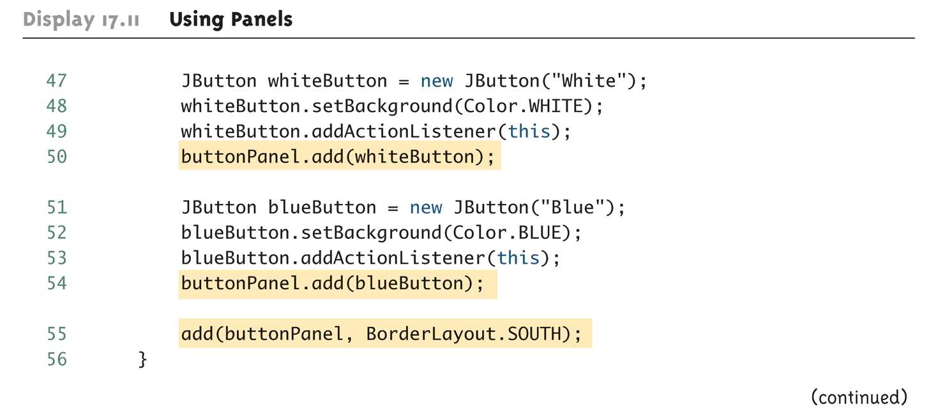
Using Panels (Part 5 of 8)

Slide 62
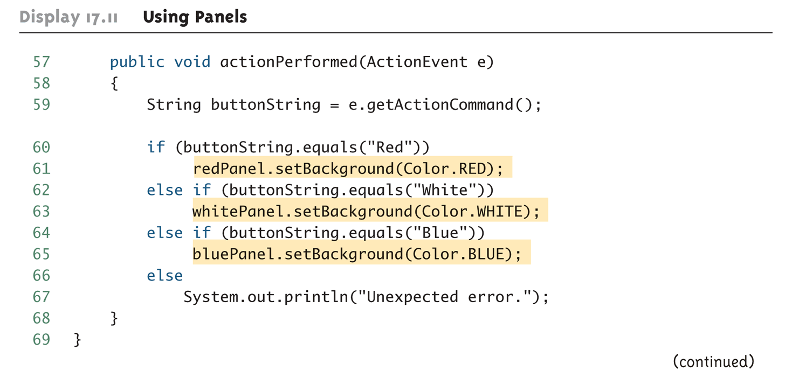
Using Panels (Part 6 of 8)

Slide 63
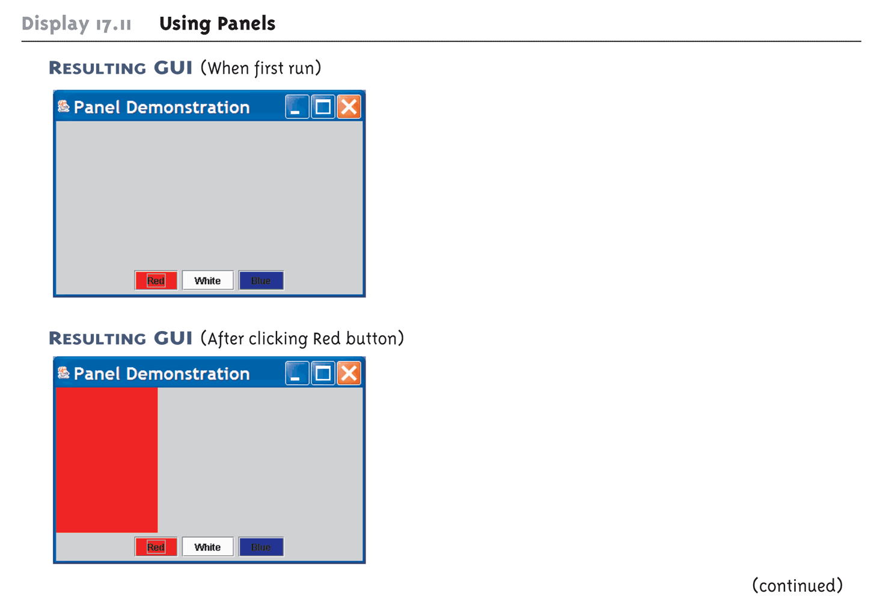
Using Panels (Part 7 of 8)

Slide 64
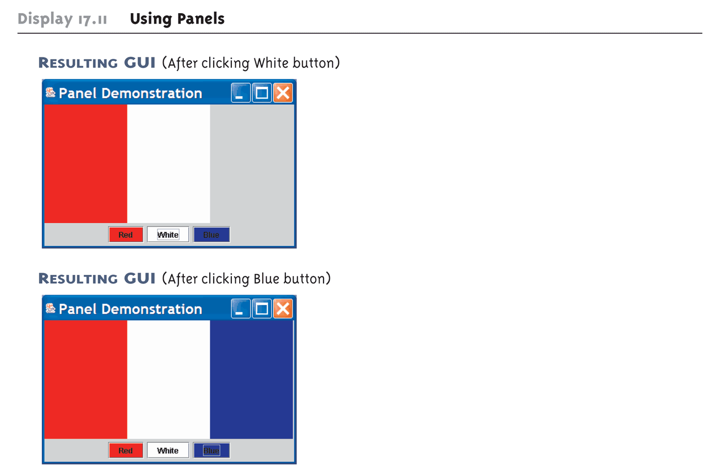
Using Panels (Part 8 of 8)

Slide 65
The Container Class
Any class that is a descendent class of the class Container is considered to be a container class
  The Container class is found in the java.awt package, not in the Swing library
Any object that belongs to a class derived from the Container class (or its descendants) can have components added to it
The classes JFrame and JPanel are descendent classes of the class Container
  Therefore they and any of their descendants can serve as a container

Slide 66
The JComponent Class
Any descendent class of the class JComponent is called a component class
  Any JComponent object or component can be added to any container class object
  Because it is derived from the class Container, a JComponent can also be added to another JComponent

Slide 67
Objects in a Typical GUI
Almost every GUI built using Swing container classes will be made up of three kinds of objects:
  The container itself, probably a panel or window-like object
  The components added to the container such as labels, buttons, and panels
  A layout manager to position the components inside the container

Slide 68
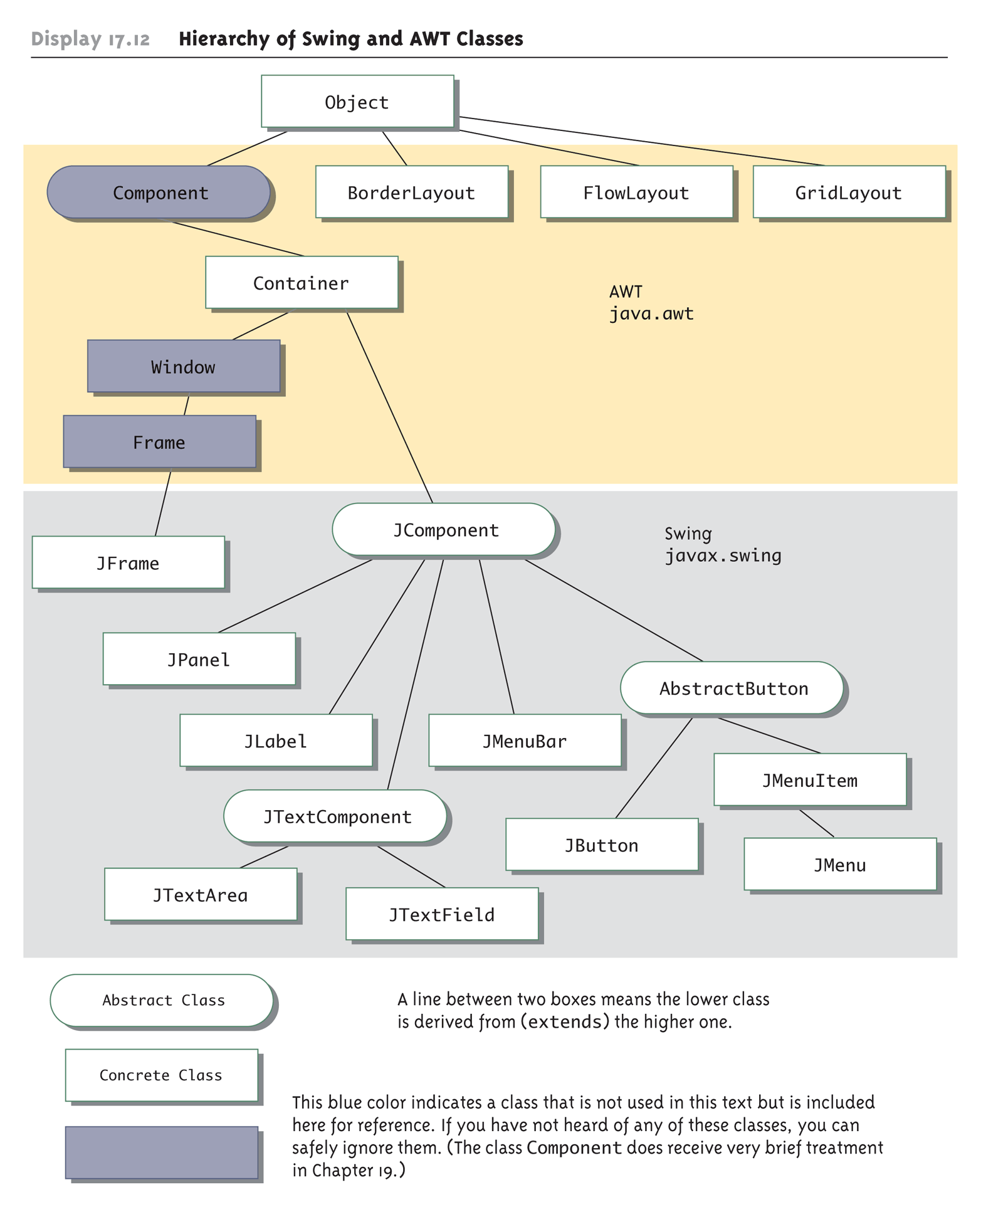
Hierarchy of Swing and AWT Classes

Slide 69
Tip: Code a GUI's Look and Actions Separately
The task of designing a Swing GUI can be divided into two main subtasks:
  Designing and coding the appearance of the GUI on the screen
  Designing and coding the actions performed in response to user actions
In particular, it is useful to implement the actionPerformed method as a stub, until the GUI looks the way it should
    public void actionPerformed(ActionEvent e)
    {}
This philosophy is at the heart of the technique used by the Model-View-Controller pattern

Slide 70
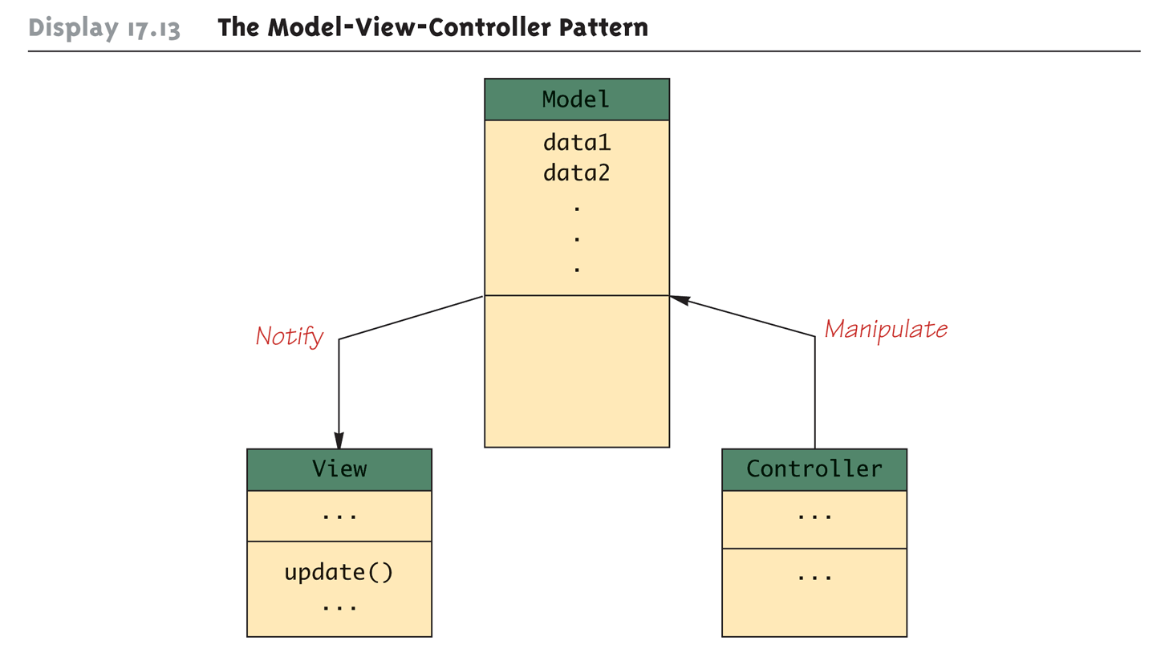
The Model-View-Controller Pattern

Slide 71
Menu Bars, Menus, and Menu Items
A menu is an object of the class JMenu
A choice on a menu is called a menu item, and is an object of the class JMenuItem
  A menu can contain any number of menu items
  A menu item is identified by the string that labels it, and is displayed in the order to which it was added to the menu
The add method is used to add a menu item to a menu in the same way that a component is added to a container object

Slide 72
Menu Bars, Menus, and Menu Items
The following creates a new menu, and then adds a menu item to it
  JMenu diner = new
  JMenu("Daily Specials");
  JMenuItem lunch = new
  JMenuItem("Lunch Specials");
  lunch.addActionListener(this);
  diner.add(lunch);
  Note that the this parameter has been registered as an action listener for the menu item

Slide 73
Nested Menus
The class JMenu is a descendent of the JMenuItem class
  Every JMenu can be a menu item in another menu
  Therefore, menus can be nested
Menus can be added to other menus in the same way as menu items

Slide 74
Menu Bars and JFrame
A menu bar is a container for menus, typically placed near the top of a windowing interface
The add method is used to add a menu to a menu bar in the same way that menu items are added to a menu
  JMenuBar bar = new JMenuBar();
  bar.add(diner);
The menu bar can be added to a JFrame in two different ways
  Using the setJMenuBar method
    setJMenuBar(bar);
  Using the add method – which can be used to add a menu bar to a JFrame or any other container

Slide 75
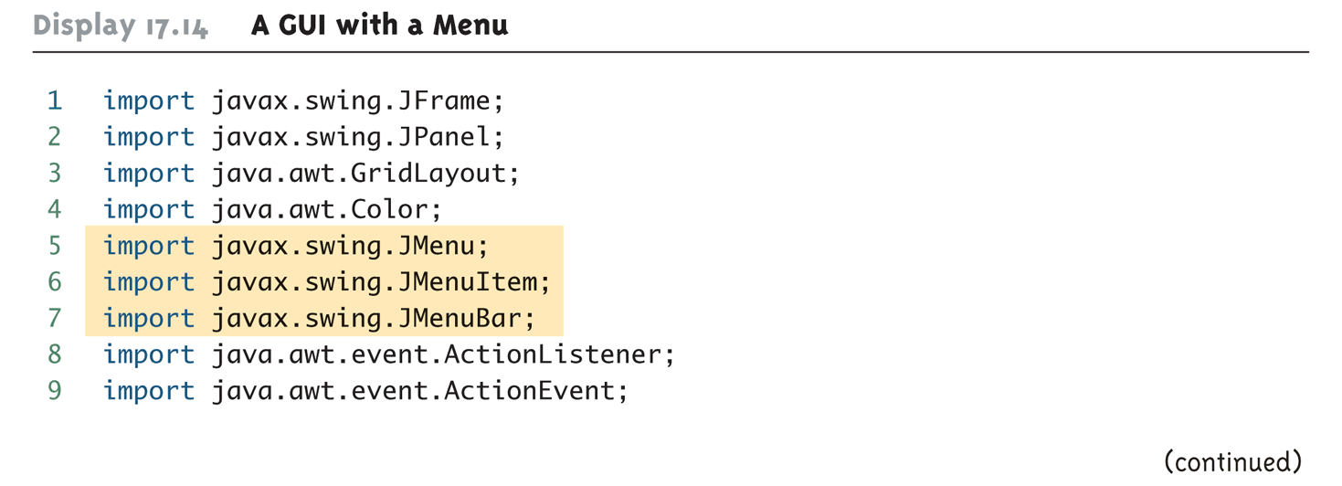
A GUI with a Menu (Part 1 of 8)

Slide 76
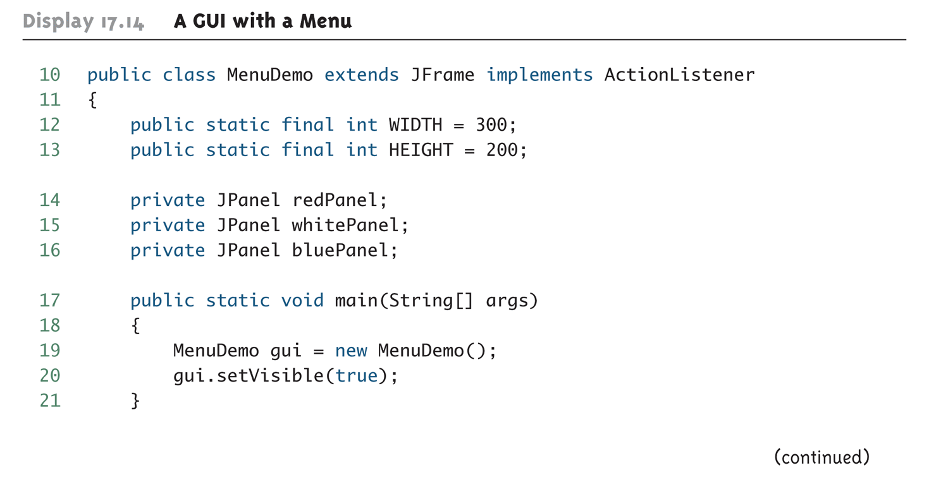
A GUI with a Menu (Part 2 of 8)

Slide 77
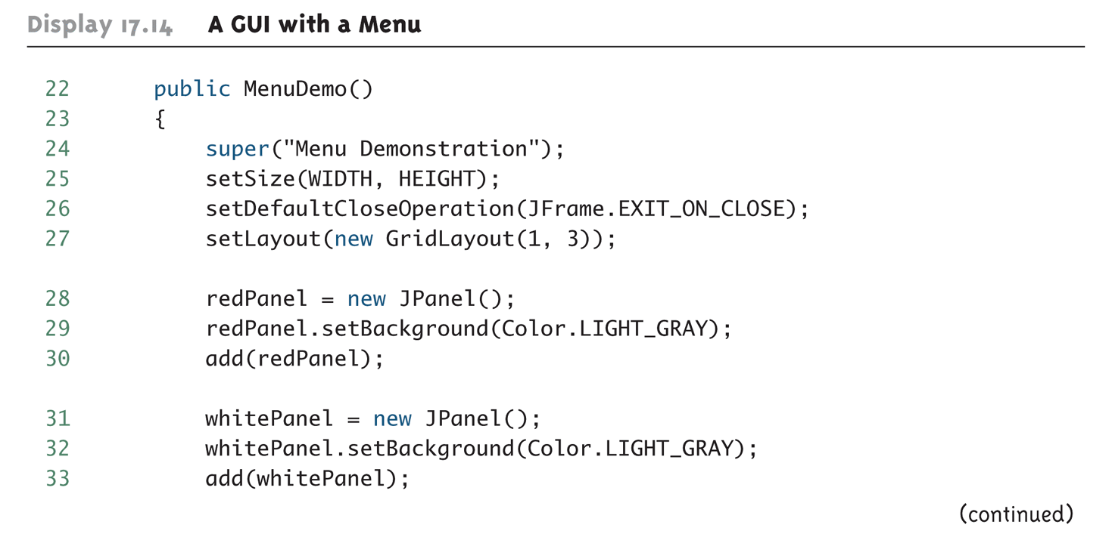
A GUI with a Menu (Part 3 of 8)

Slide 78
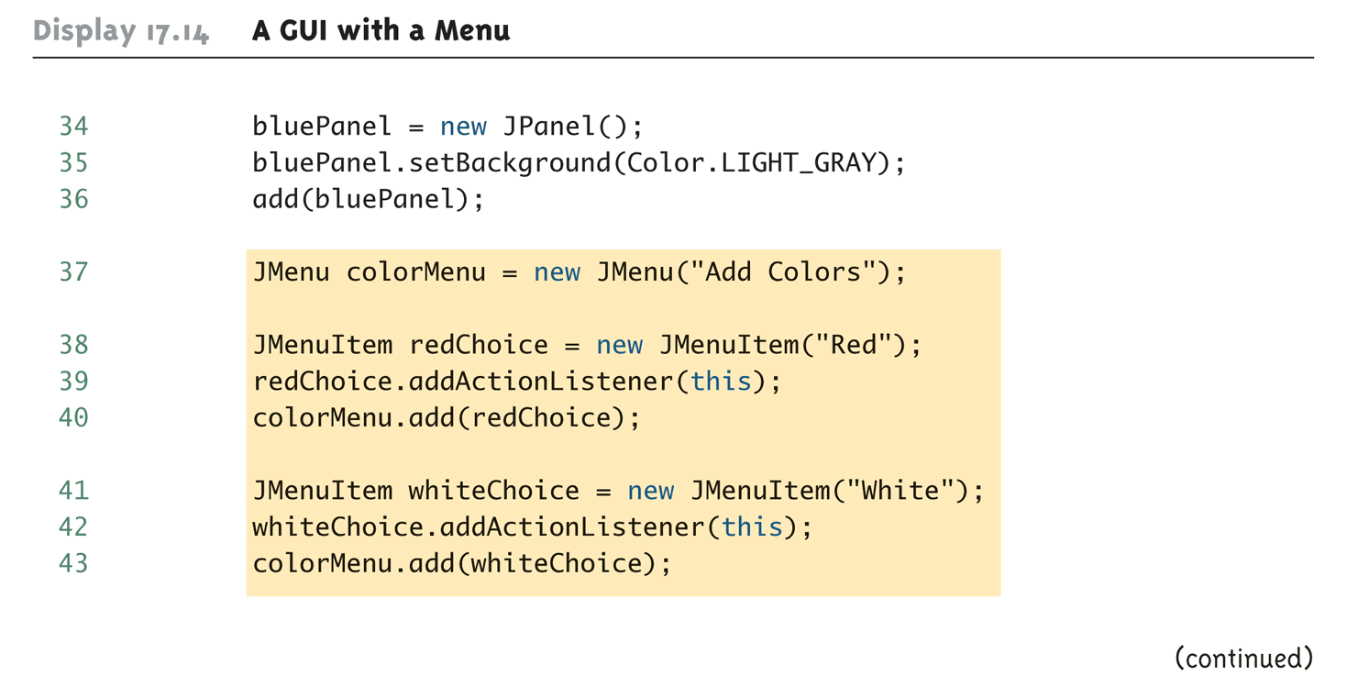
A GUI with a Menu (Part 4 of 8)

Slide 79
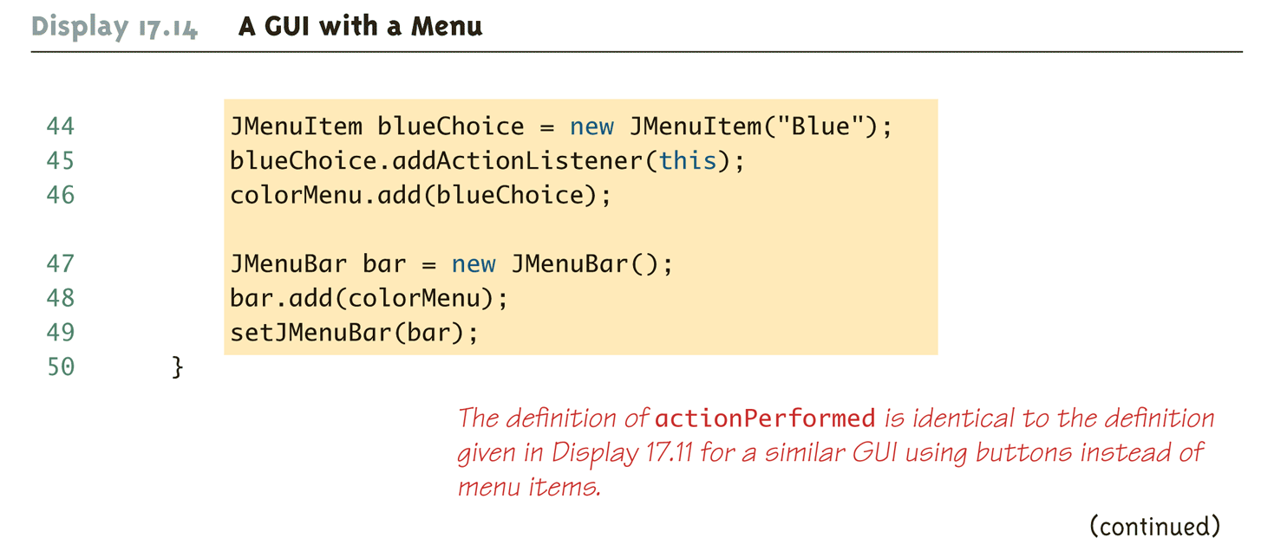
A GUI with a Menu (Part 5 of 8)

Slide 80
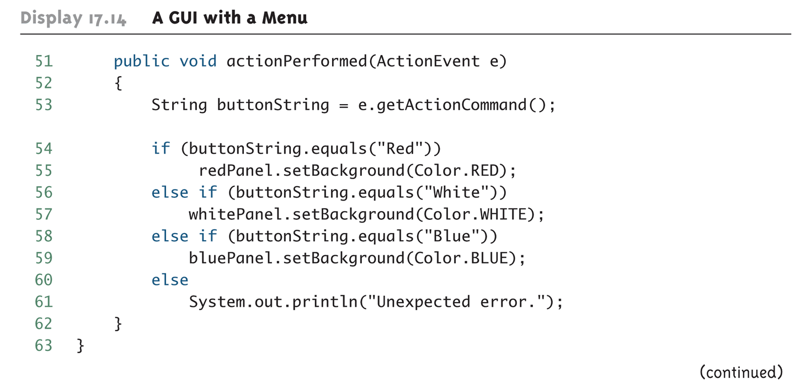
A GUI with a Menu (Part 6 of 8)

Slide 81
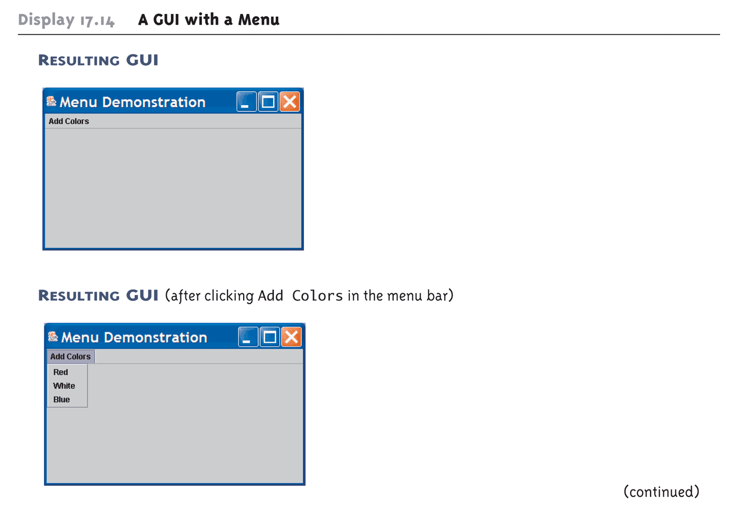
A GUI with a Menu (Part 7 of 8)

Slide 82
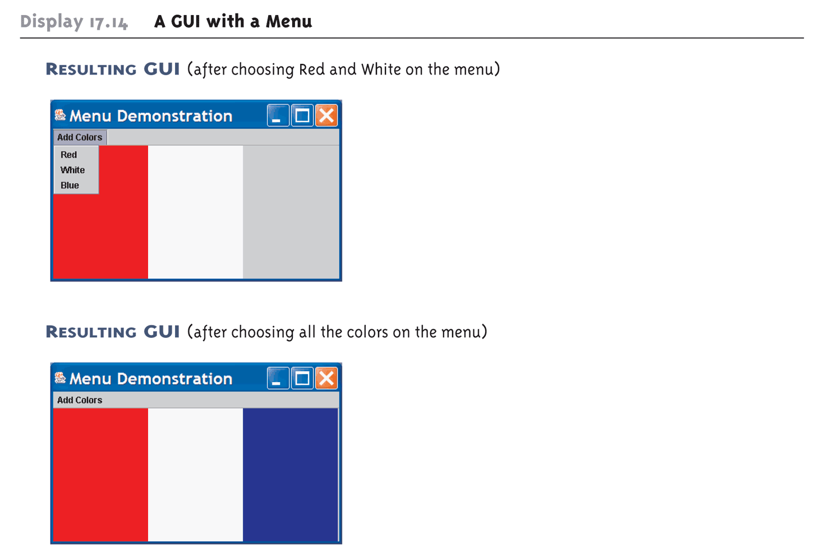
A GUI with a Menu (Part 8 of 8)

Slide 83
The AbstractButton and Dimension Classes
The classes JButton and JMenuItem are derived classes of the abstract class named AbstractButton
  All of their basic properties and methods are inherited from the class AbstractButton
Objects of the Dimension class are used with buttons, menu items, and other objects to specify a size
  The Dimension class is in the package java.awt
    Dimension(int width, int height)
  Note: width and height parameters are in pixels

Slide 84
The setActionCommand Method
When a user clicks a button or menu item, an event is fired that normally goes to one or more action listeners
  The action event becomes an argument to an actionPerformed method
  This action event includes a String instance variable called the action command for the button or menu item
  The default value for this string is the string written on the button or the menu item
  This string can be retrieved with the getActionCommand method
    e.getActionCommand()

Slide 85
The setActionCommand Method
The setActionCommand method can be used to change the action command for a component
  This is especially useful when two or more buttons or menu items have the same default action command strings
    JButton nextButton = new JButton("Next");
    nextButton.setActionCommand("Next Button");
    JMenuItem choose = new JMenuItem("Next");
    choose.setActionCommand("Next Menu Item");

Slide 86
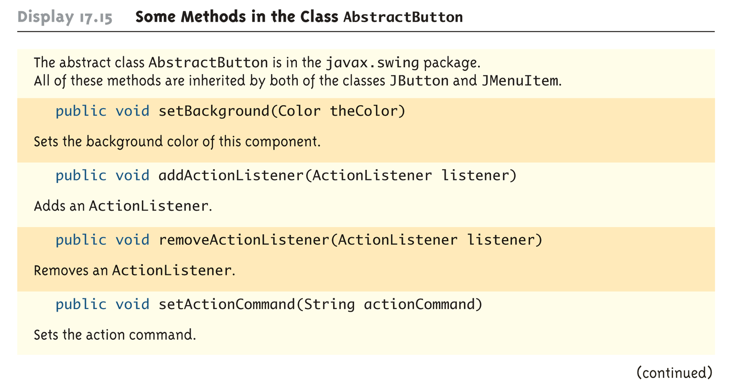
Some Methods in the Class AbstractButton (Part 1 of 3)

Slide 87
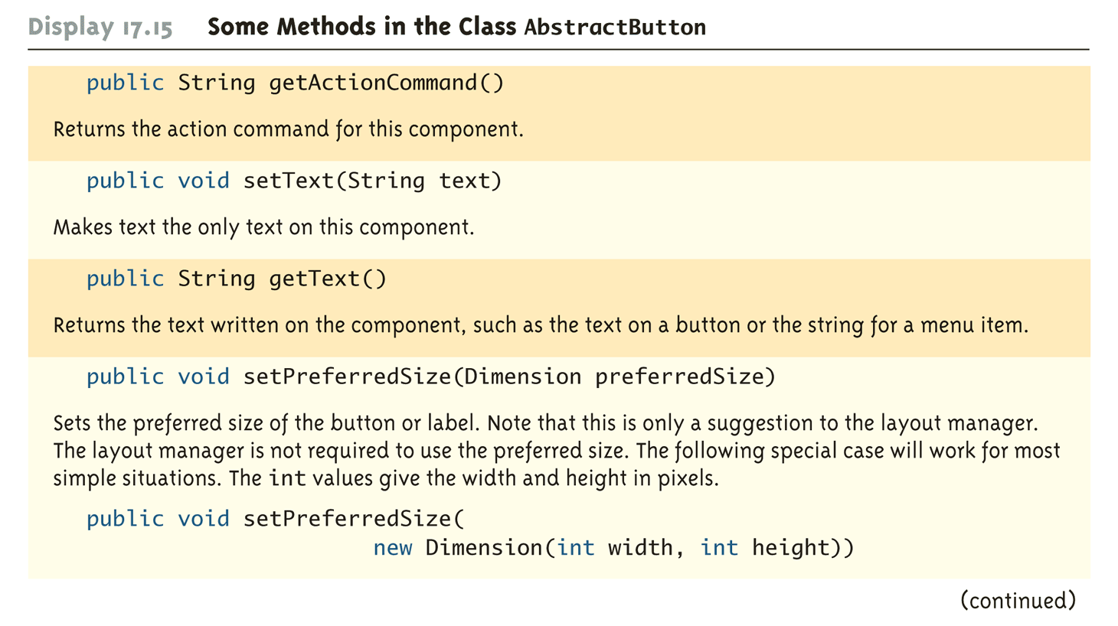
Some Methods in the Class AbstractButton (Part 2 of 3)

Slide 88
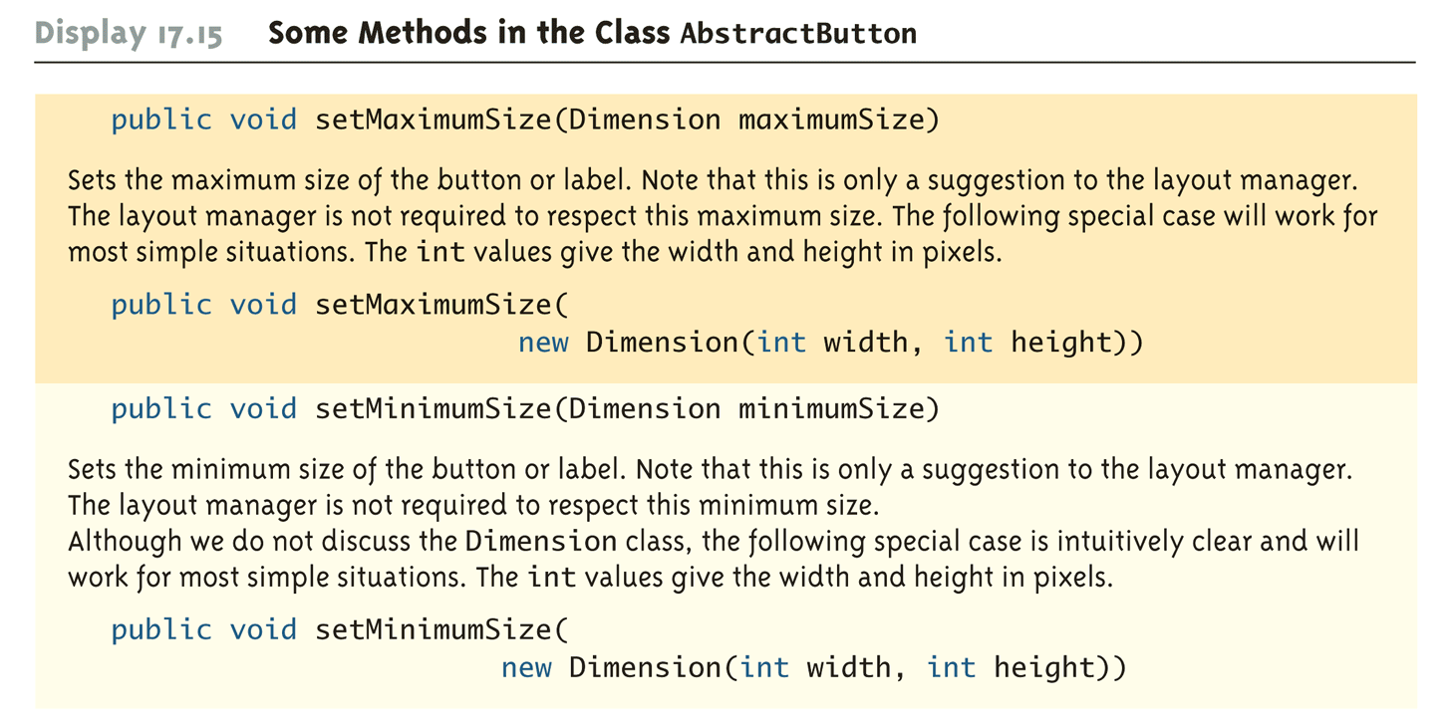
Some Methods in the Class AbstractButton (Part 3 of 3)

Slide 89
Listeners as Inner Classes
Often, instead of having one action listener object deal with all the action events in a GUI, a separate ActionListener class is created for each button or menu item
  Each button or menu item has its own unique action listener
  There is then no need for a multiway if-else statement
When this approach is used, each class is usually made a private inner class

Slide 90
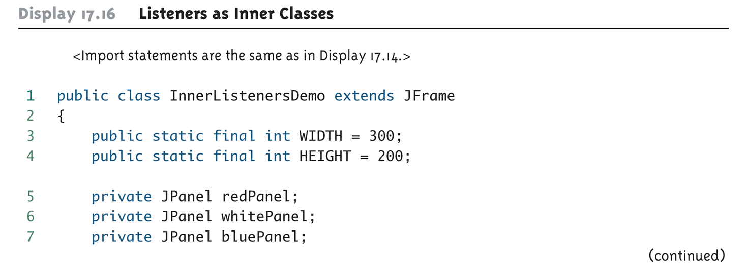
Listeners as Inner Classes (Part 1 of 6)

Slide 91
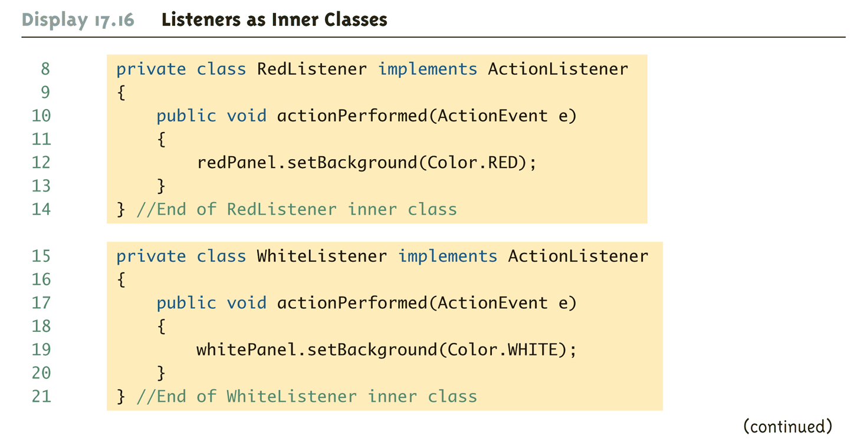
Listeners as Inner Classes (Part 2 of 6)

Slide 92

Listeners as Inner Classes (Part 3 of 6)

Slide 93

Listeners as Inner Classes (Part 4 of 6)

Slide 94

Listeners as Inner Classes (Part 5 of 6)

Slide 95

Listeners as Inner Classes (Part 6 of 6)

Slide 96
Text Fields
A text field is an object of the class JTextField
  It is displayed as a field that allows the user to enter a single line of text
    private JTextField name;
    . . .
    name = new JTextField(NUMBER_OF_CHAR);
  In the text field above, at least NUMBER_OF_CHAR characters can be visible

Slide 97
Text Fields
There is also a constructor with one additional String parameter for displaying an initial String in the text field
  JTextField name = new JTextField(
  "Enter name here.", 30);
A Swing GUI can read the text in a text field using the getText method
  String inputString = name.getText();
The method setText can be used to display a new text string in a text field
  name.setText("This is some output");

Slide 98

A Text Field (Part 1 of 7)

Slide 99

A Text Field (Part 2 of 7)

Slide 100

A Text Field (Part 3 of 7)

Slide 101

A Text Field (Part 4 of 7)

Slide 102

A Text Field (Part 5 of 7)

Slide 103

A Text Field (Part 6 of 7)

Slide 104

A Text Field (Part 7 of 7)

Slide 105
Text Areas
A text area is an object of the class JTextArea
  It is the same as a text field, except that it allows multiple lines
  Two parameters to the JTextArea constructor specify the minimum number of lines, and the minimum number of characters per line that are guaranteed to be visible
    JTextArea theText = new JTextArea(5,20);
  Another constructor has one addition String parameter for the string initially displayed in the text area
    JTextArea theText = new JTextArea(
    "Enter\ntext here." 5, 20);

Slide 106
Text Areas
The line-wrapping policy for a JTextArea can be set using the method setLineWrap
  The method takes one boolean type argument
  If the argument is true, then any additional characters at the end of a line will appear on the following line of the text area
  If the argument is false, the extra characters will remain on the same line and not be visible
    theText.setLineWrap(true);

Slide 107
Text Fields and Text Areas
A JTextField or JTextArea can be set so that it can not be changed by the user
    theText.setEditable(false);
  This will set theText so that it can only be edited by the GUI program, not the user
  To reverse this, use true instead (this is the default)
    theText.setEditable(true);

Slide 108
Tip: Labeling a Text Field
In order to label one or more text fields:
  Use an object of the class JLabel
  Place the text field(s) and label(s) in a JPanel
  Treat the JPanel as a single component

Slide 109
Numbers of Characters Per Line
The number of characters per line for a JTextField or JTextArea object is the number of em spaces
An em space is the space needed to hold one uppercase letter M
  The letter M is the widest letter in the alphabet
  A line specified to hold 20 M 's will almost always be able to hold more than 20 characters

Slide 110
Tip: Inputting and Outputting Numbers
When attempting to input numbers from any Swing GUI, input text must be converted to numbers
  If the user enters the number 42 in a JTextField, the program receives the string "42" and must convert it to the integer 42
The same thing is true when attempting to output a number
  In order to output the number 42, it must first be converted to the string "42"

Slide 111
The Class JTextComponent
Both JTextField and JTextArea are derived classes of the abstract class JTextComponent
Most of their methods are inherited from JTextComponent and have the same meanings
  Except for some minor redefinitions to account for having just one line or multiple lines

Slide 112

Some Methods in the Class JTextComponent (Part 1 of 2)

Slide 113

Some Methods in the Class JTextComponent (Part 2 of 2)

Slide 114
A Swing Calculator
A GUI for a simple calculator keeps a running total of numbers
  The user enters a number in the text field, and then clicks either + or –
  The number in the text field is then added to or subtracted from the running total, and displayed in the text field
  This value is kept in the instance variable result
  When the GUI is first run, or when the user clicks the Reset button, the value of result is set to zero

Slide 115
A Swing Calculator
If the user enters a number in an incorrect format, then one of the methods throws a NumberFormatException
  The exception is caught in the catch block inside the actionPerformed method
  Note that when this exception is thrown, the value of the instance variable result is not changed

Slide 116

A Simple Calculator (Part 1 of 11)

Slide 117

A Simple Calculator (Part 2 of 11)

Slide 118

A Simple Calculator (Part 3 of 11)

Slide 119

A Simple Calculator (Part 4 of 11)

Slide 120

A Simple Calculator (Part 5 of 11)

Slide 121

A Simple Calculator (Part 6 of 11)

Slide 122

A Simple Calculator (Part 7 of 11)

Slide 123

A Simple Calculator (Part 8 of 11)

Slide 124

A Simple Calculator (Part 9 of 11)

Slide 125

A Simple Calculator (Part 10 of 11)

Slide 126

A Simple Calculator (Part 11 of 11)

Slide 127
Uncaught Exceptions
In a Swing program, throwing an uncaught exception does not end the GUI
  However, it may leave it in an unpredictable state
It is always best to catch any exception that is thrown even if all the catch block does is output an error message, or ask the user to reenter some input

