Slide 1

Chapter 19
Java
Never Ends
Slides prepared by Rose Williams, Binghamton University
Kenrick Mock, University of Alaska Anchorage
Copyright © 2016 Pearson Inc. All rights reserved.

Slide 2
Multithreading
In Java, programs can have multiple threads
  A thread is a separate computation process
Threads are often thought of as computations that run in parallel
  Although they usually do not really execute in parallel
  Instead, the computer switches resources between threads so that each one does a little bit of computing in turn
Modern operating systems allow more than one program to run at the same time
  An operating system uses threads to do this

Slide 3
Thread.sleep
Thread.sleep is a static method in the class Thread that pauses the thread that includes the invocation
  It pauses for the number of milliseconds given as an argument
  Note that it may be invoked in an ordinary program to insert a pause in the single thread of that program
It may throw a checked exception, InterruptedException, which must be caught or declared
  Both the Thread and InterruptedException classes are in the package java.lang

Slide 4
The getGraphics Method
The method getGraphics is an accessor method that returns the associated Graphics object of its calling object
  Every JComponent has an associated Graphics object
    Component.getGraphics();

Slide 5
A Nonresponsive GUI
The following program contains a simple GUI that draws circles one after the other when the "Start" button is clicked
  There is a 1/10 of a second pause between drawing each circle
If the close-window button is clicked, nothing happens until the program is finished drawing all its circles
Note the use of the Thread.sleep (in the method doNothing) and getGraphics (in the method fill) methods

Slide 6
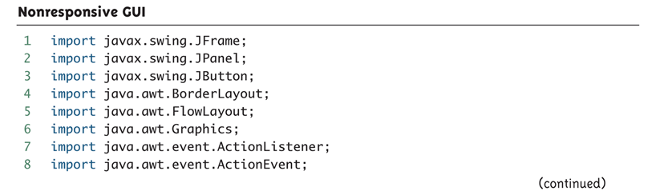
Nonresponsive GUI (Part 1 of 9)

Slide 7
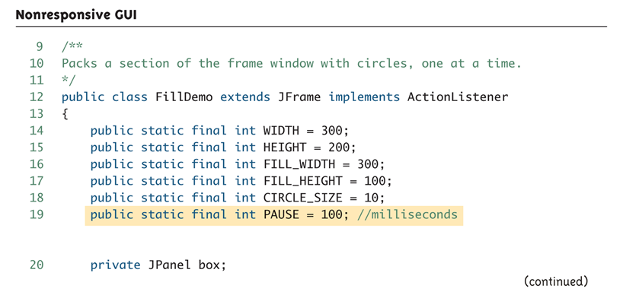
Nonresponsive GUI (Part 2 of 9)

Slide 8
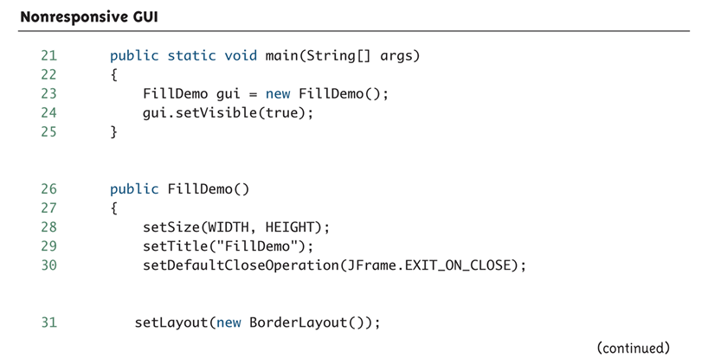
Nonresponsive GUI (Part 3 of 9)

Slide 9
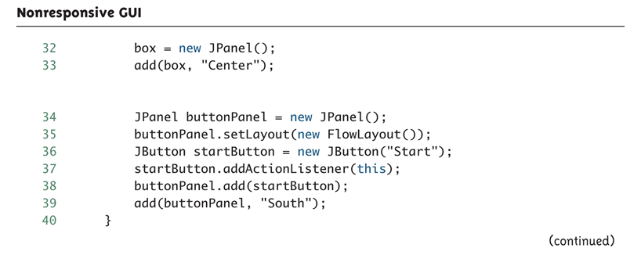
Nonresponsive GUI (Part 4 of 9)

Slide 10
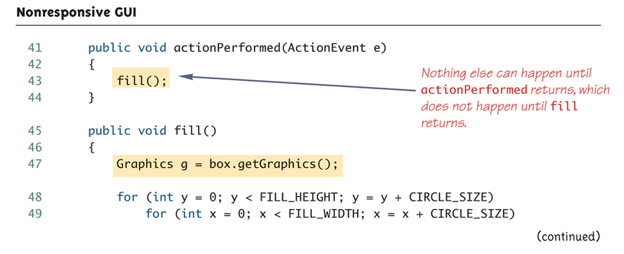
Nonresponsive GUI (Part 5 of 9)

Slide 11
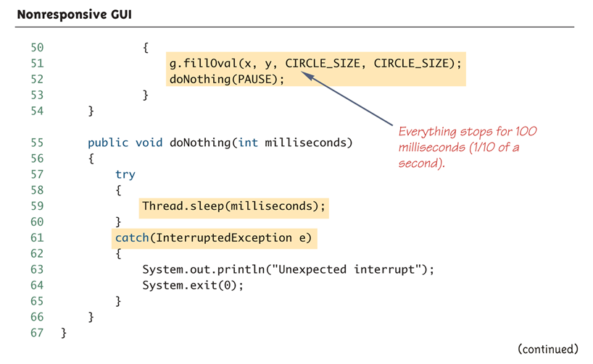
Nonresponsive GUI (Part 6 of 9)

Slide 12
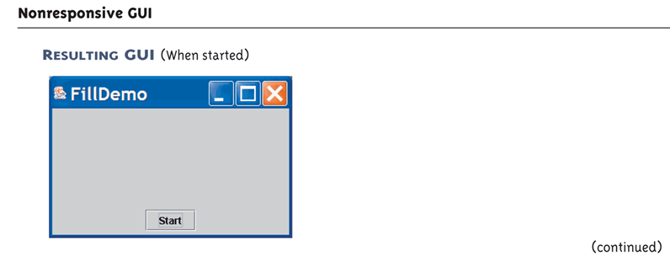
Nonresponsive GUI (Part 7 of 9)

Slide 13
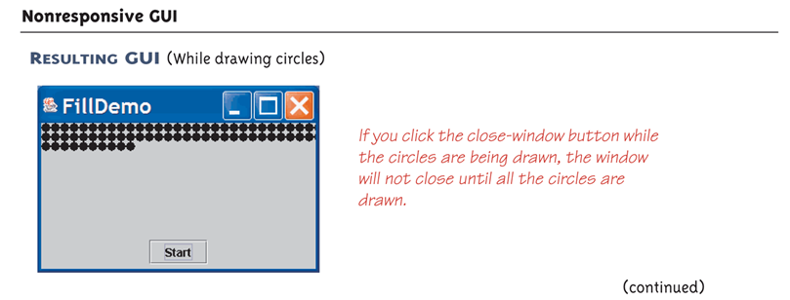
Nonresponsive GUI (Part 8 of 9)

Slide 14
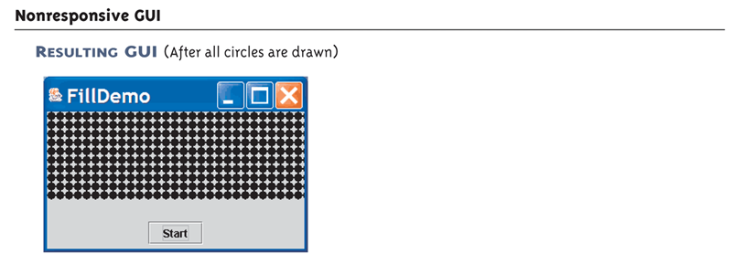
Nonresponsive GUI (Part 9 of 9)
Java is fun:
Use the values below in your code and see the result of drawing:
int x = y ;
x < y
fillOval (x,x)
g.fillOval(x, y+x)
g.fillOval (y, y )

Slide 15
Fixing a Nonresponsive Program Using Threads
This is why the close-window button does not respond immediately:
  Because the method fill is invoked in the body of the method actionPerformed, the method actionPerformed does not end until after the method fill ends
  Therefore, the method actionPerformed does not end until after the method fill ends
  Until the method actionPerformed ends, the GUI cannot respond to anything else

Slide 16
Fixing a Nonresponsive Program Using Threads
This is how to fix the problem:
  Have the actionPerformed method create a new (independent) thread to draw the circles
  Once created, the new thread will be an independent process that proceeds on its own
  Now, the work of the actionPerformed method is ended, and the main thread (containing actionPerformed) is ready to respond to something else
  If the close-window button is clicked while the new thread draws the circles, then the program will end

Slide 17
The Class Thread
In Java, a thread is an object of the class Thread
Usually, a derived class of Thread is used to program a thread
  The methods run and start are inherited from Thread
  The derived class overrides the method run to program the thread
  The method start initiates the thread processing and invokes the run method

Slide 18
A Multithreaded Program that Fixes a Nonresponsive GUI
The following program uses a main thread and a second thread to fix the nonresponsive GUI
  It creates an inner class Packer that is a derived class of Thread
  The method run is defined in the same way as the previous method fill
  Instead of invoking fill, the actionPerformed method now creates an instance of Packer, a new independent thread named packerThread
  The packerThread object then invokes its start method
  The start method initiates processing and invokes run

Slide 19
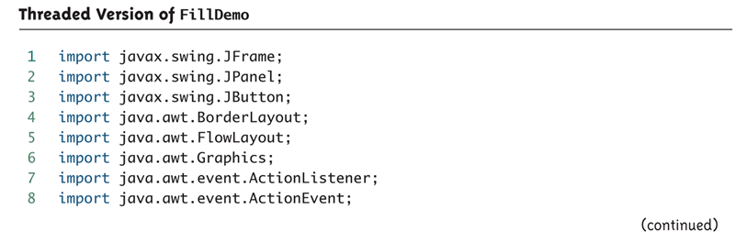
Threaded Version of FillDemo (Part 1 of 6)
The GUI produced is identical to the GUI produced by Display 19.1 except that in this version the close window button works even while the circles are being drawn, so you can end the GUI early if you get bored.

Slide 20
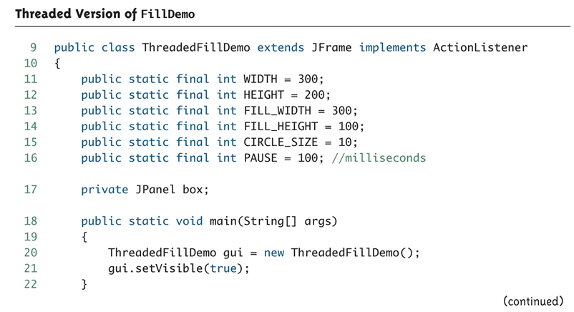
Threaded Version of FillDemo (Part 2 of 6)

Slide 21
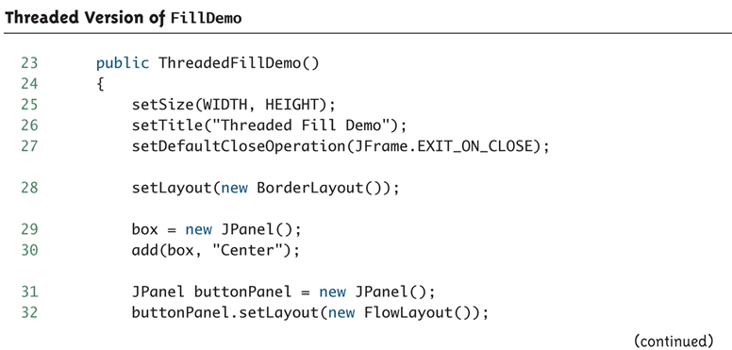
Threaded Version of FillDemo (Part 3 of 6)

Slide 22
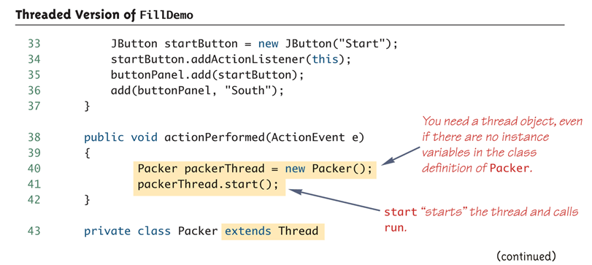
Threaded Version of FillDemo (Part 4 of 6)

Slide 23
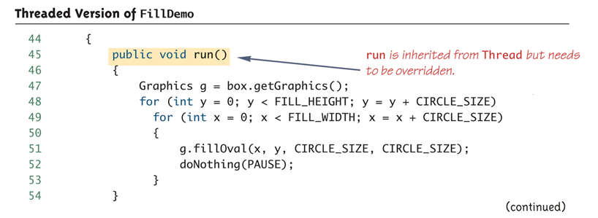
Threaded Version of FillDemo (Part 5 of 6)

Slide 24
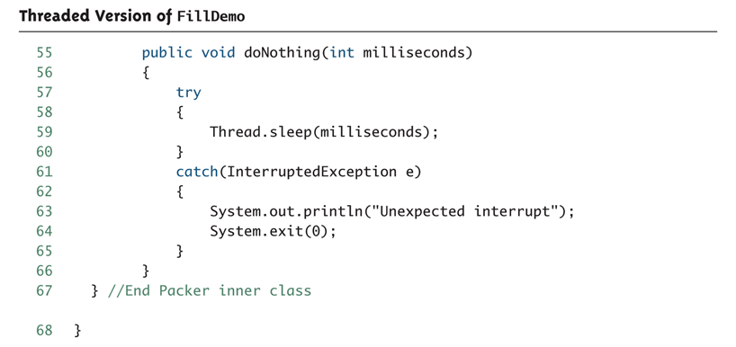
Threaded Version of FillDemo (Part 6 of 6)

Slide 25
The Runnable Interface
Another way to create a thread is to have a class implement the Runnable interface
  The Runnable interface has one method heading:
    public void run();
A class that implements Runnable must still be run from an instance of Thread
  This is usually done by passing the Runnable object as an argument to the thread constructor

Slide 26
The Runnable Interface: Suggested Implementation Outline
public class ClassToRun extends SomeClass implements Runnable
{ . . .
public void run()
{
// Fill this as if ClassToRun
// were derived from Thread
}
. . .
public void startThread()
{
Thread theThread = new Thread(this);
theThread.run();
}
. . .
}

Slide 27
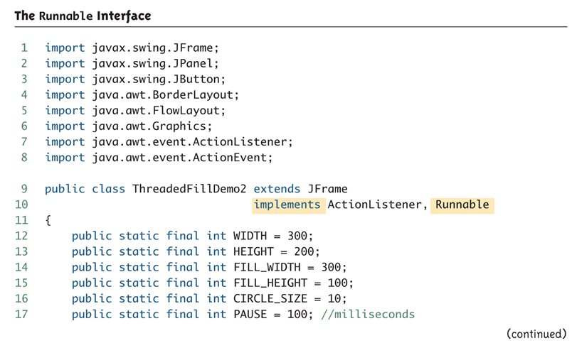
The Runnable Interface (Part 1 of 5)

Slide 28
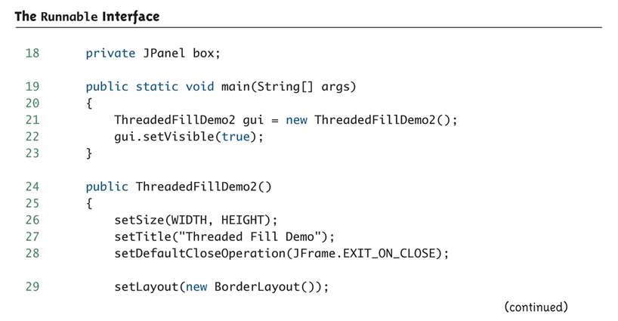
The Runnable Interface (Part 2 of 5)

Slide 29
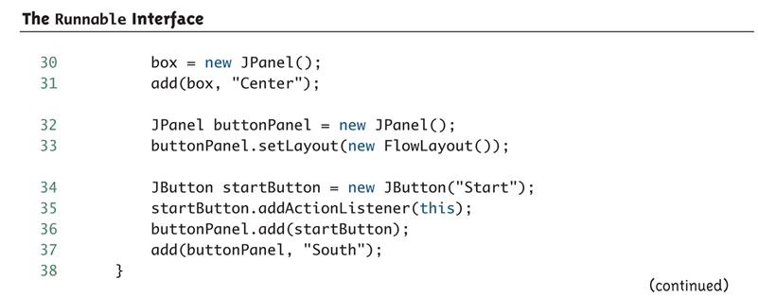
The Runnable Interface (Part 3 of 5)

Slide 30
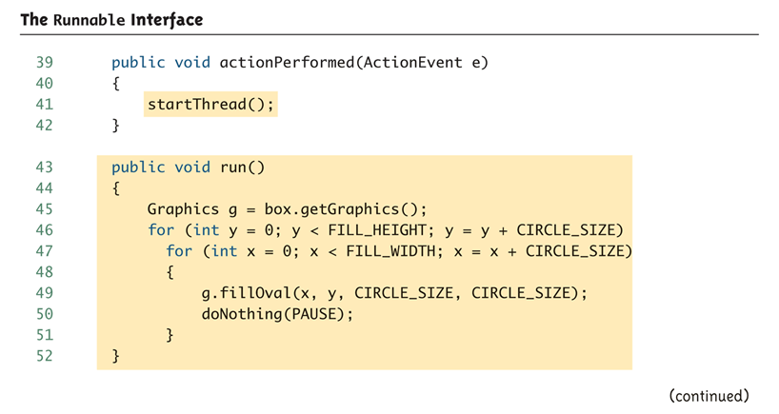
The Runnable Interface (Part 4 of 5)

Slide 31
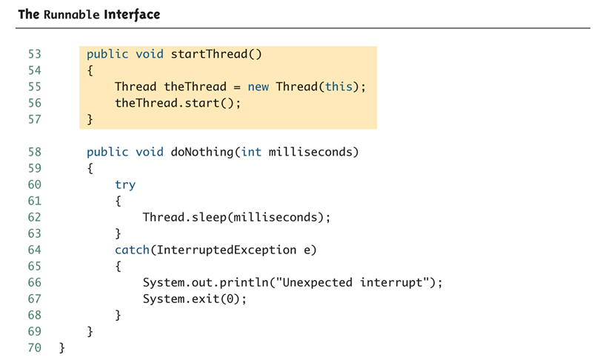
The Runnable Interface (Part 5 of 5)

Slide 32
Race Conditions
When multiple threads change a shared variable it is sometimes possible that the variable will end up with the wrong (and often unpredictable) value.
This is called a race condition because the final value depends on the sequence in which the threads access the shared value.
We will use the Counter class to demonstrate a race condition.

Slide 33
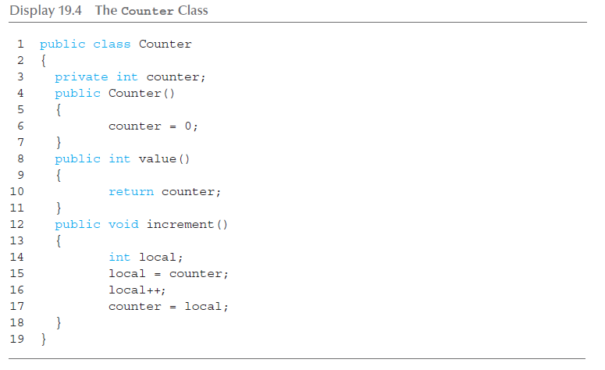
Counter Class

Slide 34
Race Condition Example
Create a single instance of the Counter class.
Create an array of many threads (30,000 in the example) where each thread references the single instance of the Counter class.
Each thread runs and invokes the increment() method.
Wait for each thread to finish and then output the value of the counter. If there were no race conditions then its value should be 30,000. If there were race conditions then the value will be less than 30,000.

Slide 35
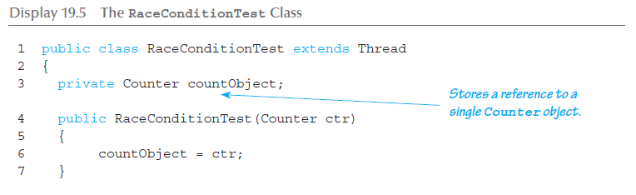
Race Condition Test Class (1 of 3)

Slide 36
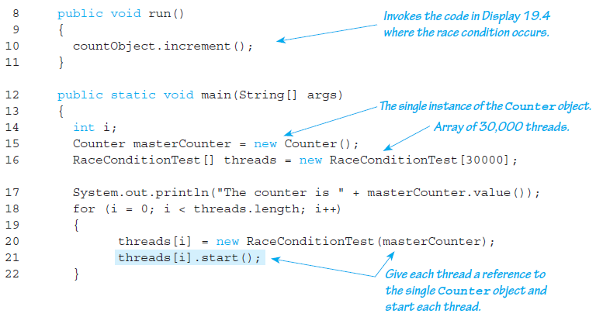
Race Condition Test Class (2 of 3)

Slide 37
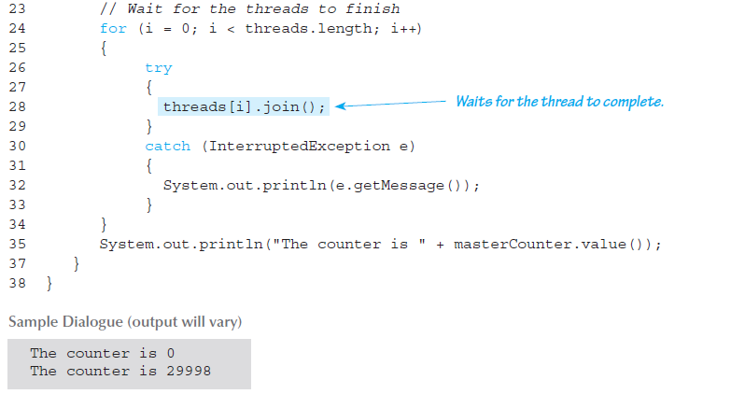
Race Condition Test Class (3 of 3)

Slide 38
Thread Synchronization
The solution is to make each thread wait so only one thread can run the code in increment() at a time.
This section of code is called a critical region . Java allows you to add the keyword synchronized around a critical region to enforce that only one thread can run this code at a time.

Slide 39
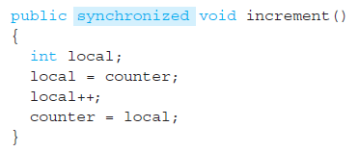
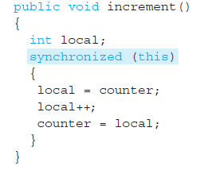
Synchronized
Two solutions:

Slide 40
Networking with Stream Sockets
Transmission Control Protocol – TCP
  Most common network protocol on the Internet
  Called a reliable protocol because it guarantees that data sent from the sender is received in the same order it is sent
Server
  Program waiting to receive input
Client
  Program that initiates a connection to the server

Slide 41
Sockets
A socket describes one end of the connection between two programs over the network. It consists of:
  An address that identifies the remote computer, e.g. IP Address
  A port for the local and remote computer
    Number between 0 and 65535
    Identifies the program that should handle data received by the network
    Only one program may bind to a port
    Ports 0 to 1024 are reserved for the operating system

Slide 42
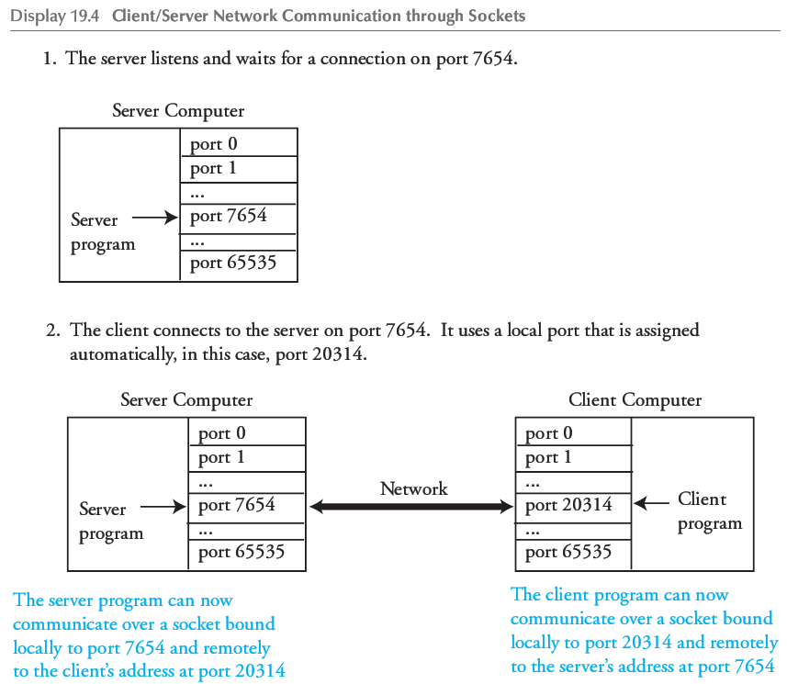
Client/Server Socket Example

Slide 43
Sockets Programming
Very similar to File I/O using a FileOutputStream but instead we substitute a DataOutputStream
We can use localhost as the name of the local machine
Socket and stream objects throw checked exceptions
  We must catch them

Slide 44
Date and Time Server (1 of 2)
1 import java.util.Date;
2 import java.net.ServerSocket;
3 import java.net.Socket;
4 import java.io.DataOutputStream;
5 import java.io.BufferedReader;
6 import java.io.InputStreamReader;
7 import java.io.IOException;
8 public class DateServer
9 {
10 public static void main(String[] args)
11 {
12 Date now = new Date( );
13 try
14 {
15 System.out.println("Waiting for a connection on port 7654.");
16 ServerSocket serverSock = new ServerSocket(7654);
17 Socket connectionSock = serverSock.accept( );
18 BufferedReader clientInput = new BufferedReader(
19 new InputStreamReader(connectionSock.getInputStream( )));
20 DataOutputStream clientOutput = new DataOutputStream(
21 connectionSock.getOutputStream( ));

Slide 45
Date and Time Server (2 of 2)
22 System.out.println("Connection made, waiting for client " +
23 "to send their name.");
24 String clientText = clientInput.readLine( );
25 String replyText = "Welcome, " + clientText +
26 ", Today is " + now.toString( ) + "\n";
27 clientOutput.writeBytes(replyText);
28 System.out.println("Sent: " + replyText);
29 clientOutput.close( );
30 clientInput.close( );
31 connectionSock.close( );
32 serverSock.close( );
33 }
34 catch (IOException e)
35 {
System.out.println(e.getMessage( ));
36 }
37 }
38 }
SAMPLE dialogue (After client connects to server)
Waiting for a connection on port 7654.
Connection made, waiting for client to send their name.
Sent: Welcome, Dusty Rhodes, Today is Fri Oct 13 03:03:21 AKDT 2006

Slide 46
Date and Time Client (1 of 2)
1 import java.net.Socket;
2 import java.io.DataOutputStream;
3 import java.io.BufferedReader;
4 import java.io.InputStreamReader;
5 import java.io.IOException;
6 public class DateClient
7 {
8 public static void main(String[] args)
9 {
10 try
11 {
12 String hostname = "localhost";
13 int port = 7654;
14 System.out.println("Connecting to server on port " + port);
15 Socket connectionSock = new Socket(hostname, port);
16 BufferedReader serverInput = new BufferedReader(
17 new InputStreamReader(connectionSock.getInputStream( )));
18 DataOutputStream serverOutput = new DataOutputStream(
19 connectionSock.getOutputStream( ));

Slide 47
Date and Time Client (2 of 2)
20 System.out.println("Connection made, sending name.");
21 serverOutput.writeBytes("Dusty Rhodes\n");
22 System.out.println("Waiting for reply.");
23 String serverData = serverInput.readLine( );
24 System.out.println("Received: " + serverData);
25 serverOutput.close( );
26 serverInput.close( );
27 connectionSock.close( );
28 }
29 catch (IOException e)
30 {
31 System.out.println(e.getMessage( ));
32 }
33 }
34 }
SAMPLE dialogue (After client connects to server)
Connecting to server on port 7654
Connection made, sending name.
Waiting for reply.
Received: Welcome, Dusty Rhodes, Today is Fri Oct 13 03:03:21 AKDT 2006

Slide 48
Sockets and Threading
The server waits, or blocks, at the serverSock.accept() call until a client connects.
The client and server block at the readLine() calls if data is not available.
This can cause an unresponsive network program and difficult to handle connections from multiple clients on the server end
The typical solution is to employ threading

Slide 49
Threaded Server
For the server, the accept() call is typically placed in a loop and a new thread created to handle each client connection:
while (true)
{
Socket connectionSock = serverSock.accept( );
ClientHandler handler = new ClientHandler(connectionSock);
Thread theThread = new Thread(handler);
theThread.start( );
}

Slide 50
The URL Class
We can retrieve data from a website in just a few lines of code using the URL class
import java.net.URL;
import java.io.BufferedReader;
import java.io.InputStreamReader;
import java.util.Scanner;
public class ReadURL {
public static void main(String[] args) {
try {
URL website = new URL("http://www.wikipedia.org");
Scanner inputStream = new Scanner(new InputStreamReader(
website.openStream()));
while (inputStream.hasNextLine()) {
String s = inputStream.nextLine();
System.out.println(s);
}
inputStream.close();
}
catch (Exception e) {
System.out.println(e.toString());
}
}
}

Slide 51
JavaBeans
JavaBeans is a framework that facilitates software building by connecting software components from different sources
  Some may be standard
  Others may be designed for a particular application
Components built using this framework are more easily integrated and reused

Slide 52
The JavaBeans Model
Software components (i.e., classes) that follow the JavaBeans model are required to provide the following interface services or abilities:
  Rules to ensure consistency in writing interfaces:
    For example, all accessor methods must begin with get, and all mutator methods must begin with set
    This is required, not optional
  An event handling model:
    Essentially, the event-handling model for the AWT and Swing

Slide 53
The JavaBeans Model
  Persistence:
    A component (such as a JFrame) can save its state (e.g., in a database), and therefore retain information about its former use
  Introspection:
    An enhancement of simple accessor and mutator methods that includes means to find what access to a component is available, as well as providing access
  Builder support:
    Integrated Development Environments (IDEs) designed to connect JavaBean components to produce a final application (e.g., Sun's Bean Builder)

Slide 54
JavaBeans and Enterprise JavaBeans
A JavaBean (often called a JavaBean component or just a Bean) is a reusable software component that satisfies the requirements of the JavaBeans framework
  It can be manipulated in an IDE designed for building applications out of Beans
The Enterprise JavaBean framework extends the JavaBeans framework to more readily accommodate business applications

Slide 55
Java and Database Connections: SQL
Structured Query Language (SQL) is a language for formulating queries for a relational database
  SQL is not a part of Java, but Java has a library (JDBC) that allows SQL commands to be embedded in Java code
SQL works with relational databases
  Most commercial database management systems are relational databases

Slide 56
Java and Database Connections: SQL
A relational database can be thought of as a collection of named tables with rows and columns
  Each table relates together certain information, but the same relationship is not repeated in other tables
  However, a piece of information in one table may provide a bridge to another

Slide 57
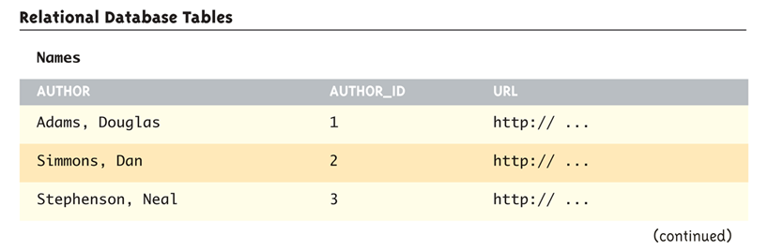
Relational Database Tables (Part 1 of 3)

Slide 58
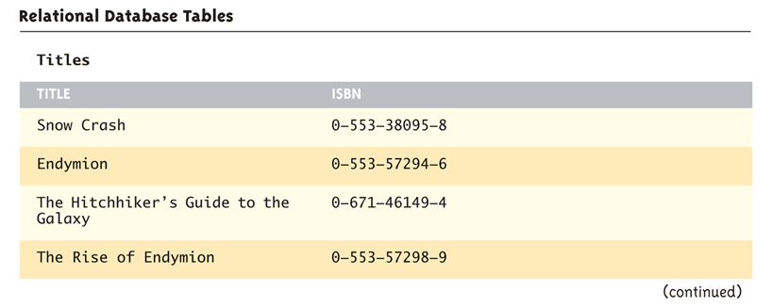
Relational Database Tables (Part 2 of 3)

Slide 59
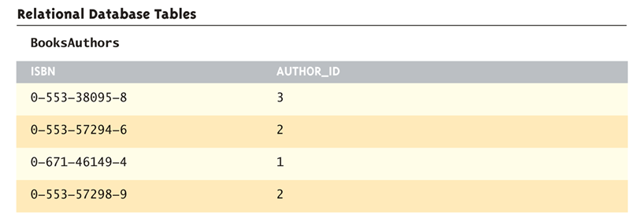
Relational Database Tables (Part 3 of 3)

Slide 60
A Sample SQL Command
The following is a sample SQL command that can be used in conjunction with the tables from the previous slide:
  SELECT Titles.Title, Titles.ISBN, BooksAuthors.Author_ID
  FROM Titles, BooksAuthors
  WHERE Titles.ISBN = BooksAuthors.ISBN
The above command will produce the table shown on the following slide

Slide 61
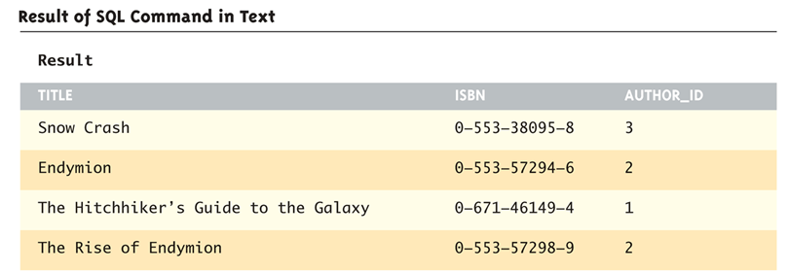
Result of SQL Command in Text

Slide 62
Common SQL Statements (1 of 2)
CREATE TABLE | Create a new table named newtable with fields field1, field2, etc. Data types are similar to Java and include: int, bigint, float, double, and var(size) which is equivalent to a String of maximum length size. | CREATE TABLE newtable (field1 datatype, field2 datatype, ...)
INSERT | Insert a new row into the table tableName where field1 has the value field1Value, field2 has the value field2Value, etc. The data types for the values must match those for the corresponding fields when the table was created. String values should be enclosed in single quotes. | INSERT INTO tableName VALUES (field1Value, field2Value, ...)

Slide 63
Common SQL Statements (2 of 2)
UPDATE | Change the specified fields to the new values for any rows that match the WHERE clause. Op is a comparison operator such as =, <> (not equal to), <, >, etc. | UPDATE tableName SET field1 = newValue, field2 = newValue, ... WHERE fieldName Op someValue
SELECT | Retrieve the specified fields for the rows that match the WHERE clause. The * may be used to retrieve all fields. Omit the WHERE clause to retrieve all rows from the table. | SELECT field1, field2 FROM tableName WHERE fieldname Op someValue

Slide 64
SQL Examples
CREATE TABLE names(author varchar(50), author_id int, url varchar(80))
INSERT INTO names VALUES ('Adams, Douglas', 1, 'http://www.douglasadams.com')
UPDATE names SET url = 'http://www.douglasadams.com/dna/bio.html' WHERE author_id = 1
SELECT author, author_id, url FROM names
SELECT author, author_id, url FROM names WHERE author_id > 1

Slide 65
JDBC
Java Database Connectivity (JDBC) allows SQL commands to be inserted into Java code
  In order to use it, both JDBC and a database system compatible with it must be installed
  A JDBC driver for the database system may need to be downloaded and installed as well
Inside the Java code, a connection to a database system is made, and SQL commands are then executed

Slide 66
Java DB
In the following examples we will use Java DB
  Packaged with version 6 or higher of the Java SDK
  Based on the open source database known as Apache Derby
  See http://www.oracle.com/technetwork/java/javadb/index.html
  Installation may require some configuration
  See instructions that come with Java DB and more detail in the book
Runs in Network Mode or Embedded Mode
  We only use embedded mode here

Slide 67
Data Flow of an Embedded Derby Application

Slide 68
Derby Database Connection and Creation
Steps in accessing a Derby database
  Load the driver
  String driver = "org.apache.derby.jdbc.EmbeddedDriver";
  Class.forName(driver).newInstance( );
  Connect to the database using a Connection String
  Connection conn = null;
  conn =
  DriverManager.getConnection("jdbc:derby:BookDatabase;create=true");
  Issue SQL commands to access or manipulate the database
  Statement s = conn.createStatement();
  s.execute(SQLString);
  Close the connection when done

Slide 69
Derby Database Creation Example (1 of 3)
1 import java.sql.Connection;
2 import java.sql.DriverManager;
3 import java.sql.SQLException;
4 import java.sql.Statement;
5 public class CreateDB
6 {
7 private static final String driver = "org.apache.derby.jdbc.EmbeddedDriver";
8 private static final String protocol = "jdbc:derby:";
9 public static void main(String[] args)
10 {
11 try
12 {
13 Class.forName(driver).newInstance();
14 System.out.println("Loaded the embedded driver.");
15 }
16 catch (Exception err)
17 {
18 System.err.println("Unable to load the embedded driver.");
19 err.printStackTrace(System.err);
20 System.exit(0);
21 }
Loads embedded Derby driver
Must catch ClassNotFoundException, InstantiationException, IllegalAccessException.

Slide 70
Derby Database Creation Example (2 of 3)
Connection String to create the database.
Remove “;create=true” if connecting to an
existing database.
22 String dbName = "BookDatabase";
23 Connection conn = null;
24 try
25 {
26 System.out.println("Connecting to and creating the database...");
27 conn = DriverManager.getConnection(protocol + dbName + ";create=true");
28 System.out.println("Database created.");
29 Statement s = conn.createStatement();
30 s.execute("CREATE TABLE names" +
31 "(author varchar(50), author_id int, url varchar(80))");
32 System.out.println("Created 'names' table.");
Create a table called "names" with three fields, 50 characters for an author, an integer author ID, and 80 characters for a URL

Slide 71
Derby Database Creation Example (3 of 3)
Insert sample data
33 System.out.println("Inserting authors.");
34 s.execute("INSERT INTO names " +
35 "VALUES ('Adams, Douglas', 1, 'http://www.douglasadams.com')");
36 s.execute("INSERT INTO names " +
37 "VALUES ('Simmons, Dan', 2, 'http://www.dansimmons.com')");
38 s.execute("INSERT INTO names " +
39 "VALUES ('Stephenson, Neal', 3, 'http://www.nealstephenson.com')");
40 System.out.println("Authors inserted.");
41 conn.close();
42 }
43 catch (SQLException err)
44 {
45 System.err.println("SQL error.");
46 err.printStackTrace(System.err);
47 System.exit(0);
48 }
49 }
50 }
Catch SQL Error Exceptions
Sample Dialogue
Loaded the embedded driver.
Connecting to and creating the database.
Database created.
Created 'names' table.
Inserting authors.
Authors inserted.

Slide 72
Retrieving Data from Derby
The SELECT statement is used to retrieve data from the database
  Invoke the executeQuery( ) method of a Statement object.
  Returns an object of type ResultSet that maintains a cursor to each matching row in the database.
    Can iterate through the set with a loop

Slide 73
Processing a ResultSet
Initially, the cursor is positioned before the first row.
The next( ) method advances the cursor to the next row. If there is no next row, then false is returned. Otherwise, true is returned.
Use one of following methods to retrieve data from a specific column in the current row :
intVal = resultSet.getInt("name of int field");
lngVal = resultSet.getLong("name of bigint field");
strVal = resultSet.getString("name of varchar field");
dblVal = resultSet.getDouble("name of double field");
fltVal = resultSet.getFloat("name of float field");

Slide 74
Reading from a Derby Database
SQL to retrieve the ID and
Author for all records
// Code to connect to the database
Statement s = conn.createStatement();
ResultSet rs = null;
rs = s.executeQuery("SELECT author, author_id FROM names");
while (rs.next())
{
int id = rs.getInt("author_id");
String author = rs.getString("author“);
System.out.println(id + " " + author);
}
rs.close();
// Above should be in a try/catch block
Loop through and print all records that match the query
Sample Dialogue
1 Adams, Douglas
2 Simmons, Dan
3 Stephenson, Neal

Slide 75
Update Query
Use the execute command for UPDATE queries
Example to change the URL to the contents of the variable newURL for author with ID 1
Statement s = conn.createStatement();
s.execute("UPDATE names SET URL = '" + newURL +
"' WHERE author_id = 1");

Slide 76
More SQL
We have just scratched the surface of what is possible to do with SQL, JDBC, Java DB, etc.
This section covered the basics about how to integrate a database with a Java application
  Refer to database and more advanced Java textbooks to learn more

Slide 77
Web Programming with Java Server Pages
Many technologies exist that allow programs to run within a web browser when visiting a website
Applets
  Run on the client
Servlets
  Compiled Java programs on the server
JSP
  Dynamically compiles to Servlets and integrated with the server

Slide 78
Running a Java Applet

Slide 79
Running a Java Servlet

Slide 80
Running a Java Server Page (JSP) Program

Slide 81
JSP Requirements
Web server capable of running JSP servlets
Here we use the Sun GlassFish Enterprise Server, previously known as the Sun Java System Application Server
  Part of the Java Enterprise Edition SDK
  See instructions that come with the software for installation
    Documents go in <glassfish_home>\domains\domain1\docroot
    Default URL is http://localhost:8080

Slide 82
HTML Forms
The information you enter into an HTML form is transmitted to the web server using a protocol called the Common Gateway Interface (CGI)
Syntax for HTML Form
ACTION identifies the program to execute
  In our case, a JSP program
GET or POST identify how data is transmitted
  GET sends data as the URL, POST over the socket
<FORM ACTION="Path_To_CGI_Program" METHOD="GET or POST">
Form_Elements
</FORM>

Slide 83
Some HTML Form Elements
Input Textbox
Submission Button
Many others form elements exist
  E.g. radio buttons, drop down list, etc.
<INPUT TYPE="TEXT" NAME="Textbox_Name" VALUE="Default_Text"
SIZE="Length_In_Characters"
MAXLENGTH="Maximum_Number_Of_Allowable_Characters">
<INPUT TYPE="SUBMIT" NAME="Name" VALUE="Button_Text">

Slide 84
Example HTML Form Document
(Display 19.16)
<html>
<head>
<title>Change Author's URL</title>
</head>
<body>
<h1>Change Author's URL</h1>
<p>
Enter the ID of the author you would like to change
along with the new URL.
</p>
<form ACTION = "EditURL.jsp" METHOD = POST>
Author ID:
<input TYPE = "TEXT" NAME = "AuthorID"
VALUE = "" SIZE = "4" MAXLENGTH = "4">
<br />
New URL:
<input TYPE = "TEXT" NAME = "URL"
VALUE = "http://" SIZE = "40" MAXLENGTH = "200">
<p>
<INPUT TYPE="SUBMIT" VALUE="Submit">
</p>
</form>
</body>
</html>
Invokes the JSP program named EditURL.jsp. If this program does not exist you will see an error message upon clicking the Submit button.
Creates a TextBox named AuthorID that is empty, displays 4 characters at once, and accepts at most 4 characters.
Creates a submission button

Slide 85
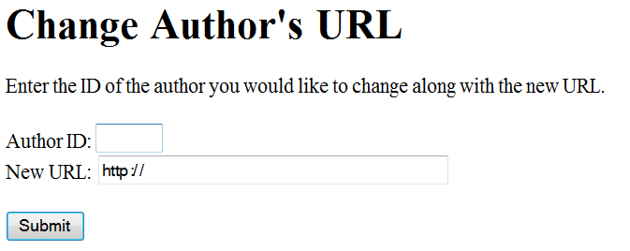
Browser View of HTML Form Document

Slide 86
JSP Tags - Declarations
Declarations
  Use to define variables and methods
  The variables and methods are accessible from any scriptlets and expressions on the same page
  Variable declarations are compiled as instance variables for a class that corresponds to the JSP page
  Syntax:
  <%!
  Declarations
  %>
<%!
private int count = 0;
private void incrementCount()
{
count++;
}
%>
Defines an instance variable named count and a method named incrementCount that increments the count variable

Slide 87
JSP Tags - Expressions
Expressions
  Use to access variables defined in declarations
  Syntax:
  <%=
  Expression
  %>
The value of count is <b> <%= count %> </b>
Outputs the value of the count variable in bold type

Slide 88
JSP Tags - Scriptlet
Scriptlet
  Use to embed blocks of Java Code
  Syntax:
  <%
  Java Code
  %>
  Use out.println() to output to the browser
<%
incrementCount();
out.println("The counter's value is " + count + "<br />");
%>
Invokes the incrementCount( ) method and then outputs the value in count

Slide 89
JSP Example To Display Heading Levels
<html>
<title>
Displaying Heading Tags with JSP
</title>
<body>
<%!
private static final int LASTLEVEL = 6;
%>
<p>
This page uses JSP to display Heading Tags from
Level 1 to Level <%= LASTLEVEL %>
</p>
<%
int i;
for (i = 1; i <= LASTLEVEL; i++)
{
out.println("<H" + i + ">" +
"This text is in Heading Level " + i +
"</H" + i + ">");
}
%>
</body>
</html>
JSP Declaration
JSP Expression that evaluates to 6
JSP Scriptlet

Slide 90
HTML Generated by JSP Example
<html>
<title>
Displaying Heading Tags with JSP
</title>
<body>
<p>
This page uses JSP to display Heading Tags from
Level 1 to Level 6
</p>
<H1>This text is in Heading Level 1</H1>
<H2>This text is in Heading Level 2</H2>
<H3>This text is in Heading Level 3</H3>
<H4>This text is in Heading Level 4</H4>
<H5>This text is in Heading Level 5</H5>
<H6>This text is in Heading Level 6</H6>
</body>
</html>

Slide 91
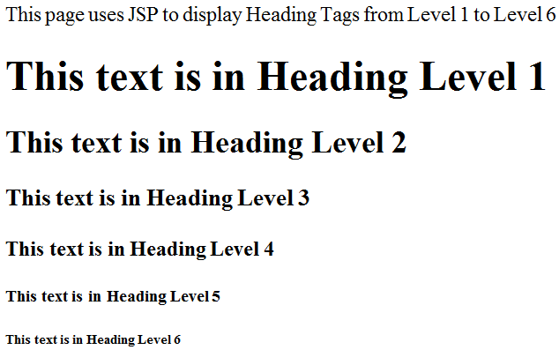
Browser View of JSP Page

Slide 92
Reading HTML Form Input
The request.getParameter method takes a String parameter as input that identifies the name of an HTML form element and returns the value entered by the user for that element on the form.
  For example, if there is a textbox named AuthorID then we can retrieve the value entered in that textbox with the scriptlet code:
String value = request.getParameter("AuthorID");
If the user leaves the field blank then getParameter returns an empty string.

Slide 93
JSP Program To Echo Input From the HTML Form in Display 19.16
This file should be named “EditURL.JSP” and match the entry in the ACTION tag of the HTML form.
<html>
<title>Edit URL: Echo submitted values</title>
<body>
<h2>Edit URL</h2>
<p>
This version of EditURL.jsp simply echoes back to the
user the values that were entered in the textboxes.
</p>
<%
String url = request.getParameter("URL");
String stringID = request.getParameter("AuthorID");
int author_id = Integer.parseInt(stringID);
out.println("The submitted author ID is: " + author_id);
out.println("<br/>");
out.println("The submitted URL is: " + url);
%>
</body>
</html>
The getParameter method calls return as Strings the values entered by the user in the URL and AuthorID textboxes from Display 19.16.

Slide 94
Sample Dialogue for EditUrl.JSP
SUBMITTED ON THE WEB BROWSER WHEN VIEWING DISPLAY 19.16
Author ID:
2
New URL:
http://www.dansimmons.com/about/bio.htm
WEB BROWSER DISPLAY AFTER CLICKING SUBMIT
Edit URL
This version of EditURL.jsp simply echoes back to the user the values that were entered in the textboxes.
The submitted author ID is: 2
The submitted URL is: http://www.dansimmons.com/about/bio.htm

Slide 95
JSP Tags - Directive
Directives
  Instruct the compiler how to process a JSP program. Examples include the definition of our own tags, including the source code of other files, and importing packages.
  Syntax:
  <%@
  Directives
  %>
<%@
page import="java.util.*,java.sql.*"
%>
Import libraries so we could use SQL code. Multiple packages separated by a comma.

Slide 96
More JSP
Although we have covered enough JSP to write fairly sophisticated programs, there is much more that we have not covered.
  For example, beans can be used as a convenient way to encapsulate data submitted from a HTML form.
  Sessions, tag libraries, security, and numerous other topics are important in the construction of JSP pages.
  Refer to a textbook dedicated to JSP to learn more.

Slide 97
Functional Programming
Functional Programming with Lambda Expressions added in Java 8
Only a brief introduction here
Lambda Function
  A nameless function
  Similar to an anonymous function
  Chunk of code that can be passed like a parameter but treated like a function
  Useful to define a function on the spot and also allows for parallelism

Slide 98
Lambda Expressions
Parallelism on multi-core or parallel architectures
  Traditional Java uses external access to data structures; e.g. we write code that loops through an ArrayList to process each element
  Lambda expressions allow internal access by telling Java how to process each element, through a lambda function, which can be farmed out to multiple processors

Slide 99
Lambda Expression
Format:
  parameters -> body
The following returns the sum of two integers x and y
(int x, int y) -> { return (x+y); }
Java can infer the type of the parameters so this becomes:
  (x, y) -> x+y

Slide 100
Example: An ActionListener
Consider the following Swing code that implements an action listener:
import javax.swing.JButton;
import javax.swing.JFrame;
import java.awt.Color;
import java.awt.Container;
import java.awt.FlowLayout;
import java.awt.event.ActionEvent;
import java.awt.event.ActionListener;
public class ButtonNotLambda extends Jframe
implements ActionListener
{
public ButtonNotLambda( )
{
setSize(250, 100);
setDefaultCloseOperation(JFrame.EXIT_ON_CLOSE);
setTitle("Action Listener");
Container contentPane = getContentPane( );
contentPane.setLayout(new FlowLayout( ));
JButton goButton = new JButton("Click Me");
goButton.addActionListener(this);
contentPane.add(goButton);
}
public void actionPerformed(ActionEvent e)
{
System.out.println("You clicked me");
}
public static void main(String[] args)
{
ButtonNotLambda buttonGui = new ButtonNotLambda( );
buttonGui.setVisible(true);
}
}

Slide 101
Example: Lambda Function
Our code is simplified by inserting a lambda function for the action to perform
import javax.swing.JButton;
import javax.swing.JFrame;
import java.awt.Color;
import java.awt.Container;
import java.awt.FlowLayout;
//import java.awt.event.ActionEvent; not needed
//import java.awt.event.ActionListener; not needed
public class ButtonLambda extends JFrame
//implements ActionListener not needed
{
public ButtonLambda( )
{
setSize(250, 100);
setDefaultCloseOperation(JFrame.EXIT_ON_CLOSE);
setTitle("Action Listener");
Container contentPane = getContentPane( );
contentPane.setLayout(new FlowLayout( ));
JButton goButton = new JButton("Click Me");
//goButton.addActionListener(this); // Modified as shown below
// Add function directly in the action listener
goButton.addActionListener(e -> System.out.println("You clicked me!"));
contentPane.add(goButton);
}
/* Method no longer needed
public void actionPerformed(ActionEvent e)
{
System.out.println("You clicked me");
}
*/
public static void main(String[] args)
{
ButtonLambda buttonGui = new ButtonLambda( );
buttonGui.setVisible(true);
}
}

Slide 102
Lambda Expressions and Collections
Lambda expressions particularly useful when applied to Collections
Common operations are to filter, map, or reduce the collection
Example: Filtering the ArrayList nums without lambda expressions to find values over 50:
for (int i = 0; i < nums.size(); i++)
if (nums.get(i) > 50)
System.out.println(nums.get(i));

Slide 103
Lambda Expressions and Collections
The old method filters external to the ArrayList
Internal filter using lambda expressions (Java infers the data type of val based on the type in the nums ArrayList:
Parallelizable by Java; other functions to map, reduce
nums.stream()
.filter(val -> val > 50)
.forEach(val -> System.out.println(val));

Slide 104
Intro to JavaFX
JavaFX is a set of packages that allows Java programmers to create rich graphics and media applications
  GUI interfaces, 2D and 3D games, visual effects, touch-enabled applications
  Uses hardware-accelerated graphics and a high-performance media engine
Declarative, XML-based markup for the design and layout of UI components, CSS for presentation
At some point expected to replace Swing as the standard library for graphical interfaces

Slide 105
JavaFX Application
Metaphor of a stage and scenes, just like the stage and scene of a theater
Hierarchical set of nodes called the scene graph
Stage (window): javafx.stage
Scene: javafx.scene
root: javafx.scene.layout.HBox
label1: javafx.scene.
control.Label
label1: javafx.scene.
control.Label

Slide 106

Hello World JavaFX App
import javafx.application.Application;
import javafx.scene.Scene;
import javafx.scene.control.Label;
import javafx.scene.layout.HBox;
import javafx.stage.Stage;
public class JavaFXHelloWorld extends Application
{
public void start(Stage primaryStage)
{
Label label1 = new Label();
Label label2 = new Label();
label1.setText("Hello");
label2.setText(" World");
HBox root = new HBox();
root.getChildren().add(label1);
root.getChildren().add(label2);
Scene scene = new Scene(root, 300, 50);
primaryStage.setTitle("JavaFX Example");
primaryStage.setScene(scene);
primaryStage.show();
}
public static void main(String[] args) {
launch(args);
}
}

Slide 107
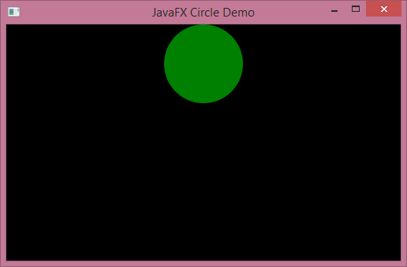
JavaFX Animated Circle
import javafx.application.Application;
import javafx.scene.Group;
import javafx.scene.Scene;
import javafx.scene.paint.Color;
import javafx.scene.shape.Circle;
import javafx.stage.Stage;
import javafx.scene.layout.AnchorPane;
import javafx.animation.FillTransition;
import javafx.animation.Timeline;
import javafx.animation.ParallelTransition;
import javafx.animation.TranslateTransition;
import javafx.util.Duration;
public class JavaFXCircleAnimate extends Application
{
public void start(Stage stage)
{
Circle c = new Circle(250,50,50);
c.setFill(Color.GREEN);
AnchorPane root = new AnchorPane();
root.getChildren().add(c);
FillTransition fill = new FillTransition(Duration.millis(500));
fill.setToValue(Color.BLUE); // Transition to Blue
TranslateTransition translate =
new TranslateTransition(Duration.millis(500));
translate.setToY(200); // Move circle to Y=200
// Run the fill and translate transitions in parallel
ParallelTransition transition = new ParallelTransition(c,
fill, translate);
transition.setCycleCount(Timeline.INDEFINITE);
transition.setAutoReverse(true);
transition.play();
Scene scene = new Scene(root, 500, 300, Color.BLACK);
stage.setTitle("JavaFX Circle Demo");
stage.setScene(scene);
stage.show();
}
public static void main(String[] args)
{
launch(args);
}
}

Slide 108
JavaFX Event Handling
JavaFX allows event handlers to be attached to UI controls in a manner similar to Swing
The following attaches an event handler to a button
  Increments the value entered in the textfield and outputs the result into a label
  Uses a Vbox pane which vertically stacks nodes added to the scene

Slide 109
JavaFX Event Demonstration
import javafx.application.Application;
import javafx.event.ActionEvent;
import javafx.event.EventHandler;
import javafx.scene.Scene;
import javafx.scene.control.Button;
import javafx.scene.control.Label;
import javafx.scene.control.TextField;
import javafx.scene.layout.VBox;
import javafx.scene.text.Font;
import javafx.stage.Stage;
public class JavaFXEvent extends Application
{
public void start(Stage primaryStage)
{
TextField txt = new TextField();
txt.setText("0");
txt.setFont(new Font(20));
Label lbl = new Label();
lbl.setFont(new Font(25));
Button btn = new Button();
btn.setFont(new Font(20));
btn.setText("Click to add one");
btn.setOnAction(new EventHandler<ActionEvent>()
{
public void handle(ActionEvent event)
{
int val = Integer.parseInt(txt.getText());
val++;
lbl.setText(Integer.toString(val));
}
});
VBox root = new VBox(); // Vertical layout
root.getChildren().add(txt);
root.getChildren().add(btn);
root.getChildren().add(lbl);
Scene scene = new Scene(root, 350, 200);
primaryStage.setTitle("JavaFX Event Handler Demo");
primaryStage.setScene(scene);
primaryStage.show();
}
public static void main(String[] args) {
launch(args);
}
}

Slide 110
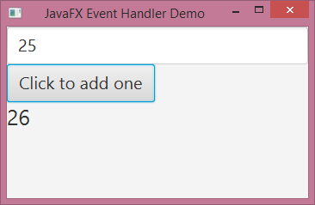
Java Event Demonstration GUI

Slide 111
JavaFX Scene Builder
Program released by Oracle to graphically construct user interfaces and generate JavaFX code
  Check Oracle website; may be part of your IDE
Application split into three separate files
  FXML file. XML file created by the Scene Builder that describes the layout of nodes
  Application file. JavaFX source code that contains the start method. Loads the FXML file.
  Controller file. Contains a class with event handlers that respond to UI controls.

Slide 112
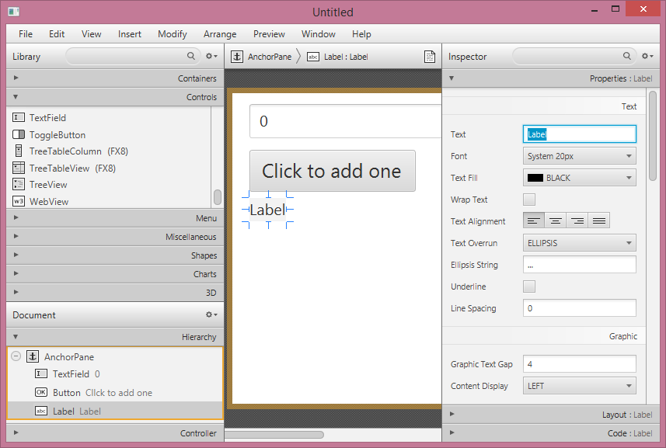
Sample GUI built by the Scene Builder

Slide 113
FXML file generated by Scene Builder
<?xml version="1.0" encoding="UTF-8"?>
<?import javafx.scene.text.*?>
<?import javafx.scene.control.*?>
<?import java.lang.*?>
<?import javafx.scene.layout.*?>
<AnchorPane maxHeight="-Infinity" maxWidth="-Infinity" minHeight="-Infinity" minWidth="-Infinity"
prefHeight="230.0" prefWidth="293.0"
xmlns="http://javafx.com/javafx/8" xmlns:fx="http://javafx.com/fxml/1" fx:controller="JavaFXAppController">
<children>
<TextField fx:id="txtNumber" layoutX="22.0" layoutY="14.0" text="0">
<font>
<Font size="20.0" />
</font>
</TextField>
<Button fx:id="btnClick" layoutX="22.0" layoutY="73.0" mnemonicParsing="false"
onAction="#handleButtonAction" prefHeight="54.0" prefWidth="249.0"
text="Click to add one" AnchorPane.leftAnchor="22.0" AnchorPane.rightAnchor="22.0">
<font>
<Font size="25.0" />
</font>
</Button>
<Label fx:id="lblNumber" layoutX="22.0" layoutY="135.0" prefHeight="54.0" prefWidth="257.0" text="Label">
<font>
<Font size="20.0" />
</font>
</Label>
</children>
</AnchorPane>

Slide 114
FXMLLoader Class
Load a saved FXML file created by the Scene Builder with the FXMLLoader class
import javafx.application.Application;
import javafx.fxml.FXMLLoader;
import javafx.scene.Parent;
import javafx.scene.Scene;
import javafx.stage.Stage;
public class JavaFXApp extends Application
{
public void start(Stage stage) throws Exception
{
Parent root = FXMLLoader.load
(getClass().getResource("JavaFXApp.fxml"));
Scene scene = new Scene(root);
stage.setScene(scene);
stage.show();
}
public static void main(String[] args) {
launch(args);
}
}

Slide 115
Linking Variables in the Scene Builder to the Controller
Place the @FXML annotation before the variable definition in the Controller; Injects necessary values from the FXML loader
import java.net.URL;
import java.util.ResourceBundle;
import javafx.event.ActionEvent;
import javafx.fxml.FXML;
import javafx.fxml.Initializable;
import javafx.scene.control.TextField;
import javafx.scene.control.Label;
import javafx.scene.control.Button;
public class JavaFXAppController implements Initializable
{
// The @FXML annotation looks up the
// corresponding ID in the FXML file so
// these variables map to the controls in
// the UI
@FXML
private Label lblNumber;
@FXML
private Button btnClick;
@FXML
private TextField txtNumber;
@FXML
private void handleButtonAction(ActionEvent event)
{
int val = Integer.parseInt(txtNumber.getText());
val++;
lblNumber.setText(Integer.toString(val));
}
public void initialize(URL url, ResourceBundle rb)
{
// Required by Initializable interface
// Called to initialize a controller after the
// root element has been processed
}
}

Slide 116
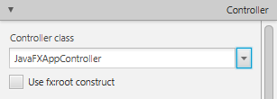
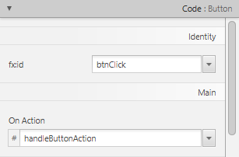
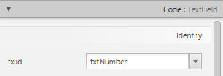
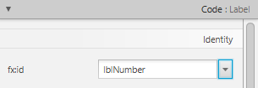
Linking Variables in the Scene Builder
Set controller class from the menu on bottom left
Select each UI control and then from the Inspector/Code section on the right, set fx:id to the corresponding name in the controller, and set the method to handle an event

Slide 117
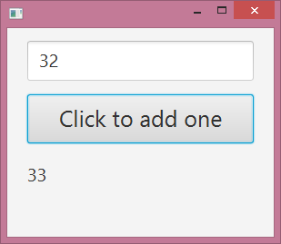
Final GUI

