Slide 1

Chapter 20
Applets
Slides prepared by Rose Williams, Binghamton University
Kenrick Mock, University of Alaska Anchorage
Copyright © 2016 Pearson Inc. All rights reserved.

Slide 2
Introduction
Java programs are divided into two main categories, applets and applications
An application is an ordinary Java program
An applet is a kind of Java program that can be run across the Internet

Slide 3
A Brief Introduction to HTML
HTML stands for Hypertext Markup Language
  Hypertext is text viewed on a browser that contains clickable entries called links or hyperlinks
  When a link or hyperlink is clicked, the document specified by the link is displayed
HTML is a language used to write HTML documents or pages that will be viewed on a Web browser

Slide 4
A Brief Introduction to HTML
HTML is made up of a collection of simple commands that can be inserted into a text file
  This converts the text file into a document meant to be viewed with a Web browser
Some commands allow pictures and hyperlinks to be inserted
Others are editing commands that specify the main heading, subheading, paragraph beginning, and so forth

Slide 5
A Brief Introduction to HTML
Much of HTML is simply a language for formatting text
  However, HTML is not a word processor
  It is more like a very simple programming language
  It is similar to the annotations used by copy editors to mark a manuscript before it is typeset for production
HTML is not part of the Java language
  There can be interaction between HTML and Java
  HTML can be used to display a Java applet program

Slide 6
HTML Formatting Commands
There are two basic kinds of HTML commands :
  Those that mark the beginning and end of a section of text
  Those that mark a single location in the text
Commands that mark the beginning and end of a section of text have the form:
    <Command>
    Some text
    </Command>

Slide 7
HTML Formatting Commands
The following makes the phrase "World's Greatest Home Page" a level 1 heading
  Level 1 is the largest standard heading
  <h1>
  World's Greatest Home Page
  </h1>
Smaller headings, Level 2 and level 3, are generated by the commands h2 and h3, and so forth

Slide 8
HTML Formatting Commands
Commands that mark a single location in the text are not closed with the command of form </Command>
  For example, the horizontal line command:
    <hr>
Commands in HTML are relative commands, instead of being absolute commands that determine exact size or locations
  The browser determines the exact sizes and locations

Slide 9
HTML Formatting Commands
The browser normally determines the location of line breaks in the displayed text
  However, a line break can be forced by inserting a break command:
    <br>
Some layout specifications can be made as well
  Anything between the commands <center> and </center> will be centered on the page

Slide 10
HTML Formatting Commands
Matching pairs of commands may be nested inside one another, but they may not cross each other:
Unlike Java, HTML commands are not case sensitive
An HTML file is a text file whose name should end with .html
<h1>
<center>
Oops!
</h1>
</center>
<h1>
<center>
OK!
</center> </h1>

Slide 11
Outline of an HTML Document
The entire HTML document should be enclosed in the pair <html> and </html> at the beginning and end of the document
The head of the document is enclosed in <head> and </head>
  The head is not displayed when the page is viewed
  It records information that is used by a browser
The head can contain a title, enclosed in <title> and </title>
  The title is used as a name for the document

Slide 12
Outline of an HTML Document
The part of the document that is displayed on the screen is divided into two parts
The body is the real content of the document
  It is enclosed in <body> and </body>
The other part should contain the e-mail address for contacting the document's maintainer, and the date that the document was last modified
  It is enclosed in <address> and </address>

Slide 13
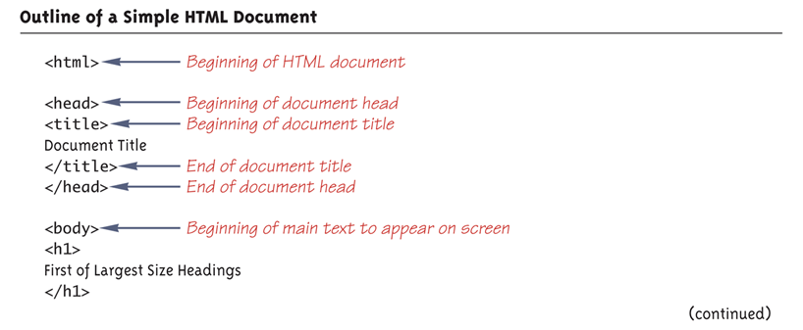
Outline of a Simple HTML Document (Part 1 of 3)

Slide 14
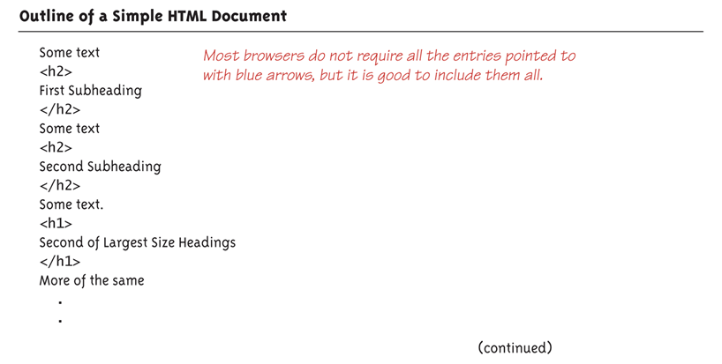
Outline of a Simple HTML Document (Part 2 of 3)

Slide 15
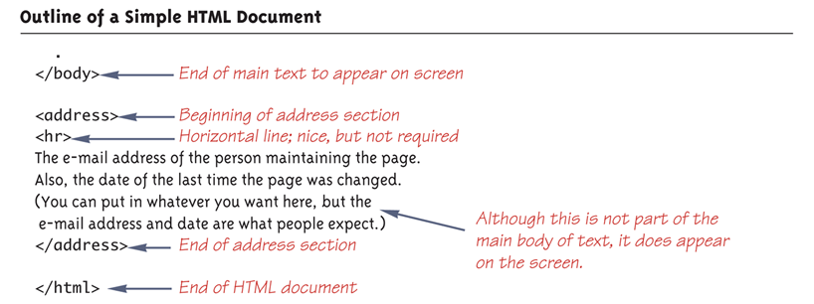
Outline of a Simple HTML Document (Part 3 of 3)

Slide 16
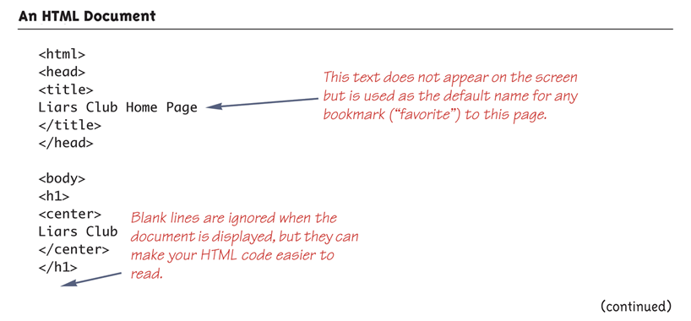
An HTML Document (Part 1 of 3)

Slide 17
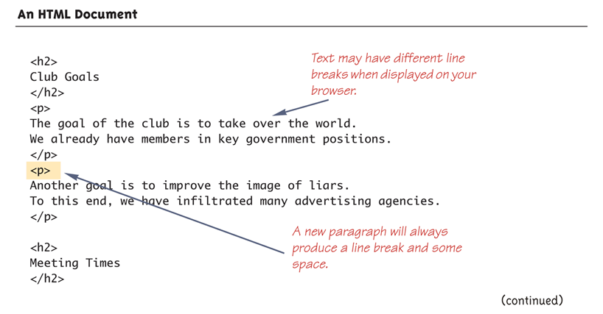
An HTML Document (Part 2 of 3)

Slide 18
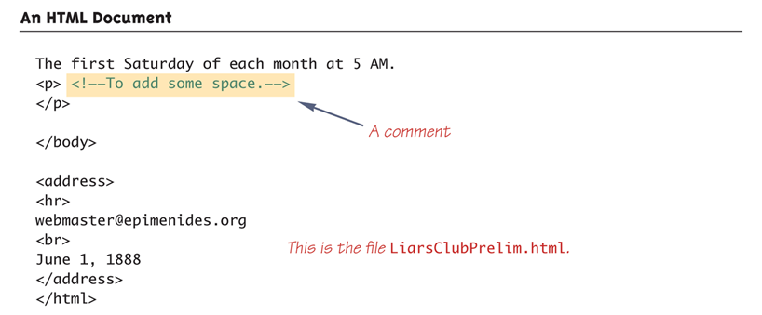
An HTML Document (Part 3 of 3)

Slide 19
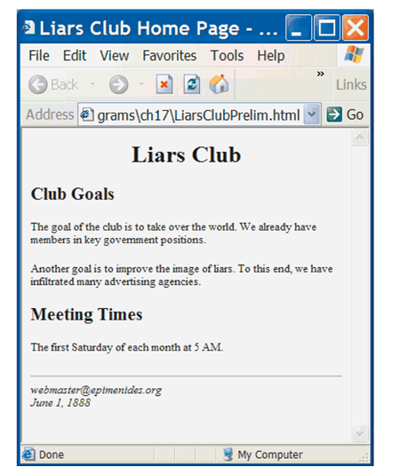
Browser View of HTML Document

Slide 20
URL
A URL is the name of an HTML document on the Web
  URL is an acronym for Uniform Resource Locator
URLs often begin with http
  This is the name of the protocol used to transfer and interpret the HTML document
  Most browsers will fill in http:// if it is omitted

Slide 21
Hyperlinks
Text can be marked as a hyperlink so that if a user clicks that text, the browser goes to another Web page specified by the link
  <a href="PathToDocument">
  TextToClick
  </a>
  The PathToDocument can be a full or relative path name to an HTML file, or a URL to any place on the Web
  The TextToClick will be displayed and underlined by the browser

Slide 22
Inserting a Picture
A picture can also be inserted in an HTML document
  <img src="PathToPicture">
  The PathToPicture can be a full or relative path name to a file with a digitally encoded picture
  Most commonly used picture-encoding formats are accepted, such as .gif, .tiff, and .jpg

Slide 23
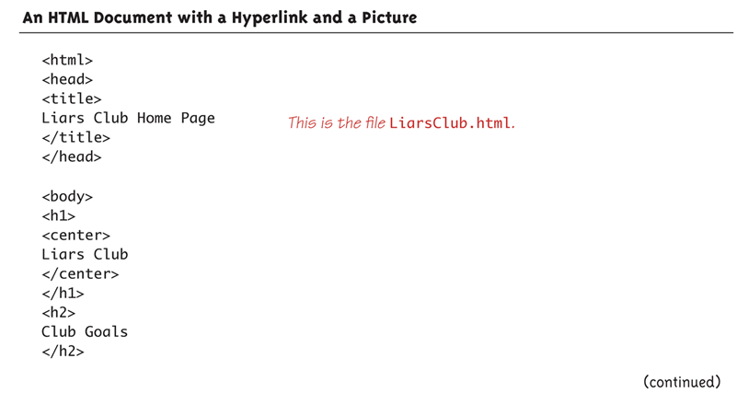
An HTML Document with a Hyperlink and a Picture (Part 1 of 3)

Slide 24
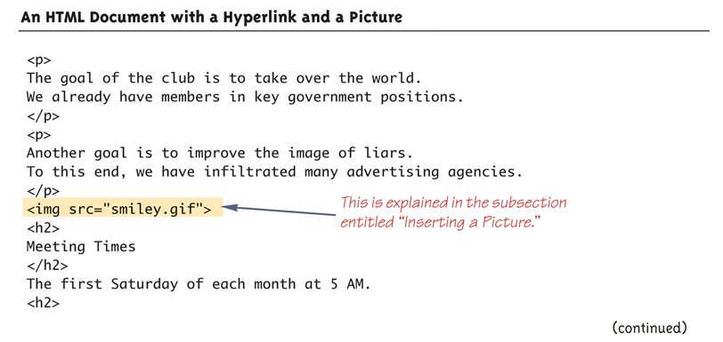
An HTML Document with a Hyperlink and a Picture (Part 2 of 3)

Slide 25
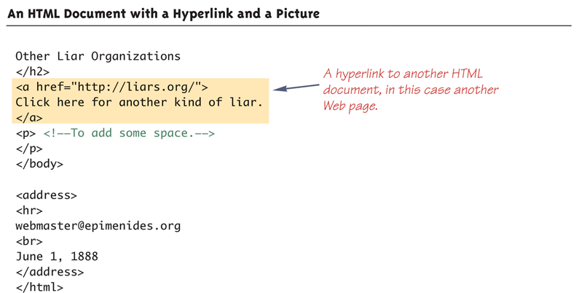
An HTML Document with a Hyperlink and a Picture (Part 3 of 3)

Slide 26
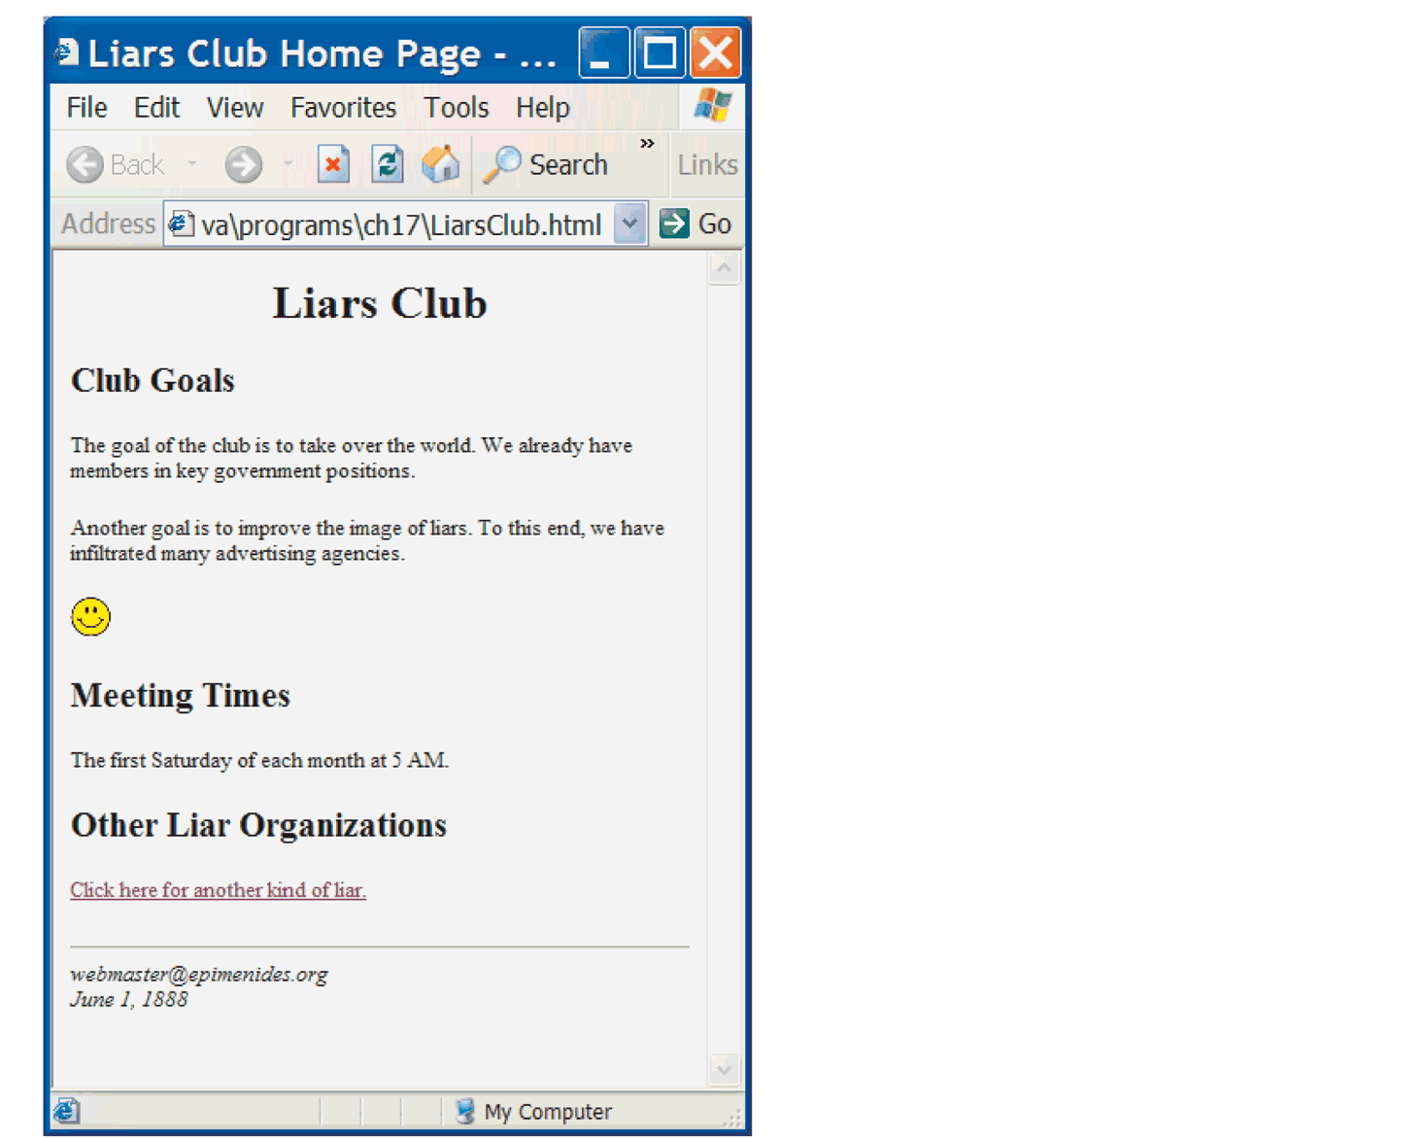
Browser View of an HTML Document with a Hyperlink and a Picture

Slide 27
Pitfall: Not Using Your Browser's Refresh Command
Browsers normally keep copies of the most recently viewed HTML pages
  This helps the browser retrieve a page quickly when someone returns to that page
This feature can be a problem when designing and debugging an HTML page
  If a change is made to a page, and that page is viewed again, it may still look the same
  This is because the copy is being viewed, not the new page
Browsers have a command to reload a page, and thus get the most recent version of it
  It is usually called "Refresh" or "Reload", and is a button or menu item

Slide 28
Tip: Other Languages for Authoring Web Pages
HTML is a low-level language for a Web browser much the same as assembly language is a low-level language for a computer
Most Web page designers today use a high-level Web page design language that translates into HTML
  For example Dreamweaver (Macromedia, Inc.), FrontPage (Microsoft Corporation), and GoLive (Adobe Systems Inc.)

Slide 29
Programming Applets
The word applet is meant to suggest a small application
Applets were intended to be small programs run over the Internet
  However, there are no size constraints on applets
  Applets can be viewed over the Internet, or without any connection to the internet
An applet is similar to a Swing GUI
  In fact, almost all of the Swing techniques can be used in applets

Slide 30
Defining an Applet
An applet class is normally defined as a derived class of the class JApplet
  The class JApplet is in the package javax.swing
There is also an older class, Applet, which has been superseded by the JApplet class

Slide 31
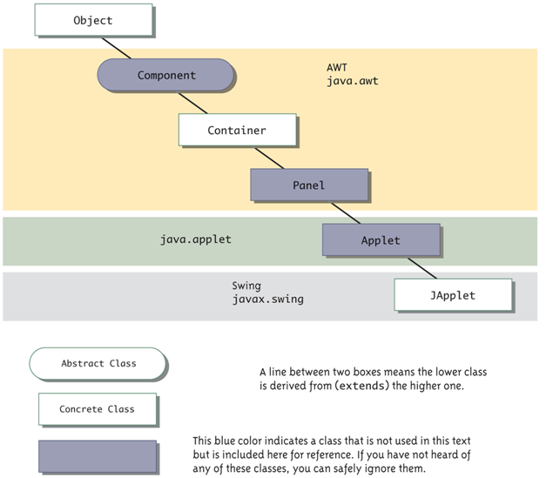
Applets in the Class Hierarchy

Slide 32
Designing an Applet
An applet class can be designed as a derived class of JApplet in much the same way that regular Swing GUIs are defined as derived classes of JFrame
However, an applet normally defines no constructors
  The method init performs the initializations that would be performed in a constructor for a regular Swing GUI

Slide 33
Designing an Applet
Components can be added to an applet in the same way that a component is added to a JFrame
  The method add is used to add components to an applet in the same way that components are added to a JFrame

Slide 34
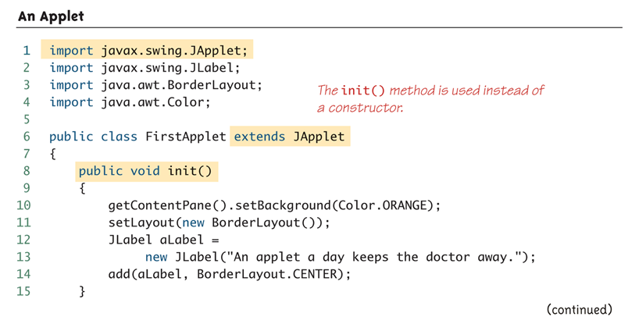
An Applet (Part 1 of 2)

Slide 35
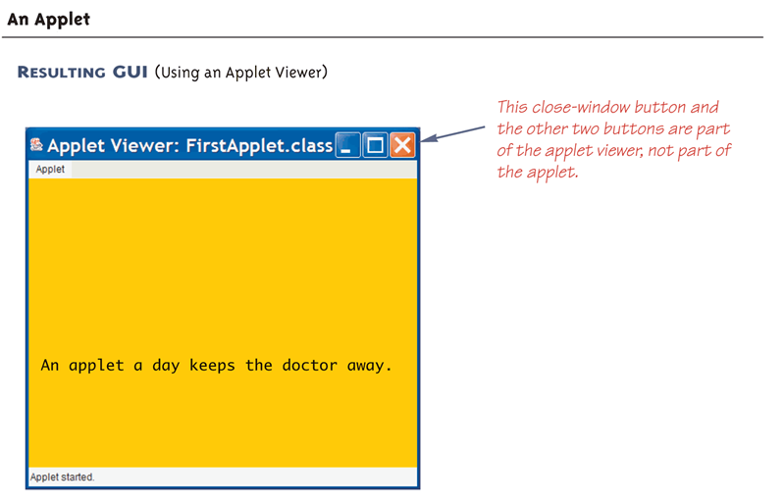
An Applet (Part 2 of 2)

Slide 36
How Applets Differ from Swing GUIs
Some of the items included in a Swing GUI are not included in an applet
Applets do not contain a main or setVisible method
  Applets are displayed automatically by a Web page or an applet viewer
Applets do not have titles
  Therefore, they do not use the setTitle method
  They are normally embedded in an HTML document, and the HTML document can add any desired title

Slide 37
How Applets Differ from Swing GUIs
Applets do not use the setSize method
  The HTML document takes care of sizing the applet
Applets do not have a close-window button
  Therefore, they do not have a setDefaultCloseOperation method
  When the HTML document containing the applet is closed, then the applet is automatically closed

Slide 38
Running an Applet
An applet class is compiled in the same way as any other Java class
  However, an applet is run differently from other Java programs
The normal way to run an applet is to embed it in an HTML document
  The applet is then run and viewed through a Web browser

Slide 39
Running an Applet
An applet can also be viewed using an applet viewer
  An applet viewer is a program designed to run an applet as a stand-alone program
The Java appletviewer can be used to run an applet:
  appletviewer FirstApplet.html
It may be necessary, however, to create the HTML document, and place the applet in it

Slide 40
Menus in a JApplet
Menus are constructed and added to a JApplet as they are for a JFrame
  JApplet has a method named setJMenuBar that behaves the same as the setJMenuBar method of a JFrame
  JApplet can also have menu bars added to a JApplet or to a panel that is part of the JApplet using the add method

Slide 41
Tip: Converting a Swing Application to an Applet
The fastest and easiest way to explain how to define an applet, is to explain how to modify a Swing GUI to transform it into an applet
  Derive the class from the class JApplet instead of from the class Jframe
  Remove the main method
  Replace the constructor with a no-parameter method named init
    The body of the init method can be the same as the body of the deleted constructor, but with some items removed

Slide 42
Tip: Converting a Swing Application to an Applet
  Delete any invocation of super
  Delete any method invocations that program the close-window button of a windowing GUI
  Delete any invocation of setTitle
  Delete any invocation of setSize
The following applet was generated in this way

Slide 43
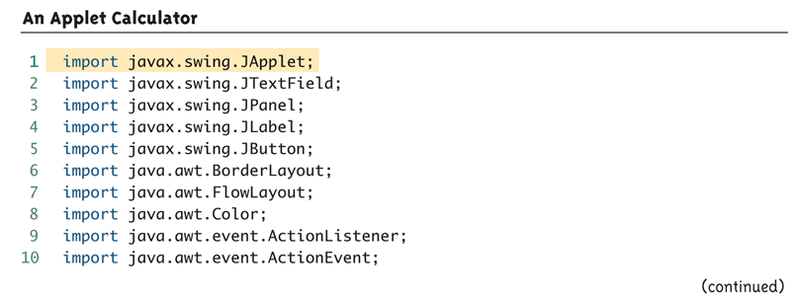
An Applet Calculator (Part 1 of 9)

Slide 44
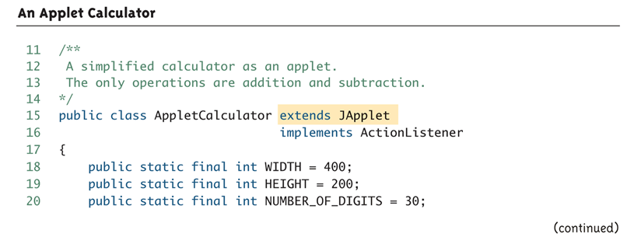
An Applet Calculator (Part 2 of 9)

Slide 45
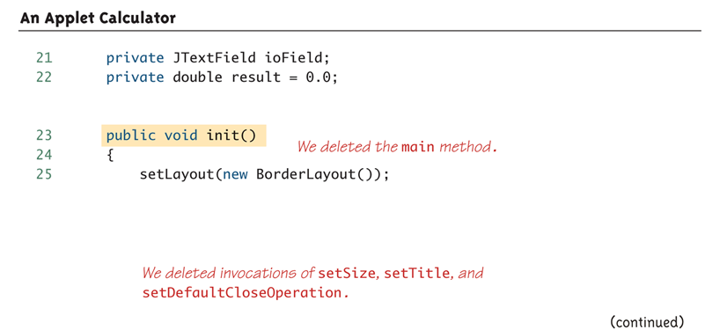
An Applet Calculator (Part 3 of 9)

Slide 46
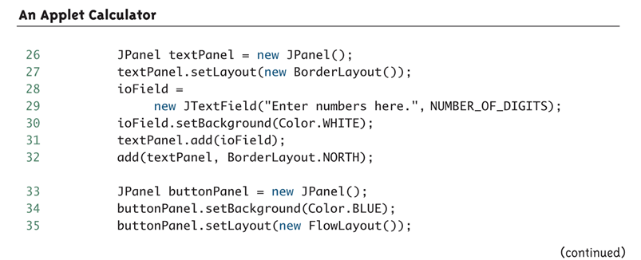
An Applet Calculator (Part 4 of 9)

Slide 47
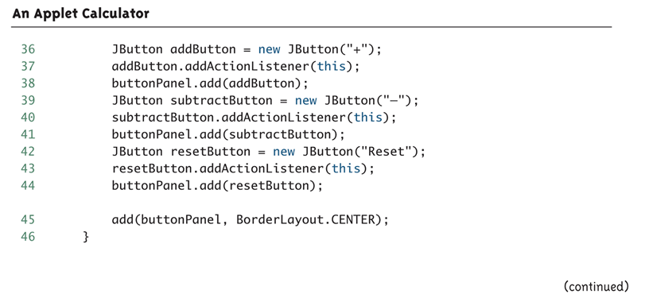
An Applet Calculator (Part 5 of 9)
The method actionPerformed is identical to the one in Display 17.19

Slide 48
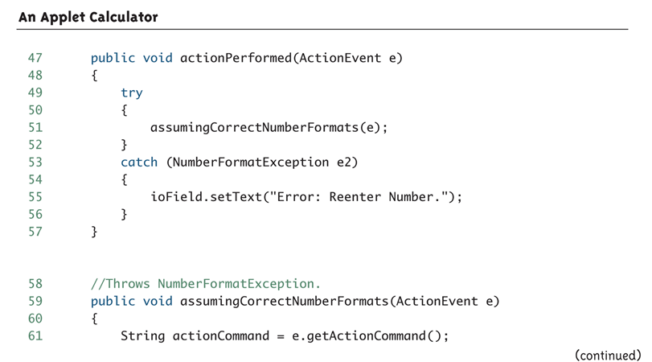
An Applet Calculator (Part 6 of 9)
The methods assumingCorrectNumberFormats and
stringToDouble are identical to the ones in Display 17.19

Slide 49
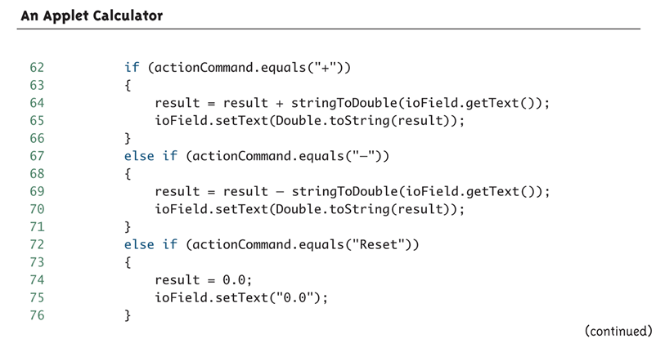
An Applet Calculator (Part 7 of 9)

Slide 50
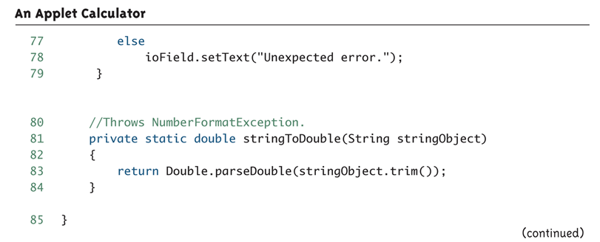
An Applet Calculator (Part 8 of 9)

Slide 51
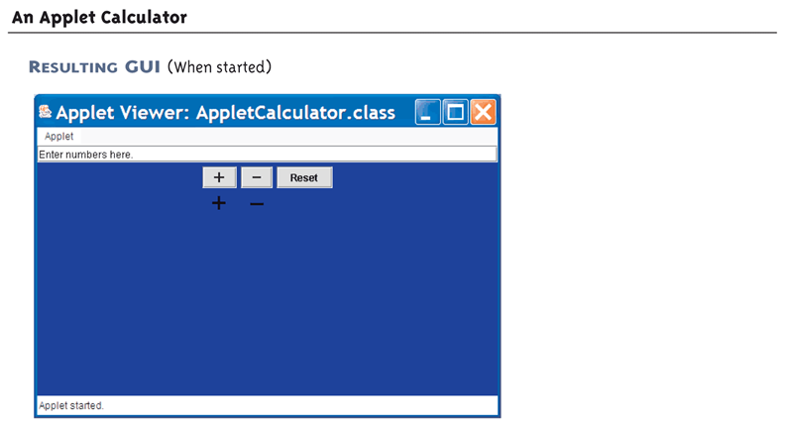
An Applet Calculator (Part 9 of 9)

Slide 52
Pitfall: Browser Security
If your applet does not run in the web browser, it may be due to security restrictions on the computer
  In the control panel, select Java and change the security restrictions to allow Java applets to run in the browser

Slide 53
Icons
An icon is a picture
  It is typically, but not always, a small picture
An icon can be stored in a file of many different standard formats
  Such as .gif, .tiff, or .jpg
The class ImageIcon is used to convert a picture file to a Swing icon
  Then it can be added as a component to any Container class, such as JApplet
  The class ImageIcon is in the javax.swing package
    ImageIcon NameOfImageIcon = new
  ImageIcon("PictureFileName");

Slide 54
Adding Icons to an Applet
The easiest way to display an icon in an applet is to place it in a JLabel
The following three lines create a label, create an icon, and then add the icon to the label:
JLabel aLabel=new JLabel("Welcome to my applet.");
ImageIcon dukeIcon = new
ImageIcon("duke_waving.gif");
aLabel.setIcon(dukeIcon);
The character pictured in this icon is named Duke
  He is Sun Microsystem's mascot for the Java language

Slide 55
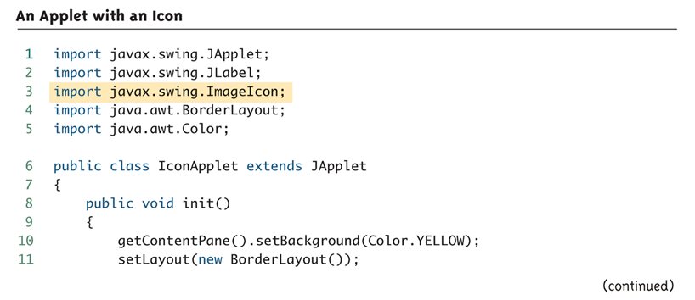
An Applet with an Icon (Part 1 of 3)

Slide 56
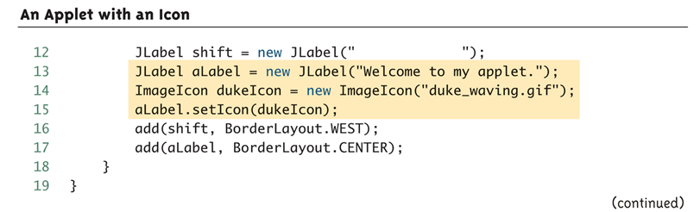
An Applet with an Icon (Part 2 of 3)

Slide 57
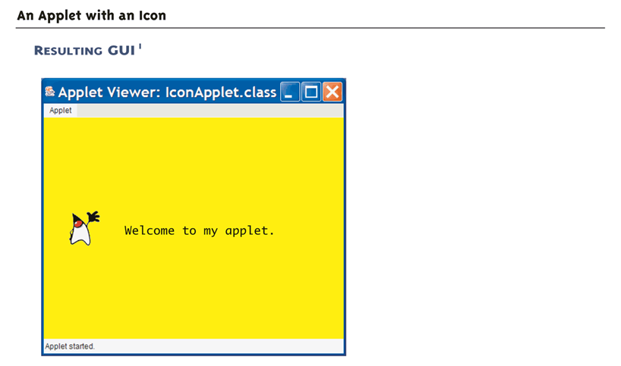
An Applet with an Icon (Part 3 of 3)

Slide 58
Inserting an Applet in an HTML Document
An applet can be placed in an HTML document with an applet tag:
<applet code="PathToApplet"
width=Number1 height=Number2>
</applet>
If given a .class file name only, then the HTML file and the applet file must be in the same directory
  The PathToApplet can be a full or relative path name

Slide 59
Inserting an Applet in an HTML Document
Note that the name of the .class file, not the .java file, is given
Note also that the width and height of the applet is given in this command, and not within the applet class definition
  The width and height are in pixels
The following code, when placed in an HTML document, will display the calculator applet in a browser as shown
<applet code="AppletCalculator.class"
width=400 height=300>
</applet>

Slide 60
An Applet in an HTML Document
<html>
<head>
<title>
Vampire Control
</title>
</head>
. . .
  <applet code="AppletCalculator.class" width=400 height=300>
  </applet>
. . .
</html>

Slide 61
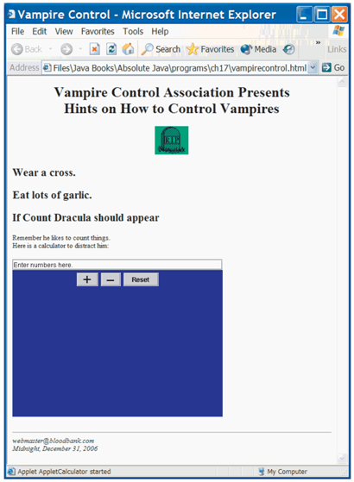
Browser View

Slide 62
Pitfall: Using an Old Web Browser
An old browser may not be able to run applets from an HTML document
  Even if a java application runs correctly on the same system
Web browsers do not use the same Java Virtual Machine used to run regular Java applications
  An old browser will have an old Java Virtual Machine, or perhaps, no Java Virtual Machine
However, an applet viewer will work, as long as a recent version of Java is installed

Slide 63
Applets and Security
An applet can be a program, written by someone else, that runs on your computer
Whenever someone else's program runs on your computer, there are security questions you should ask:
  Will it read information from your files?
  Will it corrupt your operating system?
Applets are designed so that they cannot do any of these things (at least easily)

