Slide 1
Chapter 18
Swing II
Slides prepared by Rose Williams, Binghamton University
Kenrick Mock, University of Alaska Anchorage
Copyright © 2016 Pearson Inc. All rights reserved.

Slide 2
Window Listeners
Clicking the close-window button on a JFrame fires a window event
Window events are objects of the class WindowEvent
The setWindowListener method can register a window listener for a window event
A window listener can be programmed to respond to this type of event
A window listener is any class that satisfies the WindowListener interface

Slide 3
Window Listeners
A class that implements the WindowListener interface must have definitions for all seven method headers in this interface
Should a method not be needed, it is defined with an empty body
public void windowDeiconified(WindowEvent e)
{ }

Slide 4
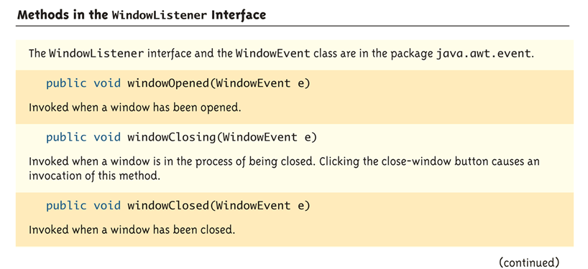
Methods in the WindowListener Interface (Part 1 of 2)

Slide 5
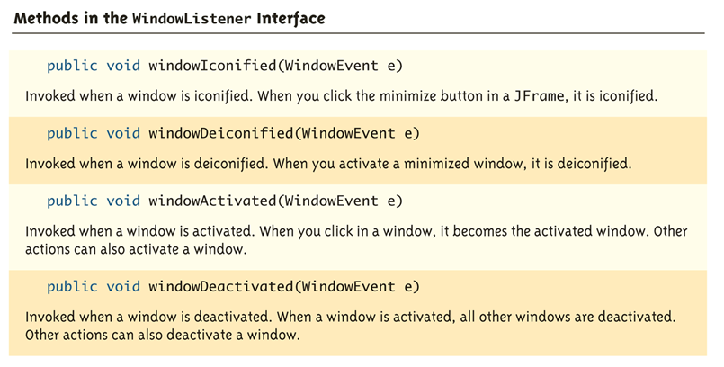
Methods in the WindowListener Interface (Part 2 of 2)

Slide 6
A Window Listener Inner Class
An inner class often serves as a window listener for a JFrame
The following example uses a window listener inner class named CheckOnExit
addWindowListener(new CheckOnExit());
When the close-window button of the main window is clicked, it fires a window event
This is received by the anonymous window listener object
This causes the windowClosing method to be invoked

Slide 7
A Window Listener Inner Class
The method windowClosing creates and displays a ConfirmWindow class object
It contains the message "Are you sure you want to exit?" as well as "Yes" and "No" buttons
If the user clicks "Yes," the action event fired is received by the actionPerformed method
It ends the program with a call to System.exit
If the user clicks "No," the actionPerformed method invokes the dispose method
This makes the calling object go away (i.e., the small window of the ConfirmWindow class), but does not affect the main window

Slide 8
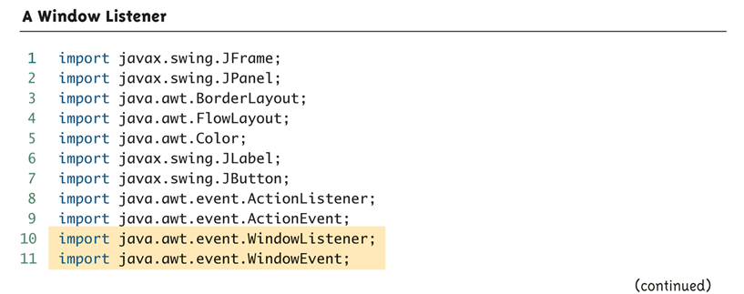
A Window Listener (Part 1 of 8)

Slide 9
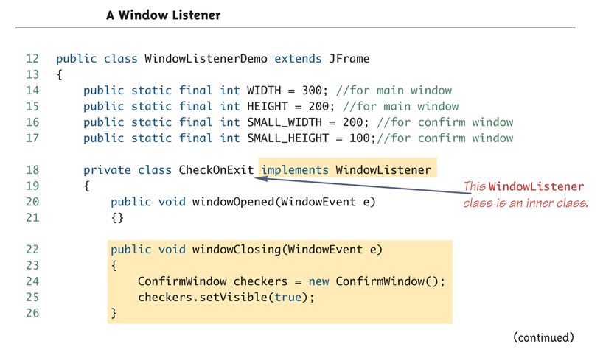
A Window Listener (Part 2 of 8)

Slide 10
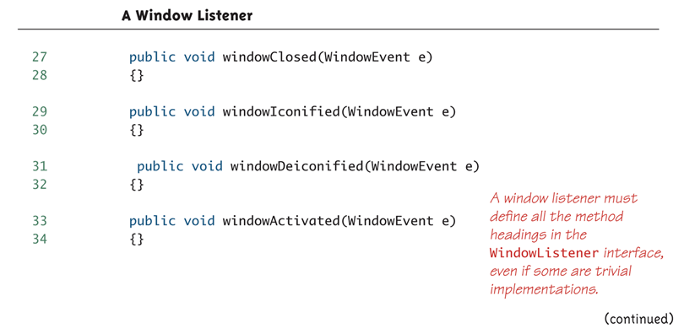
A Window Listener (Part 3 of 8)

Slide 11
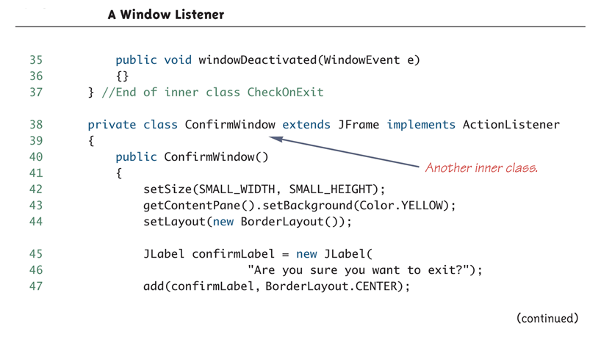
A Window Listener (Part 4 of 8)

Slide 12
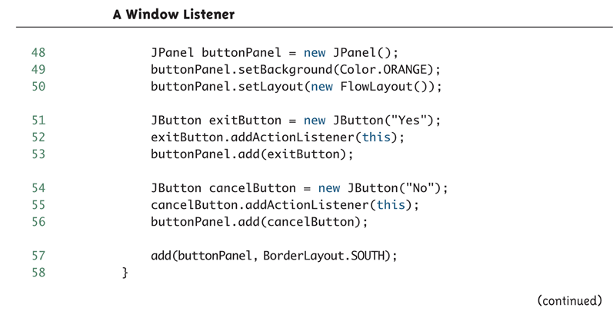
A Window Listener (Part 5 of 8)

Slide 13
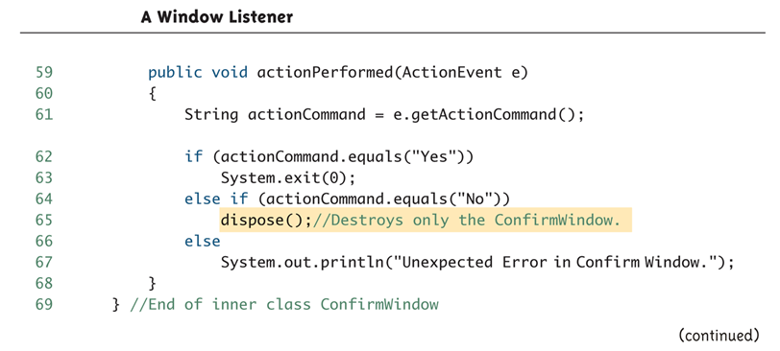
A Window Listener (Part 6 of 8)

Slide 14
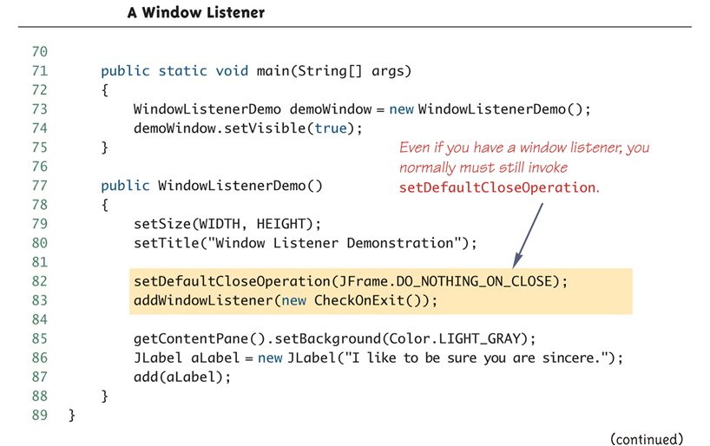
A Window Listener (Part 7 of 8)

Slide 15
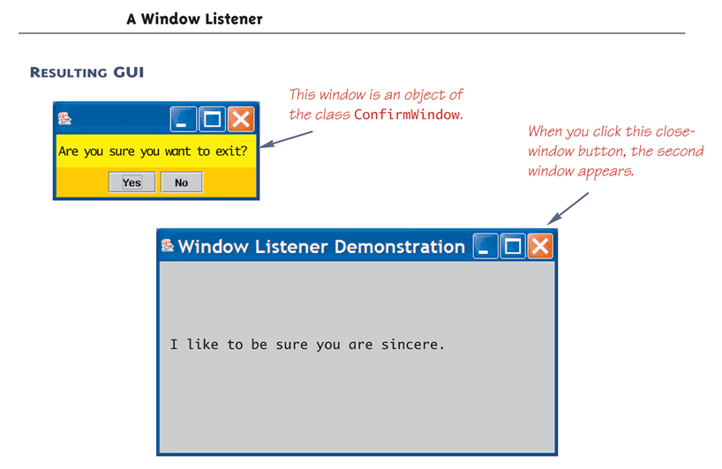
A Window Listener (Part 8 of 8)

Slide 16
The dispose Method
The dispose method of the JFrame class is used to eliminate the invoking JFrame without ending the program
The resources consumed by this JFrame and its components are returned for reuse
Unless all the elements are eliminated (i.e., in a one window program), this does not end the program
dispose is often used in a program with multiple windows to eliminate one window without ending the program

Slide 17
Pitfall: Forgetting to Invoke setDefaultCloseOperation
The behavior set by the setDefaultCloseOperation takes place even if there is a window listener registered to the JFrame
Whether or not a window listener is registered to respond to window events, a setDefaultCloseOperation invocation should be included
This invocation is usually made in the JFrame constructor

Slide 18
Pitfall: Forgetting to Invoke setDefaultCloseOperation
If the window listener takes care of all of the window behavior, then the JFrame constructor should contain the following:
setDefaultCloseOperation(
JFrame.DO_NOTHING_ON_CLOSE)
If it is not included, the following default action will take place instead, regardless of whether or not a window listener is supposed to take care of it:
setDefaultCloseOperation(
JFrame.HIDE_ON_CLOSE);
This will hide the JFrame , but not end the program

Slide 19
The WindowAdapter Class
When a class does not give true implementations to most of the method headings in the WindowListener interface, it may be better to make it a derived class of the WindowAdapter class
Only the method headings used need be defined
The other method headings inherit trivial implementation from WindowAdapter, so there is no need for empty method bodies
This can only be done when the JFrame does not need to be derived from any other class

Slide 20
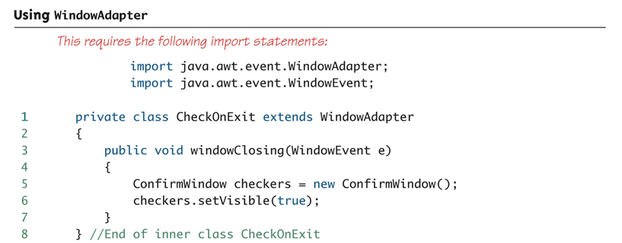
Using WindowAdapter

Slide 21
Icons
JLabels, JButtons, and JMenuItems can have icons
An icon is just a small picture (usually)
It is not required to be small
An icon is an object of the ImageIcon class
It is based on a digital picture file such as .gif, .jpg, or .tiff
Labels, buttons, and menu items may display a string, an icon, a string and an icon, or nothing

Slide 22
Icons
The class ImageIcon is used to convert a picture file to a Swing icon
ImageIcon dukeIcon = new ImageIcon("duke_waving.gif");
The picture file must be in the same directory as the class in which this code appears, unless a complete or relative path name is given
Note that the name of the picture file is given as a string

Slide 23
Icons
An icon can be added to a label using the setIcon method as follows:
JLabel dukeLabel = new JLabel("Mood check");
dukeLabel.setIcon(dukeIcon);
Instead, an icon can be given as an argument to the JLabel constructor:
JLabel dukeLabel = new JLabel(dukeIcon);
Text can be added to the label as well using the setText method:
dukeLabel.setText("Mood check");

Slide 24
Icons
Icons and text may be added to JButtons and JMenuItems in the same way as they are added to a JLabel
JButton happyButton = new
JButton("Happy");
ImageIcon happyIcon = new
ImageIcon("smiley.gif");
happyButton.setIcon(happyIcon);

Slide 25
Icons
Button or menu items can be created with just an icon by giving the ImageIcon object as an argument to the JButton or JMenuItem constructor
ImageIcon happyIcon = new
ImageIcon("smiley.gif");
JButton smileButton = new JButton(happyIcon);
JMenuItem happyChoice = new
JMenuItem(happyIcon);
A button or menu item created without text should use the setActionCommand method to explicitly set the action command, since there is no string

Slide 26
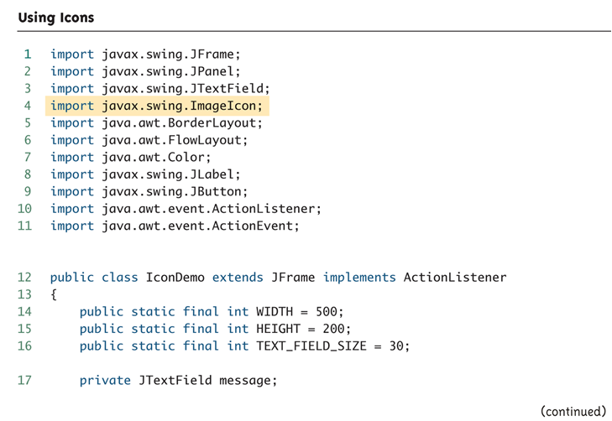
Using Icons (Part 1 of 5)

Slide 27
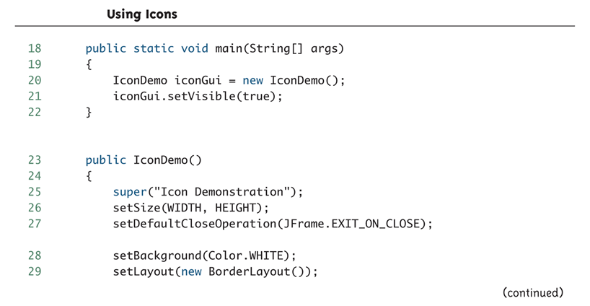
Using Icons (Part 2 of 5)

Slide 28
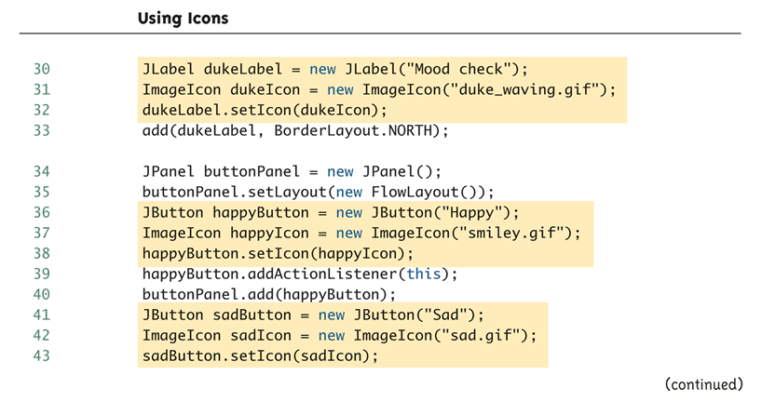
Using Icons (Part 3 of 5)

Slide 29
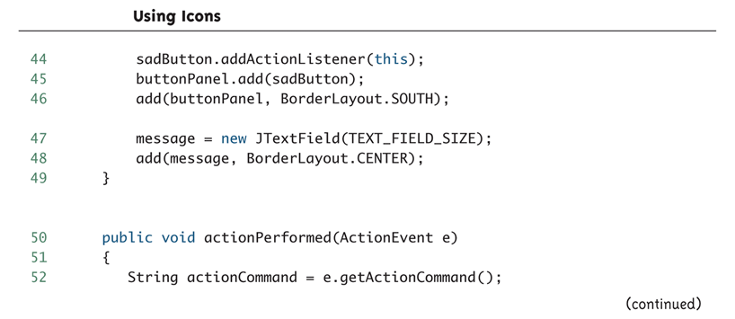
Using Icons (Part 4 of 5)

Slide 30
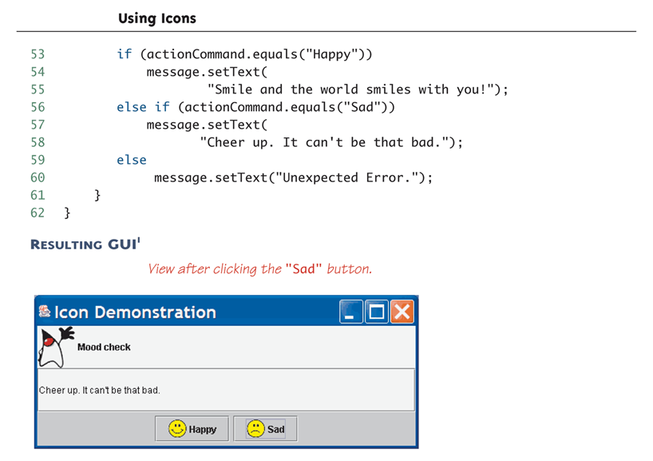
Using Icons (Part 5 of 5)

Slide 31
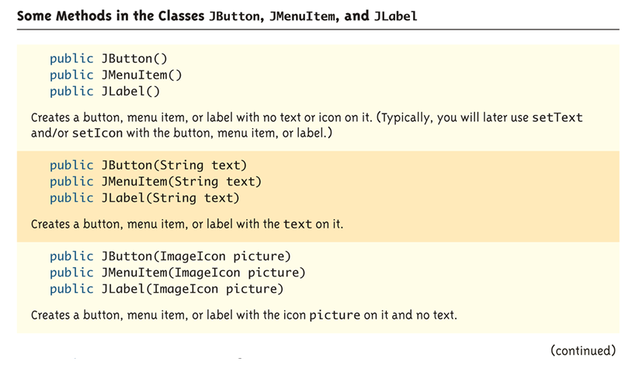
Some Methods in the Classes JButton, JMenuItem, and JLabel (Part 1 of 4)

Slide 32
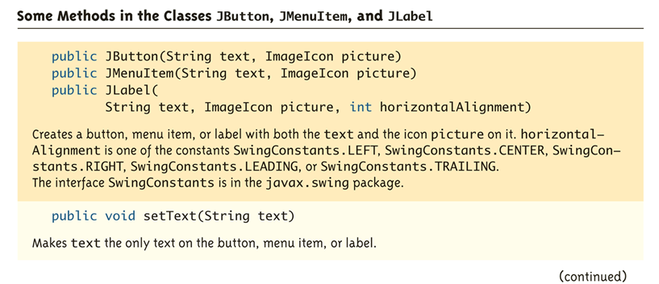
Some Methods in the Classes JButton, JMenuItem, and JLabel (Part 2 of 4)

Slide 33
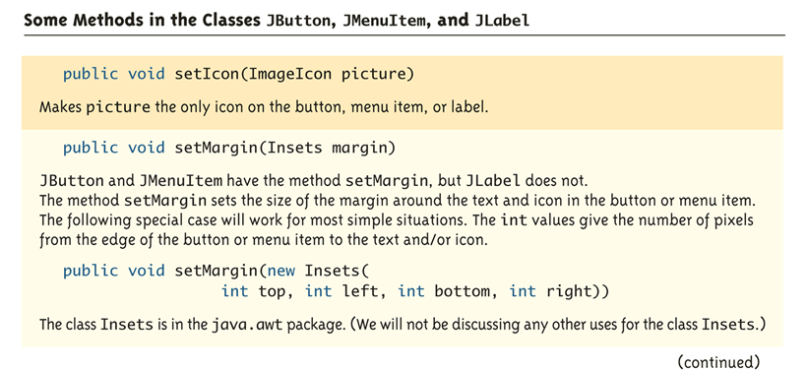
Some Methods in the Classes JButton, JMenuItem, and JLabel (Part 3 of 4)

Slide 34
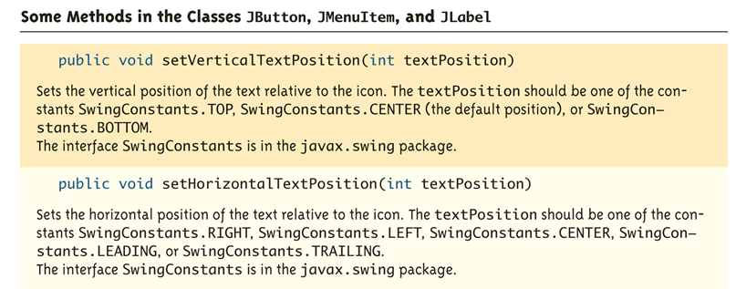
Some Methods in the Classes JButton, JMenuItem, and JLabel (Part 4 of 4)

Slide 35
The Insets Class
Objects of the class Insets are used to specify the size of the margin in a button or menu item
The arguments given when an Insets class object is created are in pixels
The Insets class is in the package java.awt
public Insets(int top, int left,
int bottom, int right)

Slide 36
Scroll Bars
When a text area is created, the number of lines that are visible and the number of characters per line are specified as follows:
JTextArea memoDisplay = new
JTextArea(15, 30);
However, it would often be better not to have to set a firm limit on the number of lines or the number of characters per line
This can be done by using scroll bars with the text area

Slide 37
Scroll Bars
When using scroll bars, the text is viewed through a view port that shows only part of the text at a time
A different part of the text may be viewed by using the scroll bars placed along the side and bottom of the view port
Scroll bars can be added to text areas using the JScrollPane class
The JScrollPane class is in the javax.swing package
An object of the class JScrollPane is like a view port with scroll bars

Slide 38
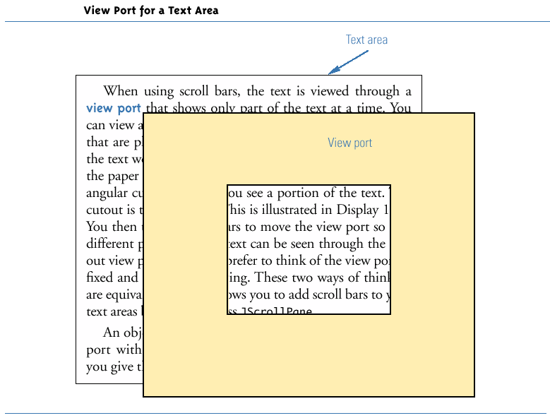
View Port for a Text Area

Slide 39
Scroll Bars
When a JScrollPane is created, the text area to be viewed is given as an argument
JScrollPane scrolledText = new
JScrollPane(memoDisplay);
The JScrollPane can then be added to a container, such as a JPanel or JFrame
textPanel.add(scrolledText);

Slide 40
Scroll Bars
The scroll bar policies can be set as follows:
scrolledText.setHorizontalScrollBarPolicy(
JScrollPane.HORIZONTAL_SCROLLBAR_ALWAYS);
scrolledText.setVerticalScrollBarPolicy(
JscrollPane.VERTICAL_SCROLLBAR_ALWAYS);
If invocations of these methods are omitted, then the scroll bars will be visible only when needed
If all the text fits in the view port, then no scroll bars will be visible
If enough text is added, the scroll bars will appear automatically

Slide 41
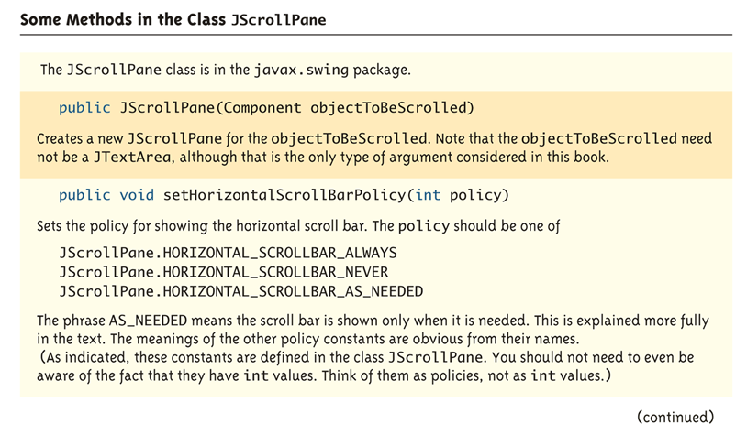
Some Methods in the Class JScrollPane (Part 1 of 2)

Slide 42
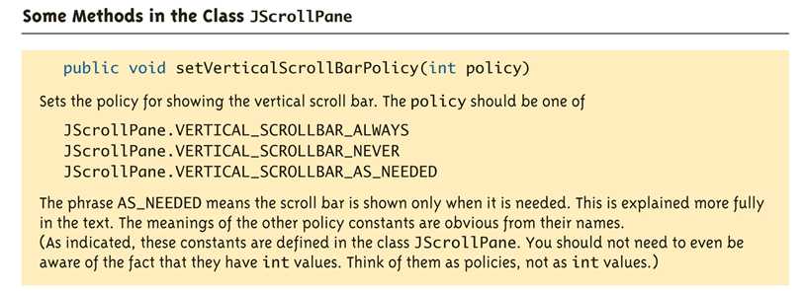
Some Methods in the Class JScrollPane (Part 2 of 2)

Slide 43
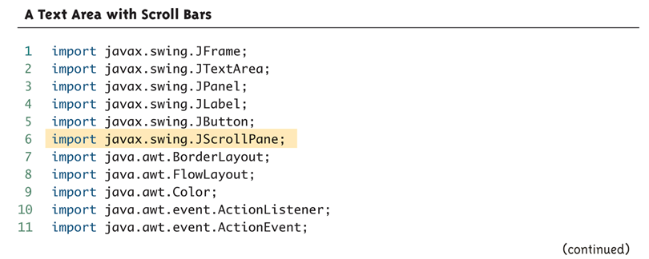
A Text Area with Scroll Bars (Part 1 of 8)

Slide 44
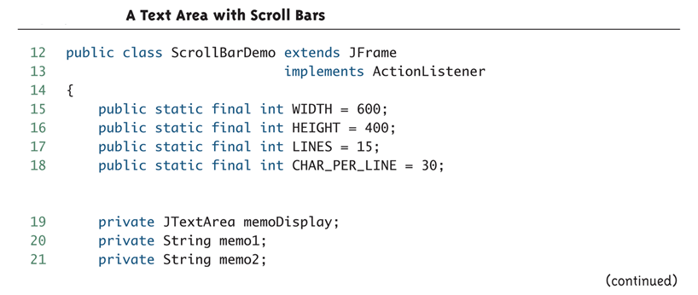
A Text Area with Scroll Bars (Part 2 of 8)

Slide 45
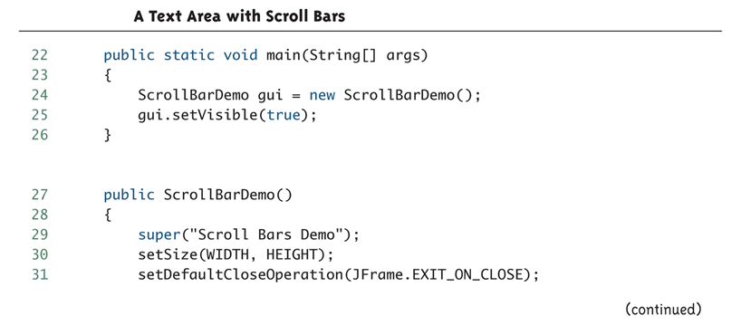
A Text Area with Scroll Bars (Part 3 of 8)

Slide 46
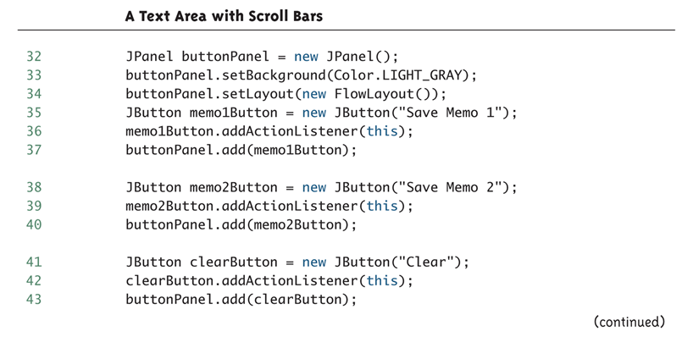
A Text Area with Scroll Bars (Part 4 of 8)

Slide 47
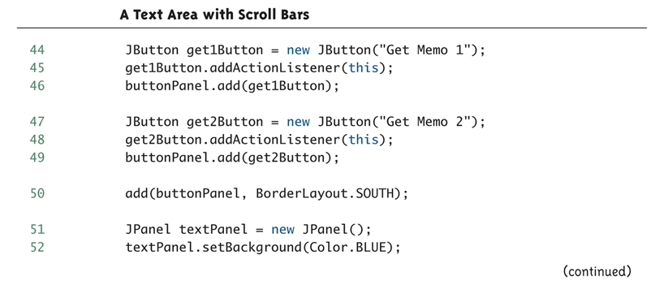
A Text Area with Scroll Bars (Part 5 of 8)

Slide 48
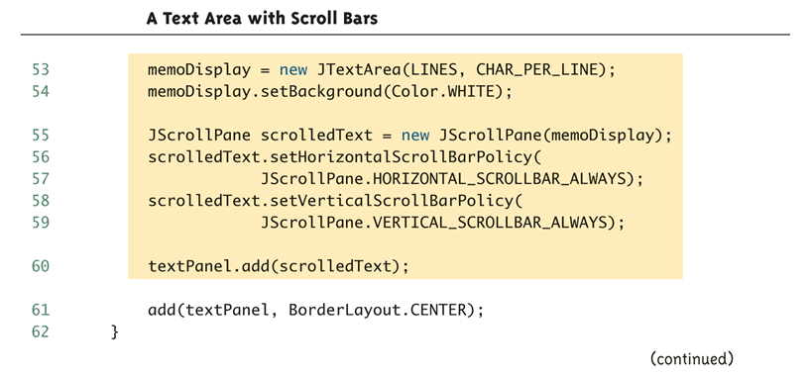
A Text Area with Scroll Bars (Part 6 of 8)

Slide 49
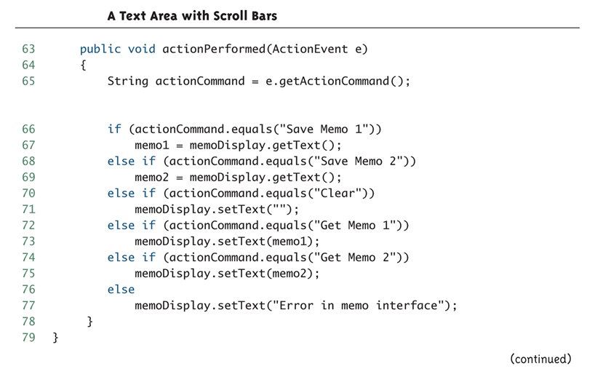
A Text Area with Scroll Bars (Part 7 of 8)

Slide 50
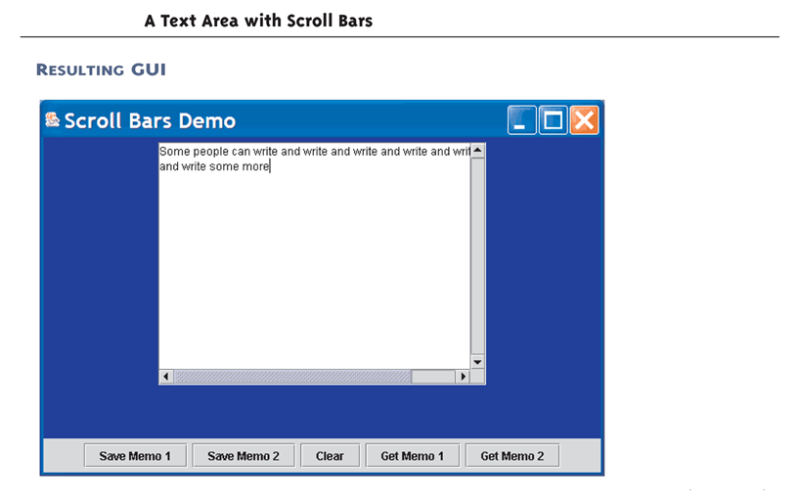
A Text Area with Scroll Bars (Part 8 of 8)

Slide 51
Components with Changing Visibility
A GUI can have components that change from visible to invisible and back again
In the following example, the label with the character Duke not waving is shown first
When the "Wave" button is clicked, the label with Duke not waving disappears and the label with Duke waving appears
When the "Stop" button is clicked, the label with Duke waving disappears, and the label with Duke not waving returns
Duke is Sun Microsystem's mascot for the Java Language
A component can be made invisible without making the entire GUI invisible

Slide 52
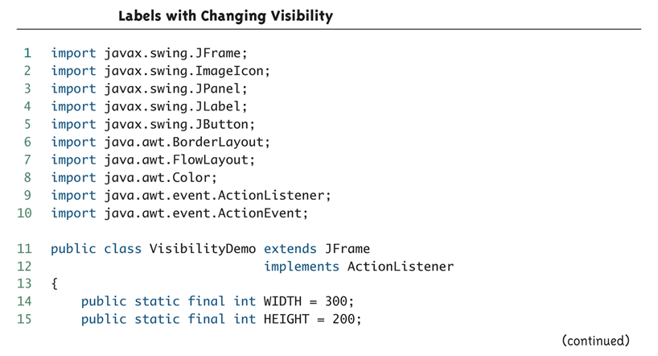
Labels with Changing Visibility (Part 1 of 6)

Slide 53
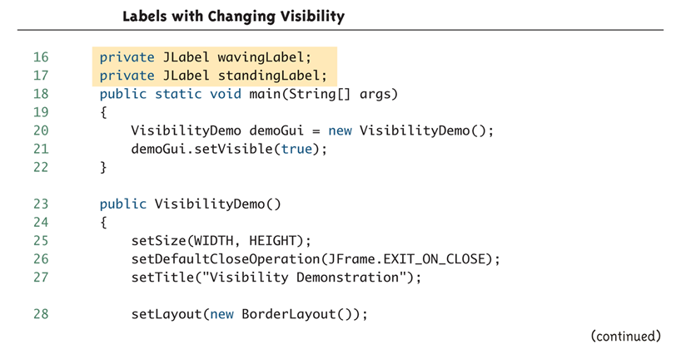
Labels with Changing Visibility (Part 2 of 6)

Slide 54
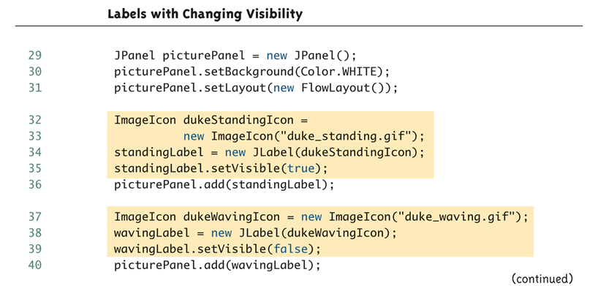
Labels with Changing Visibility (Part 3 of 6)

Slide 55
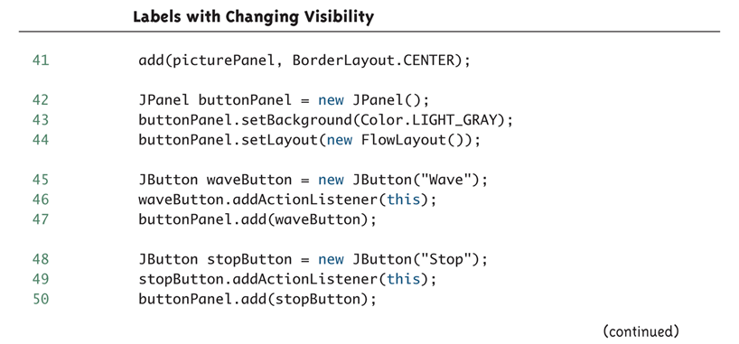
Labels with Changing Visibility (Part 4 of 6)

Slide 56
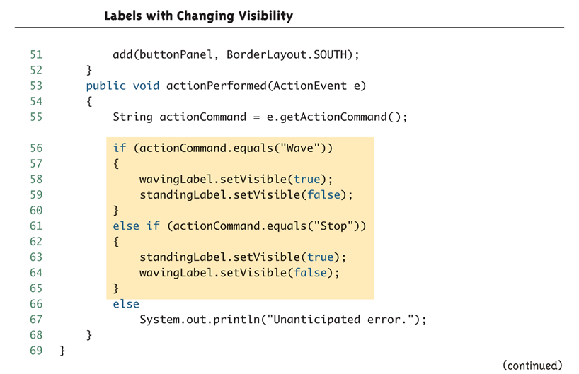
Labels with Changing Visibility (Part 5 of 6)

Slide 57
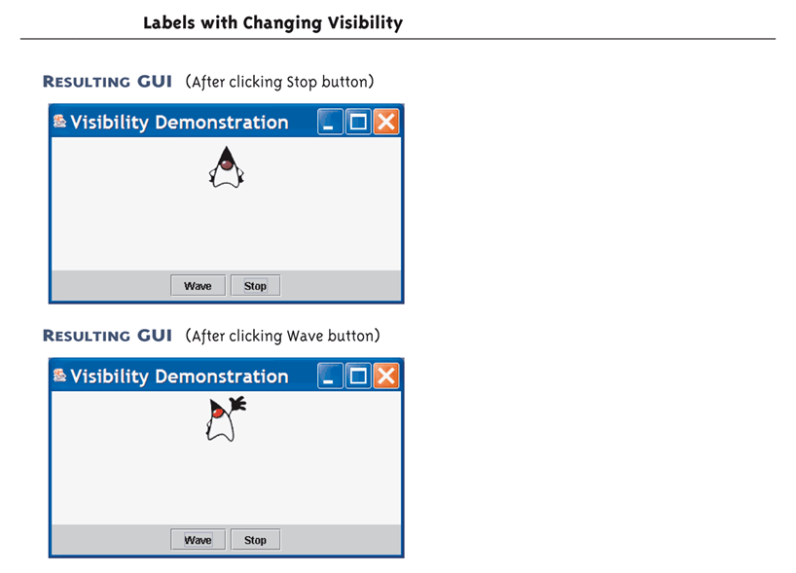
Labels with Changing Visibility (Part 6 of 6)

Slide 58
Coordinate System for Graphics Objects
When drawing objects on the screen, Java uses a coordinate system where the origin point (0,0) is at the upper-left corner of the screen area used for drawing
The x-coordinate (horizontal) is positive and increasing to the right
The y- coordinate(vertical) is positive and increasing down
All coordinates are normally positive
Units and sizes are in pixels
The area used for drawing is typically a JFrame or JPanel

Slide 59
Coordinate System for Graphics Objects
The point (x,y) is located x pixels in from the left edge of the screen, and down y pixels from the top of the screen
When placing a rectangle on the screen, the location of its upper-left corner is specified
When placing a figure other than a rectangle on the screen, Java encloses the figure in an imaginary rectangle, called a bounding box, and positions the upper-left corner of this rectangle

Slide 60
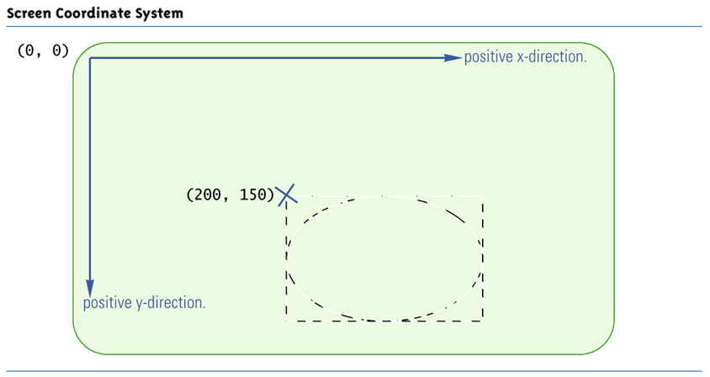
Screen Coordinate System

Slide 61
The Method paint and the Class Graphics
Almost all Swing and Swing-related components and containers have a method called paint
The method paint draws the component or container on the screen
It is already defined, and is called automatically when the figure is displayed on the screen
However, it must be redefined in order to draw geometric figures like circles and boxes
When redefined, always include the following:
super.paint(g);

Slide 62
The Method paint and the Class Graphics
Every container and component that can be drawn on the screen has an associated Graphics object
The Graphics class is an abstract class found in the java.awt package
This object has data specifying what area of the screen the component or container covers
The Graphics object for a JFrame specifies that drawing takes place inside the borders of the JFrame object

Slide 63
The Method paint and the Class Graphics
The object g of the class Graphics can be used as the calling object for a drawing method
The drawing will then take place inside the area of the screen specified by g
The method paint has a parameter g of type Graphics
When the paint method is invoked, g is replaced by the Graphics object associated with the JFrame
Therefore, the figures are drawn inside the JFrame

Slide 64
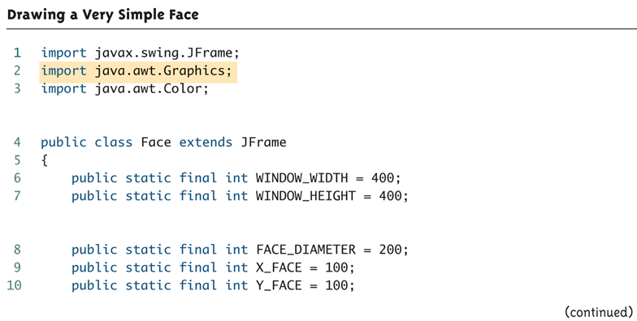
Drawing a Very Simple Face (part 1 of 5)

Slide 65
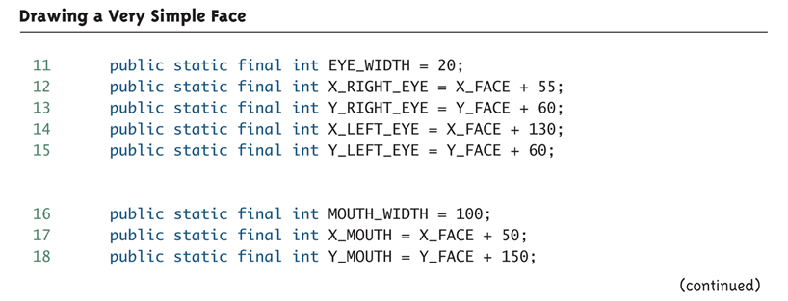
Drawing a Very Simple Face (part 2 of 5)

Slide 66
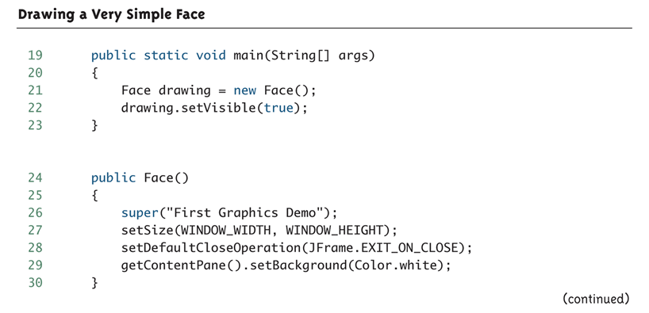
Drawing a Very Simple Face (part 3 of 5)

Slide 67
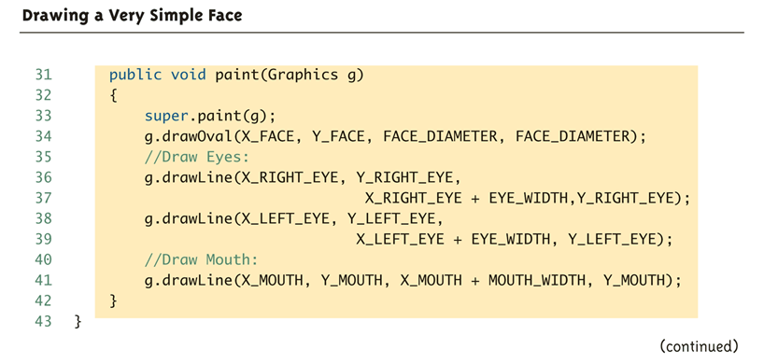
Drawing a Very Simple Face (part 4 of 5)

Slide 68
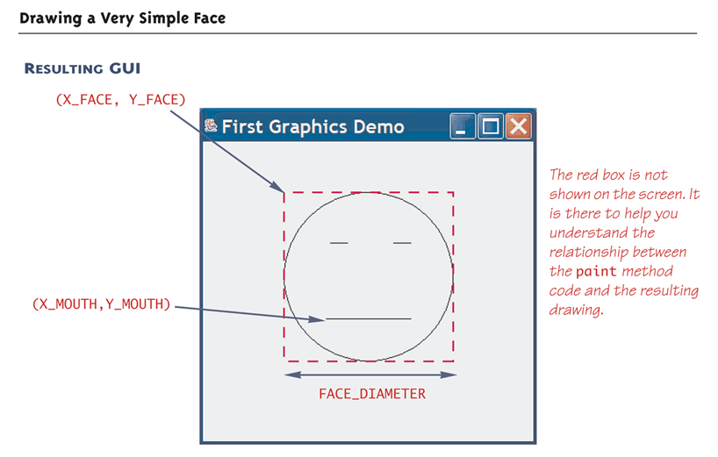
Drawing a Very Simple Face (part 5 of 5)

Slide 69
Some Methods in the Class Graphics (part 1 of 4)

Slide 70
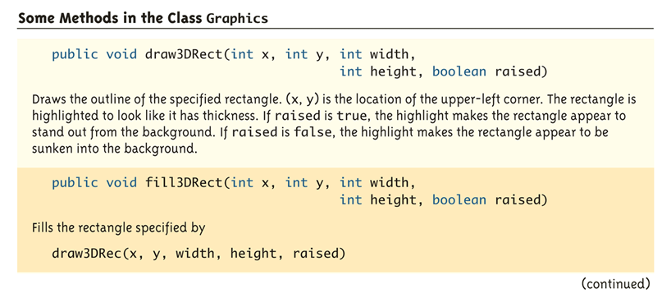
Some Methods in the Class Graphics (part 2 of 4)

Slide 71
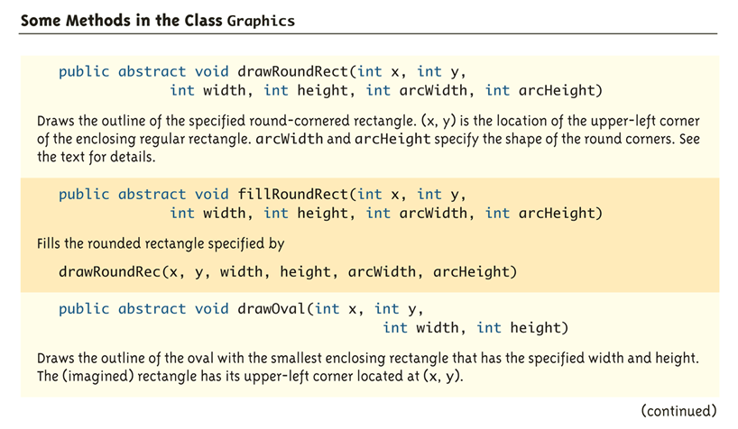
Some Methods in the Class Graphics (part 3 of 4)

Slide 72
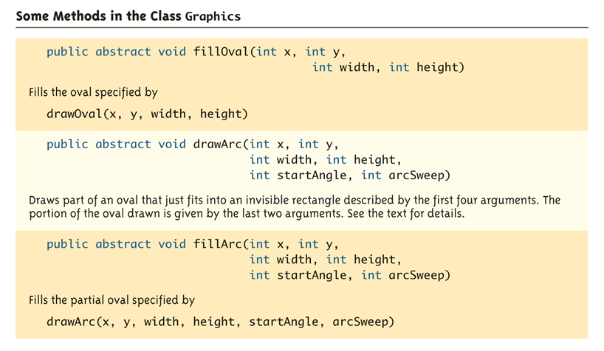
Some Methods in the Class Graphics (part 4 of 4)

Slide 73
Drawing Ovals
An oval is drawn by the method drawOval
The arguments specify the location, width, and height of the smallest rectangle that can enclose the oval
g.drawOval(100, 50, 300, 200);
A circle is a special case of an oval in which the width and height of the rectangle are equal
g.drawOval(X_FACE, Y_FACE,
FACE_DIAMETER, FACE_DIAMETER);

Slide 74
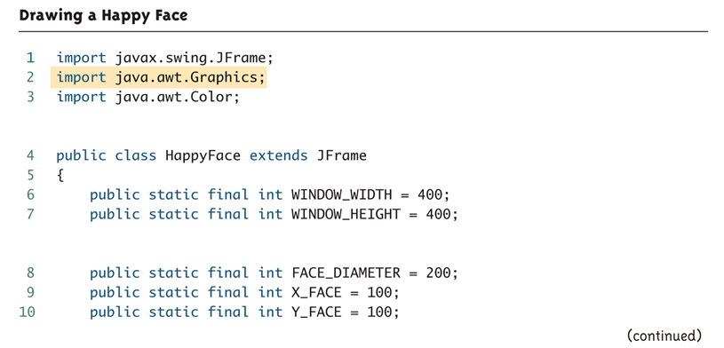
Drawing a Happy Face (Part 1 of 5)

Slide 75
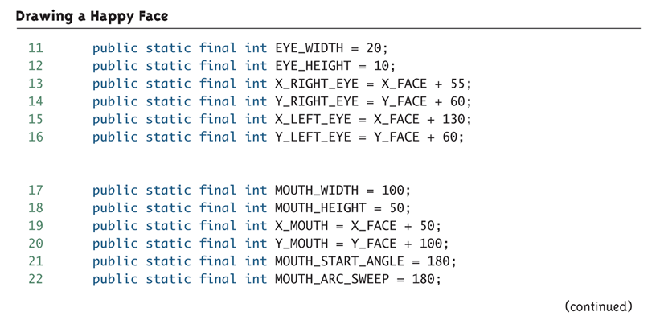
Drawing a Happy Face (Part 2 of 5)

Slide 76
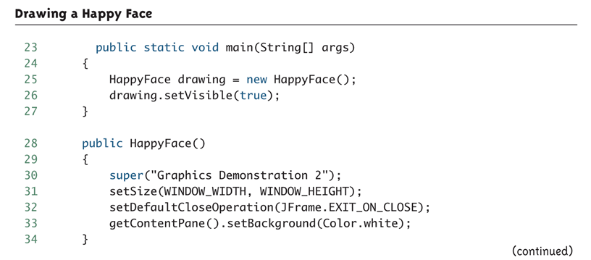
Drawing a Happy Face (Part 3 of 5)

Slide 77
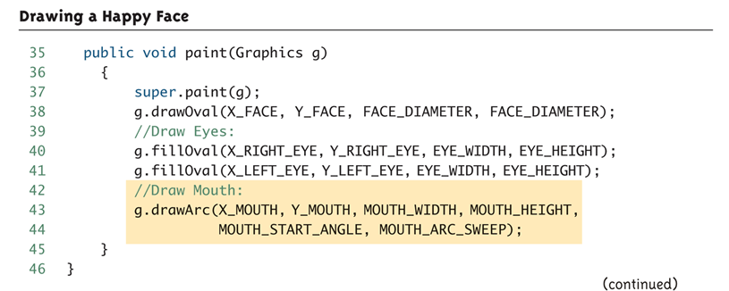
Drawing a Happy Face (Part 4 of 5)

Slide 78
Drawing a Happy Face (Part 5 of 5)

Slide 79
Drawing Arcs
Arcs are described by giving an oval, and then specifying a portion of it to be used for the arc
The following statement draws the smile on the happy face:
g.drawArc(X_MOUTH, Y_MOUTH, MOUTH_WIDTH,
MOUTH_HEIGHT, MOUTH_START_ANGLE,
MOUTH_ARC_SWEEP);
The arguments MOUTH_WIDTH and MOUTH_HEIGHT determine the size of the bounding box, while the arguments X_MOUTH and Y_MOUTH determine its location
The last two arguments specify the portion made visible

Slide 80
Specifying an Arc (Part 1 of 2)

Slide 81
Specifying an Arc (Part 2 of 2)

Slide 82
Rounded Rectangles
A rounded rectangle is a rectangle whose corners have been replaced by arcs so that the corners are rounded
g.drawRoundRect(x, y, width, height,
arcWidth, arcHeight)
The arguments x, y, width, and height determine a regular rectangle in the usual way
The last two arguments arcWidth, and arcHeight, specify the arcs that will be used for the corners
Each corner is replaced with an quarter of an oval that is arcWidth pixels wide and arcHeight pixels high
When arcWidth and arcHeight are equal, the corners will be arcs of circles

Slide 83
A Rounded Rectangle

Slide 84
paintComponent for Panels
A JPanel is a JComponent, but a JFrame is a Component, not a JComponent
Therefore, they use different methods to paint the screen
Figures can be drawn on a JPanel, and the JPanel can be placed in a JFrame
When defining a JPanel class in this way, the paintComponent method is used instead of the paint method
Otherwise the details are the same as those for a JFrame

Slide 85
paintComponent Demonstration (Part 1 of 4)

Slide 86
paintComponent Demonstration (Part 2 of 4)

Slide 87
paintComponent Demonstration (Part 3 of 4)

Slide 88
paintComponent Demonstration (Part 4 of 4) 0

Slide 89
Action Drawings and repaint
The repaint method should be invoked when the graphics content of a window is changed
The repaint method takes care of some overhead, and then invokes the method paint, which redraws the screen
Although the repaint method must be explicitly invoked, it is already defined
The paint method, in contrast, must often be defined, but is not explicitly invoked

Slide 90
An Action Drawing (Part 1 of 7)

Slide 91
An Action Drawing (Part 2 of 7)

Slide 92
An Action Drawing (Part 3 of 7)

Slide 93
An Action Drawing (Part 4 of 7)

Slide 94
An Action Drawing (Part 5 of 7)

Slide 95
An Action Drawing (Part 6 of 7)

Slide 96
An Action Drawing (Part 7 of 7)

Slide 97
Some More Details on Updating a GUI
With Swing, most changes to a GUI are updated automatically to become visible on the screen
This is done by the repaint manager object
Although the repaint manager works automatically, there are a few updates that it does not perform
For example, the ones taken care of by validate or repaint
One other updating method is pack
pack resizes the window to something known as the preferred size

Slide 98
The validate Method
An invocation of validate causes a container to lay out its components again
It is a kind of "update" method that makes changes in the components shown on the screen
Every container class has the validate method, which has no arguments
Many simple changes made to a Swing GUI happen automatically, while others require an invocation of validate or some other "update" method
When in doubt, it will do no harm to invoke validate

Slide 99
Specifying a Drawing Color
Using the method drawLine inside the paint method is similar to drawing with a pen that can change colors
The method setColor will change the color of the pen
The color specified can be changed later on with another invocation of setColor so that a single drawing can have multiple colors
g.setColor(Color.BLUE)

Slide 100
Adding Color
If you replace the paint method in Display 18.13 with this version then the happy face will have blue eyes and red lips.

Slide 101
Defining Colors
Standard colors in the class Color are already defined in Chapter 17
The Color class can also be used to define additional colors
It uses the RGB color system in which different amounts of red, green, and blue light are used to produce any color

Slide 102
The Color Constants

Slide 103
Defining Colors
Integers or floats may be used when specifying the amount of red, green, and/or blue in a color
Integers must be in the range 0-255 inclusive
Color brown = new Color(200, 150, 0);
float values must be in the range 0.0-1.0 inclusive
Color brown = new Color(
(float)(200.0/255),(float)(150.0/255),
(float)0.0);

Slide 104
Pitfall: Using doubles to Define a Color
Constructors for the class Color only accept arguments of type int or float
Without a cast, numbers like 200.0/255, 0.5, and 0.0 are considered to be of type double, not of type float
Don't forget to use a type cast when intending to use float numbers
Note that these numbers should be replaced by defined constants in any final code produced
public static final float RED_VALUE =
(float)0.5;

Slide 105
Some Methods in the Class Color (Part 1 of 2)

Slide 106
Some Methods in the Class Color (Part 2 of 2)

Slide 107
The JColorChooser Dialog Window
The class JColorChooser can be used to allow a user to choose a color
The showDialog method of JColorChooser produces a color-choosing window
The user can choose a color by selecting RGB values or from a set of color samples
sample Color =
JColorChooser.showDialog(this,
"JColorChooser", sampleColor);

Slide 108
JColorChooser Dialog (Part 1 of 5)

Slide 109
JColorChooser Dialog (Part 2 of 5)

Slide 110
JColorChooser Dialog (Part 3 of 5)

Slide 111
JColorChooser Dialog (Part 4 of 5)

Slide 112
JColorChooser Dialog (Part 5 of 5)

Slide 113
The drawString Method
The method drawString is similar to the drawing methods in the Graphics class
However, it displays text instead of a drawing
If no font is specified, a default font is used
g.drawString(theText, X_START, Y_Start);

Slide 114
Using drawString (Part 1 of 7)

Slide 115
Using drawString (Part 2 of 7)

Slide 116
Using drawString (Part 3 of 7)

Slide 117
Using drawString (Part 4 of 7)

Slide 118
Using drawString (Part 5 of 7)

Slide 119
Using drawString (Part 6 of 7)

Slide 120
Using drawString (Part 7 of 7)

Slide 121
Fonts
A font is an object of the Font class
The Font class is found in the java.awt package
The constructor for the Font class creates a font in a given style and size
Font fontObject = new Font("SansSerif",
Font.PLAIN, POINT_SIZE);
A program can set the font for the drawString method within the paint method
g.setFont(fontObject);

Slide 122
Font Types
Any font currently available on a system can be used in Java
However, Java guarantees that at least three fonts will be available: "Monospaced", "SansSerif", and "Serif"
Serifs are small lines that finish off the ends of the lines in letters
This S has serifs, but this S does not
A "Serif" font will always have serifs
Sans means without, so the "SansSerif" font will not have serifs
"Monospaced" means that all the characters have equal width

Slide 123
Font Styles
Fonts can be given style modifiers, such as bold or italic
Multiple styles can be specified by connecting them with the | symbol (called the bitwise OR symbol)
new Font("Serif",
Font.BOLD|Font.ITALIC, POINT_SIZE);
The size of a font is called its point size
Character sizes are specified in units known as points
One point is 1/72 of an inch

Slide 124
Result of Running FontDisplay.java (Found on the Accompanying CD)

Slide 125
Some Methods and Constants for the Class Font (Part 1 of 2)

Slide 126
Some Methods and Constants for the Class Font (Part 2 of 2)

