Slide 1
Chapter 19
Java Never Ends
Slides prepared by Rose Williams, Binghamton University
Kenrick Mock, University of Alaska Anchorage
Copyright © 2016 Pearson Inc. All rights reserved.

Slide 2
Multithreading
In Java, programs can have multiple threads
A thread is a separate computation process
Threads are often thought of as computations that run in parallel
Although they usually do not really execute in parallel
Instead, the computer switches resources between threads so that each one does a little bit of computing in turn
Modern operating systems allow more than one program to run at the same time
An operating system uses threads to do this

Slide 3
Thread.sleep
Thread.sleep is a static method in the class Thread that pauses the thread that includes the invocation
It pauses for the number of milliseconds given as an argument
Note that it may be invoked in an ordinary program to insert a pause in the single thread of that program
It may throw a checked exception, InterruptedException, which must be caught or declared
Both the Thread and InterruptedException classes are in the package java.lang

Slide 4
The getGraphics Method
The method getGraphics is an accessor method that returns the associated Graphics object of its calling object
Every JComponent has an associated Graphics object
Component.getGraphics();

Slide 5
A Nonresponsive GUI
The following program contains a simple GUI that draws circles one after the other when the "Start" button is clicked
There is a 1/10 of a second pause between drawing each circle
If the close-window button is clicked, nothing happens until the program is finished drawing all its circles
Note the use of the Thread.sleep (in the method doNothing) and getGraphics (in the method fill) methods

Slide 6
Nonresponsive GUI (Part 1 of 9)

Slide 7
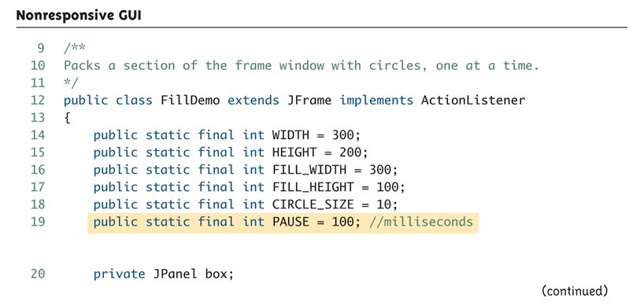
Nonresponsive GUI (Part 2 of 9)

Slide 8
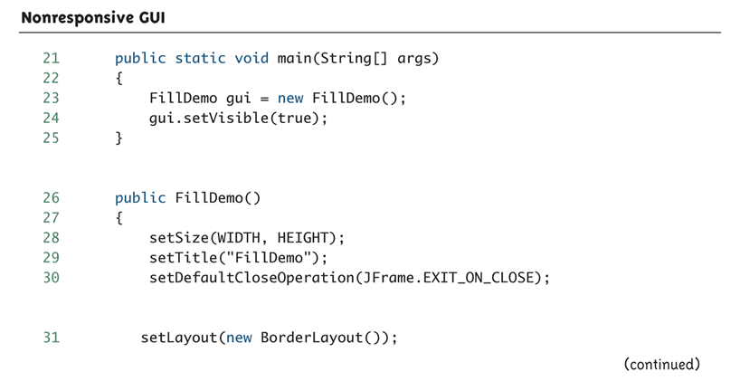
Nonresponsive GUI (Part 3 of 9)

Slide 9
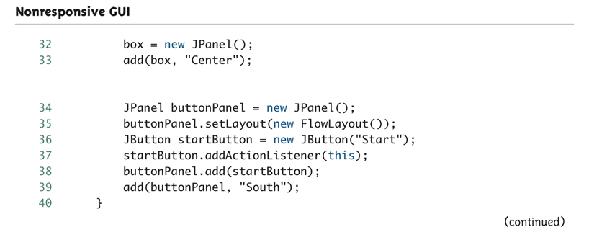
Nonresponsive GUI (Part 4 of 9)

Slide 10
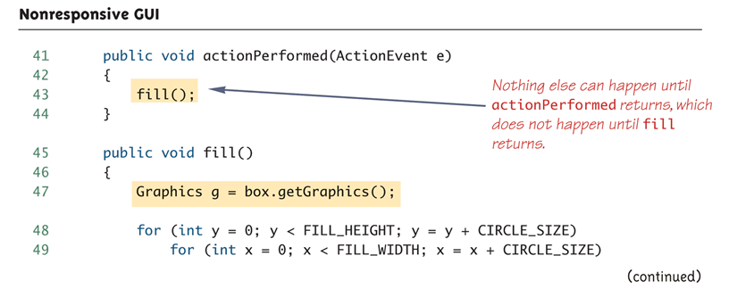
Nonresponsive GUI (Part 5 of 9)

Slide 11
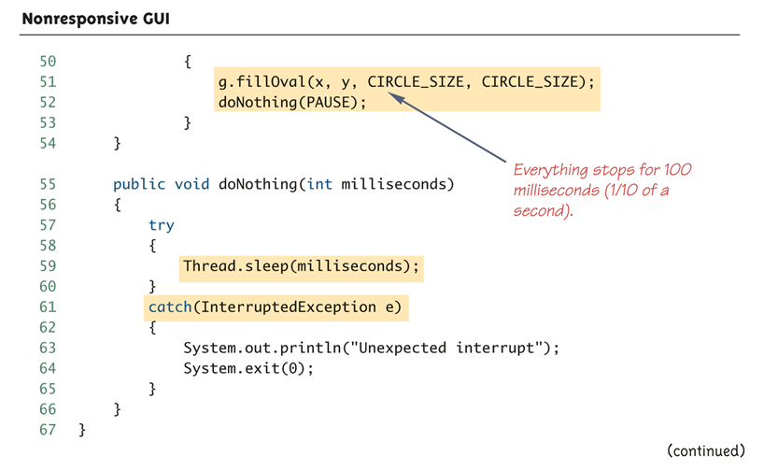
Nonresponsive GUI (Part 6 of 9)

Slide 12
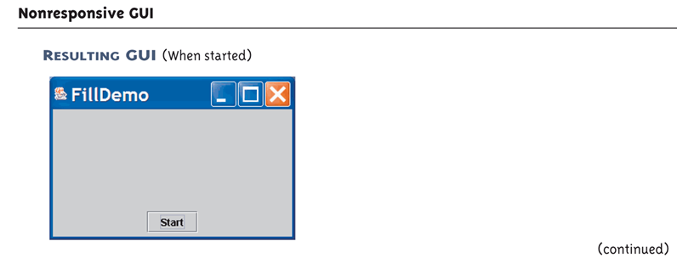
Nonresponsive GUI (Part 7 of 9)

Slide 13
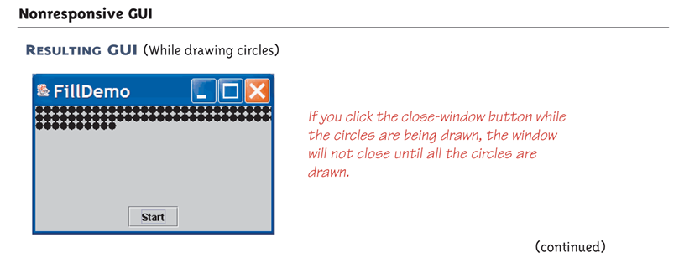
Nonresponsive GUI (Part 8 of 9)

Slide 14
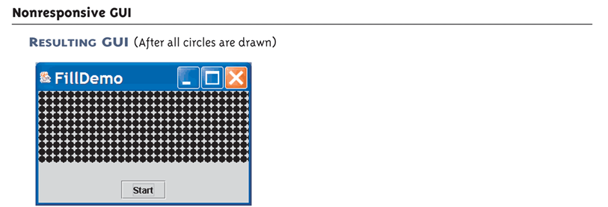
Nonresponsive GUI (Part 9 of 9)

Slide 15
Fixing a Nonresponsive Program Using Threads
This is why the close-window button does not respond immediately:
Because the method fill is invoked in the body of the method actionPerformed, the method actionPerformed does not end until after the method fill ends
Therefore, the method actionPerformed does not end until after the method fill ends
Until the method actionPerformed ends, the GUI cannot respond to anything else

Slide 16
Fixing a Nonresponsive Program Using Threads
This is how to fix the problem:
Have the actionPerformed method create a new (independent) thread to draw the circles
Once created, the new thread will be an independent process that proceeds on its own
Now, the work of the actionPerformed method is ended, and the main thread (containing actionPerformed) is ready to respond to something else
If the close-window button is clicked while the new thread draws the circles, then the program will end

Slide 17
The Class Thread
In Java, a thread is an object of the class Thread
Usually, a derived class of Thread is used to program a thread
The methods run and start are inherited from Thread
The derived class overrides the method run to program the thread
The method start initiates the thread processing and invokes the run method

Slide 18
A Multithreaded Program that Fixes a Nonresponsive GUI
The following program uses a main thread and a second thread to fix the nonresponsive GUI
It creates an inner class Packer that is a derived class of Thread
The method run is defined in the same way as the previous method fill
Instead of invoking fill, the actionPerformed method now creates an instance of Packer, a new independent thread named packerThread
The packerThread object then invokes its start method
The start method initiates processing and invokes run

Slide 19
Threaded Version of FillDemo (Part 1 of 6)
The GUI produced is identical to the GUI produced by Display 19.1 except that in this version the close window button works even while the circles are being drawn, so you can end the GUI early if you get bored.

Slide 20
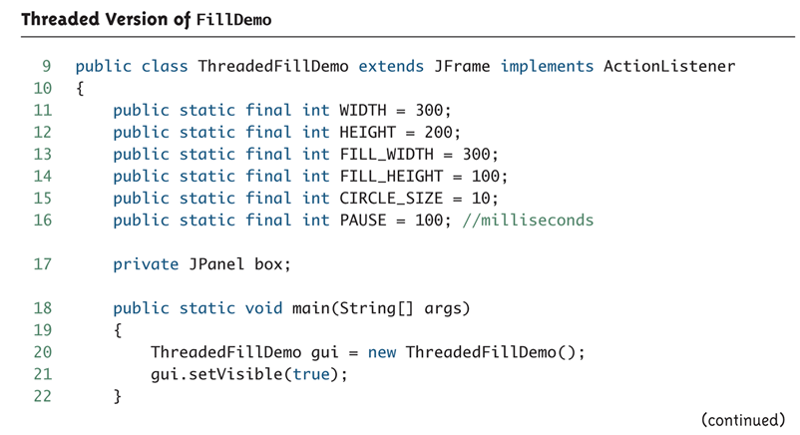
Threaded Version of FillDemo (Part 2 of 6)

Slide 21
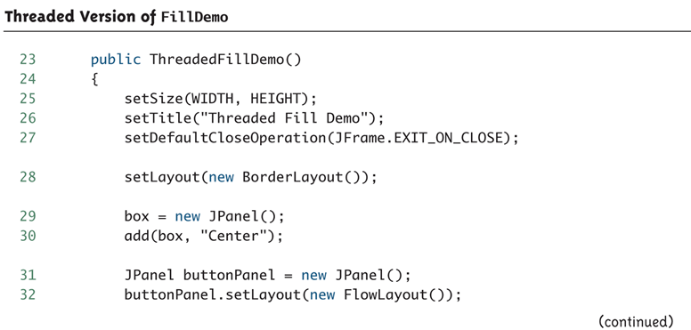
Threaded Version of FillDemo (Part 3 of 6)

Slide 22
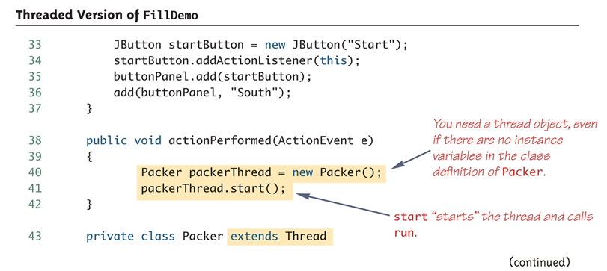
Threaded Version of FillDemo (Part 4 of 6)

Slide 23
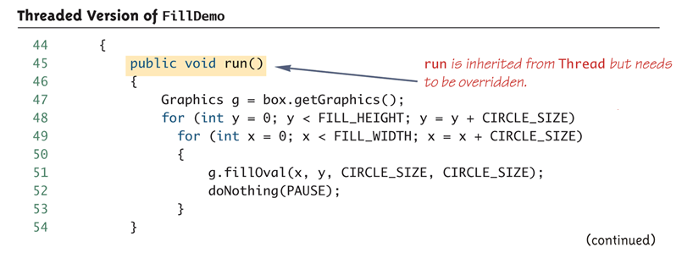
Threaded Version of FillDemo (Part 5 of 6)

Slide 24
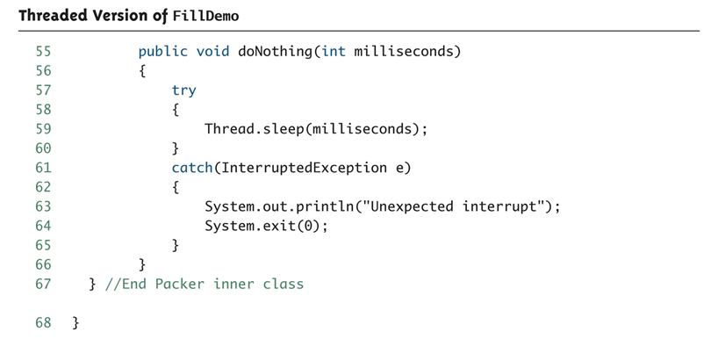
Threaded Version of FillDemo (Part 6 of 6)

Slide 25
The Runnable Interface
Another way to create a thread is to have a class implement the Runnable interface
The Runnable interface has one method heading:
public void run();
A class that implements Runnable must still be run from an instance of Thread
This is usually done by passing the Runnable object as an argument to the thread constructor

Slide 26
The Runnable Interface: Suggested Implementation Outline
public class ClassToRun extends SomeClass implements Runnable
{ . . .
public void run()
{
// Fill this as if ClassToRun
// were derived from Thread
}
. . .
public void startThread()
{
Thread theThread = new Thread(this);
theThread.run();
}
. . .
}

Slide 27
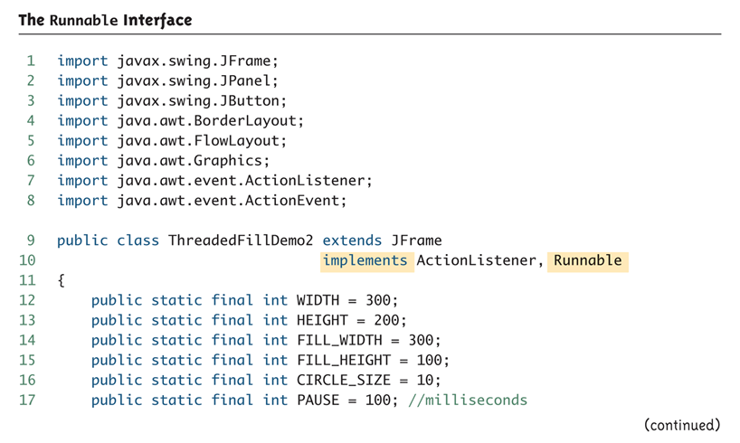
The Runnable Interface (Part 1 of 5)

Slide 28
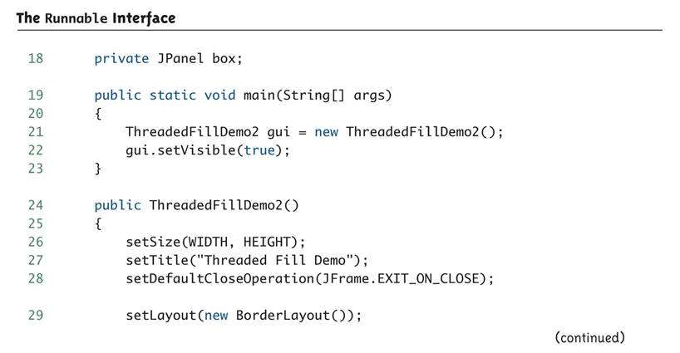
The Runnable Interface (Part 2 of 5)

Slide 29
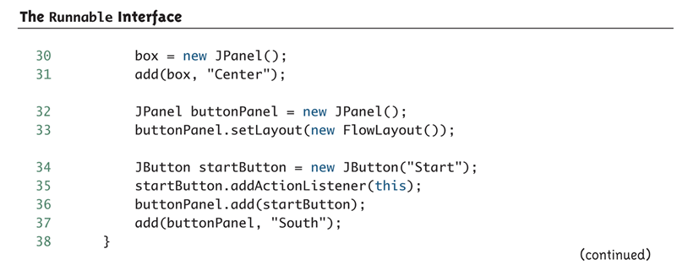
The Runnable Interface (Part 3 of 5)

Slide 30
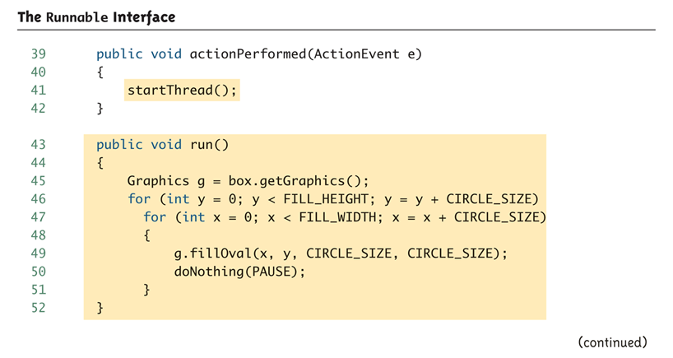
The Runnable Interface (Part 4 of 5)

Slide 31
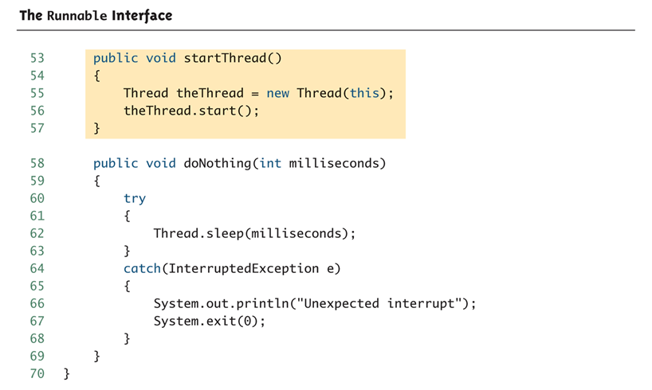
The Runnable Interface (Part 5 of 5)

Slide 32
Race Conditions
When multiple threads change a shared variable it is sometimes possible that the variable will end up with the wrong (and often unpredictable) value.
This is called a race condition because the final value depends on the sequence in which the threads access the shared value.
We will use the Counter class to demonstrate a race condition.

Slide 33
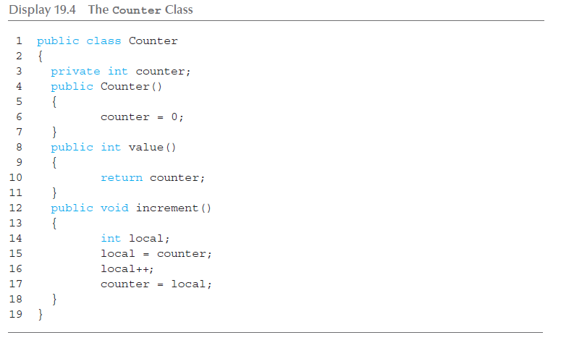
Counter Class

Slide 34
Race Condition Example
Create a single instance of the Counter class.
Create an array of many threads (30,000 in the example) where each thread references the single instance of the Counter class.
Each thread runs and invokes the increment() method.
Wait for each thread to finish and then output the value of the counter. If there were no race conditions then its value should be 30,000. If there were race conditions then the value will be less than 30,000.

Slide 35
Race Condition Test Class (1 of 3)

Slide 36
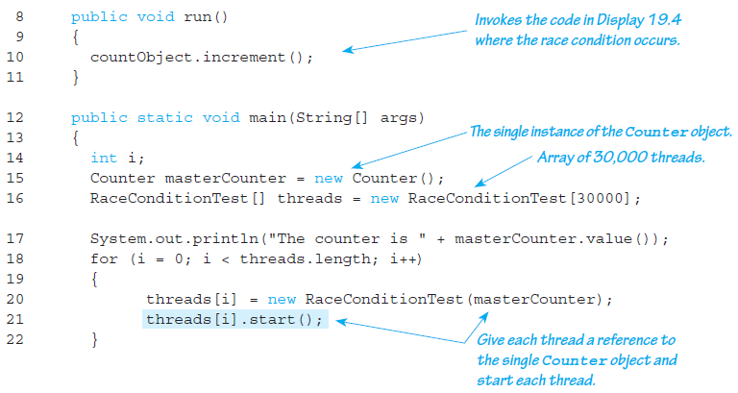
Race Condition Test Class (2 of 3)

Slide 37
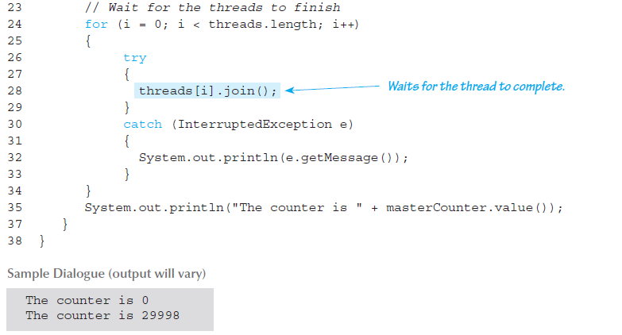
Race Condition Test Class (3 of 3)

Slide 38
Thread Synchronization
The solution is to make each thread wait so only one thread can run the code in increment() at a time.
This section of code is called a critical region . Java allows you to add the keyword synchronized around a critical region to enforce that only one thread can run this code at a time.

Slide 39
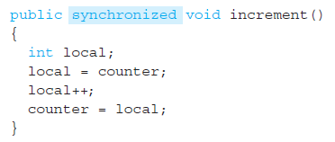
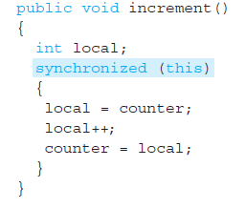
Synchronized
Two solutions:

